Slide 1





Social Justice in Action -
Our Stories from the Regions
Johnathan Edwards
Jodie Denehy
Megan Bingham

Slide 2
Acknowledgement of Country

Slide 3
Social Justice Priorities
Table 1 - Disaster Response
Tables 2&3 - Homelessness
Table 4 - Loneliness/Mental health
Tables 5&6 - Welfare reform/Financial Inclusion
Table 7 - Energy affordability
Table 8 – Domestic & Family Violence

Slide 4

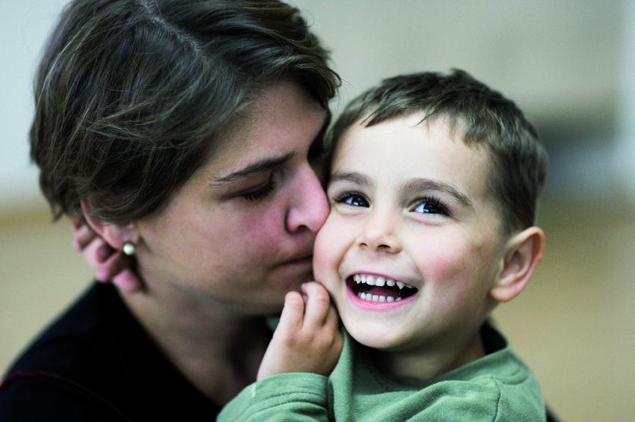

Table Questions
1) Share a story from the People We Assist that illustrates the Table social justice issue?
2) What are some barriers and hurdles PWA face?
3) We are called to empower the PWA to speak for themselves and to speak up with them when they are ignored. How can we help to remove barriers and hurdles?
4) Share a story about what you have personally done or are interested in doing to advocate for the PWA with local politicians or decision-makers?

Slide 5

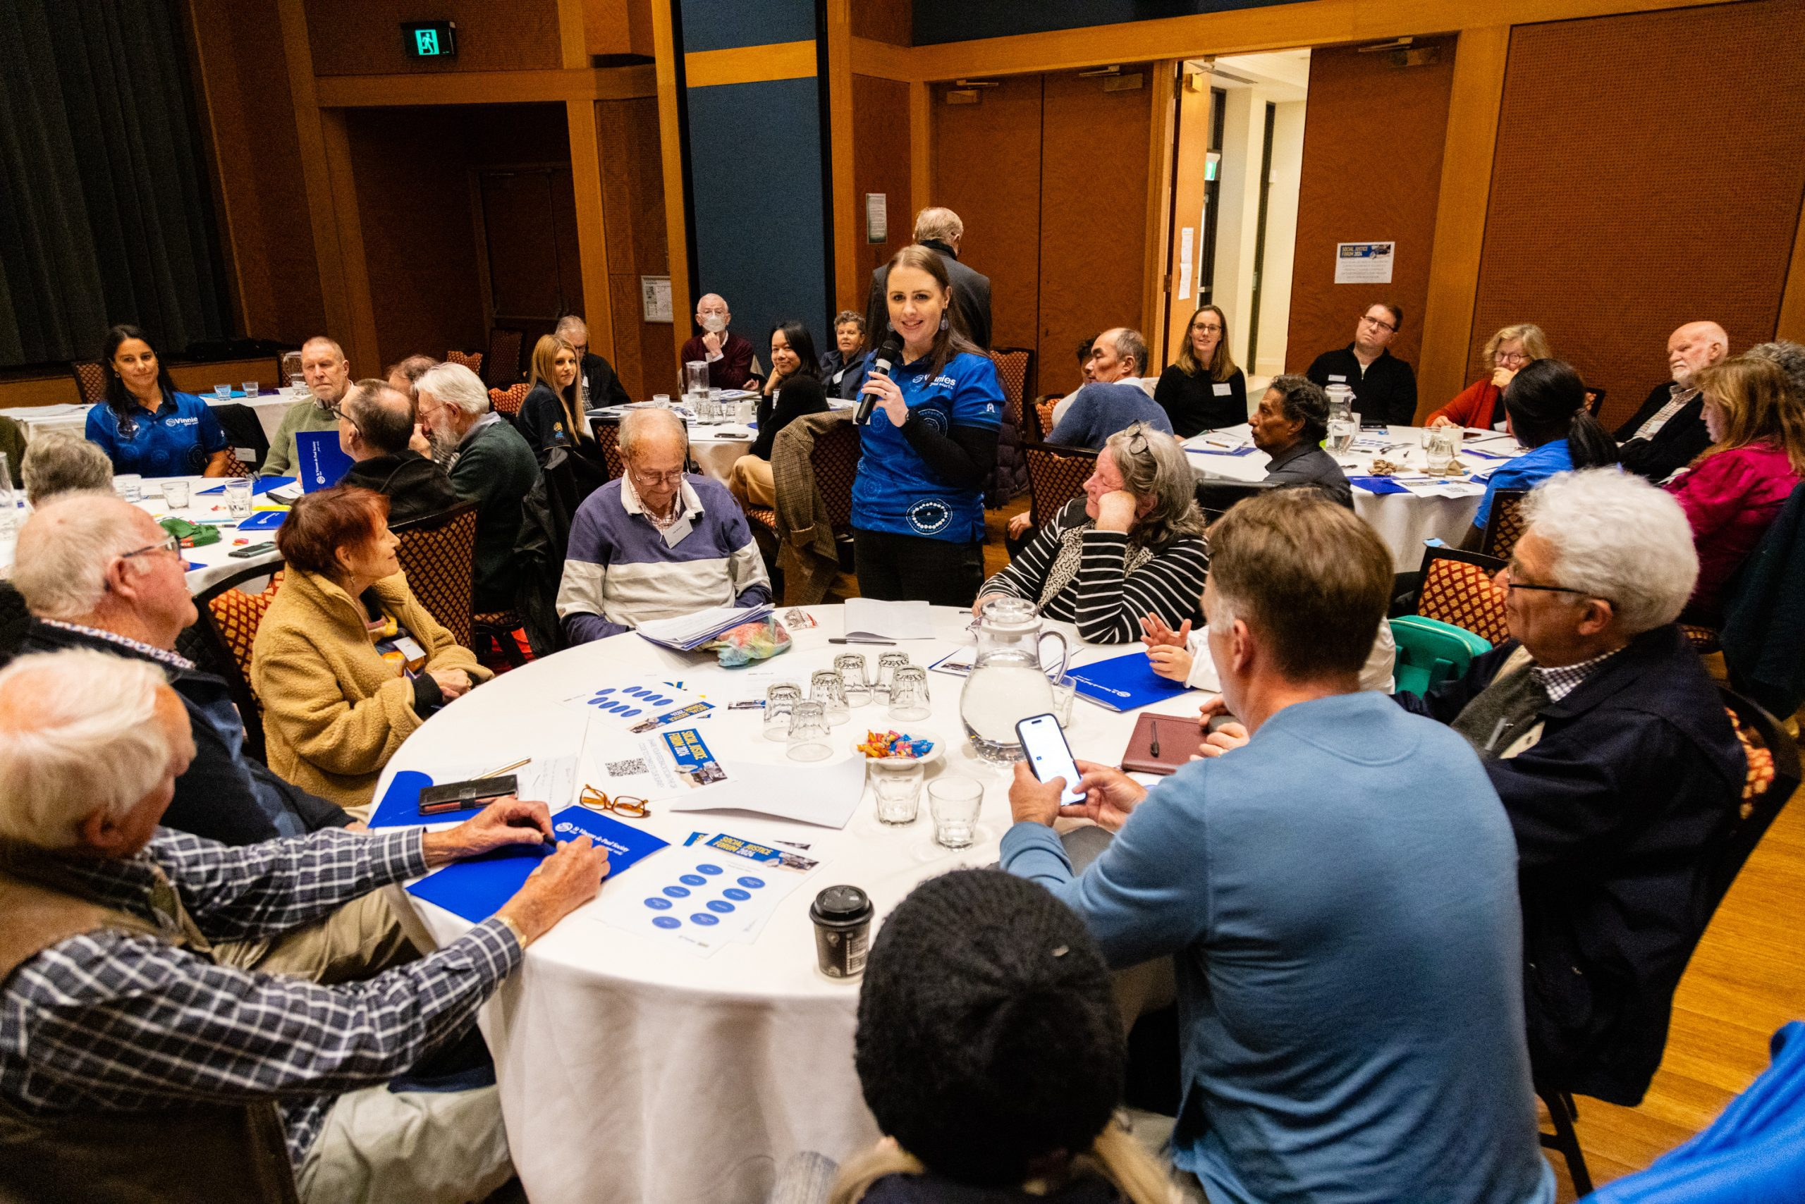
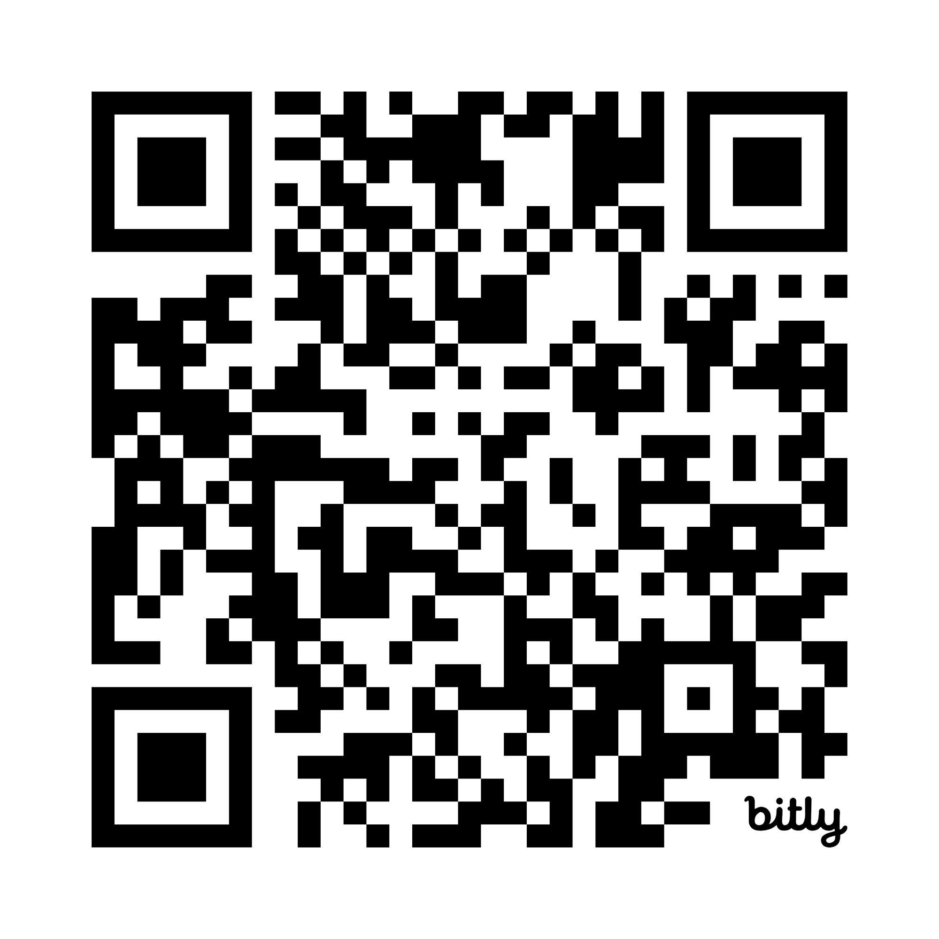
COMPLETE OUR QUICK SOCIAL JUSTICE SURVEY http://bit.ly/3KY6nE2

Slide 6
THANKS FOR YOUR VALUABLE SOCIAL JUSTICE CONTRIBUTIONS!!

