Slide 1





Together, we are more
The Scope of Services in NSW- Housing, Health, Addiction and Disability Services

Slide 2
Acknowledgement of Country

Slide 3
Overview
Vinnies Services Overview
Homelessness and Housing Services
Alcohol and Other Drug Services
Health Services
Disability and Inclusion

Slide 4
Vinnies Services originated as Special Works of the Society:
The Society’s services were initially set up and funded through the local Conferences and Vincentians, who saw a local need in their community and responded to that need through setting up and operating the services.
Through the great effort and inspiration of local members, these services grew and became foundational to the Society’s response to homelessness, domestic and family violence, disability and alcohol and other drug services, amongst others, today.
The member-run and operated services proceeded to became funded through the different funding opportunities and morphed into the specialist services operated by the Society today.

Slide 5
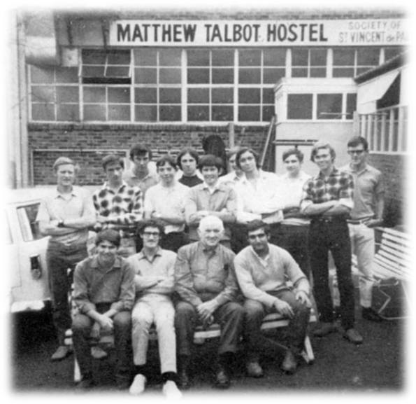
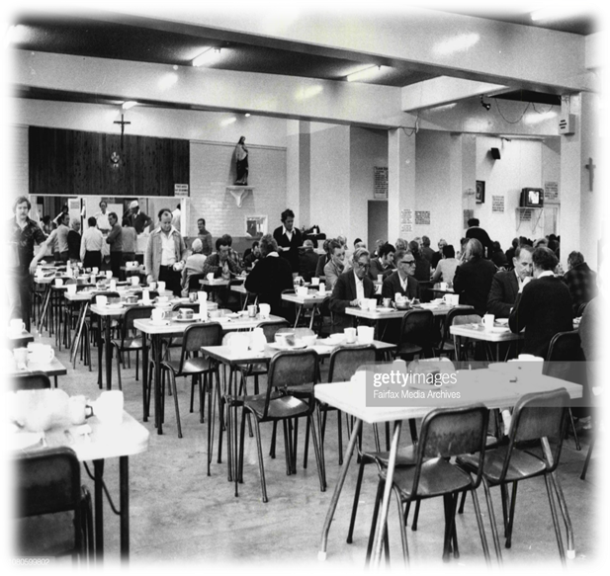
Members operating the Matthew Talbot Hostel in the 1980s

Slide 6




Our Purpose: We aspire to enable people experiencing disadvantage to have improved wellbeing, social inclusion and economic participation through focussing on supporting people to:
have access to long-term, stable and safe accommodation that meets their needs
maintain or improve their health and wellbeing, relevant to their personal situations
address concerns and seek assistance to develop or strengthen skills and increase resilience
feel more accepted and included in their communities
be capable of making informed choices and having the ability to access the supports they need

Slide 7
How: We achieve this purpose through delivering a state-wide service delivery network across 3 focus areas:
Housing and Homelessness
Health Services
Disability and Inclusion
… which are supported by a Clinical Governance & Quality and a First Nations Strategy & Outcomes function

Slide 8
Data insights 2024-25
1
2
3
4
Our Homelessness and Housing services experienced a 14% decrease in unassisted enquiries for support
Domestic and Family Violence (27%) was the leading reason people sought support from our Homelessness and Housing services
69% of people were referred to our alcohol and other drugs services for case management / care coordination
The Ozanam Learning Centre experienced a 64% increase in people accessing the service over the last year, providing 9,100 instances of service

Slide 9
Vinnies Services Impact 2024-25
11,800 people assisted through Vinnies Services in 2024/25
6,674 people supported through Homelessness and Housing services
3,715 people supported through Community Inclusion programs
1,296 people supported through Alcohol and other Drugs services
93 people supported through Disability services
1,716 people supported through Domestic and Family Violence services
677 people supported through our homelessness primary health care clinic
1,585 people supported through migrant and humanitarian entrant resettlement service
4,186 people supported through our Client Engagement Hubs

Slide 10
Homelessness and Housing Division
Crisis and Transitional Accommodation
Domestic and Family Violence Services
Social and Affordable Housing Funds Tailored Support
Engagement Hubs

Slide 11
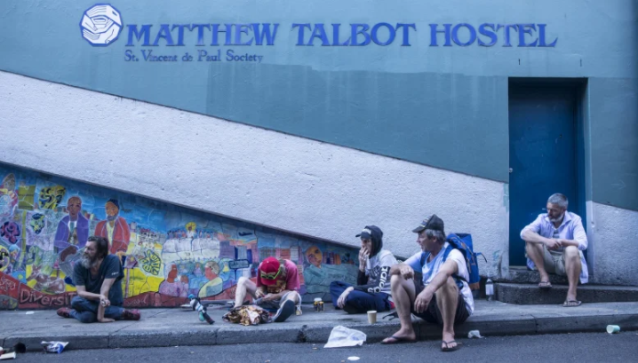
Seeking to give people access to long-term, safe, and stable accommodation that meets their individual needs
Our approach is Housing First – prioritising permanent and stable accommodation for people experiencing homelessness
We additionally focus on early intervention and sustaining tenancies, providing support to interrupt the trajectory towards homelessness
Crisis and transitional accommodation:
We operate more than over 26 crisis and transitional accommodation services across NSW to meet the needs of single men and women, families, older women, and young people.
We provide accommodation responses in Sydney, Newcastle, Wagga, Nowra, Deniliquin and Wingecarribee.
We are continuously seeking opportunities to provide additional accommodation in areas of highest need.

Slide 12
Domestic and Family Violence
We provide specialist responses for women and children experiencing domestic and family violence. This includes services for families wishing to escape while retaining their housing, and accommodation and support.
We also have physical refuges located across Sydney e.g. Dolores Refuge and Killara in the Eastern Suburbs; Louise House, Marian Villa and Amelie House in the Sydney South region; Marian Centre and Elsie’s in the Inner City; Vinchez House and Eden House in Macarthur.
Our Lady of the Way in Western Sydney and Rosalie House in the Inner West both specialise in supporting older women who have experienced domestic/family violence.
In South-East and South-West Sydney, we also provide the Domestic Violence Response Enhancement service, an afterhours crisis service for families who need to escape domestic violence immediately and are supported straight away with a crisis response.

Slide 13

Social and Affordable Housing Fund- Tailored Support
Through our community housing provider, St Vincent de Paul Society Housing, we provide social and affordable housing. This program embodies the housing-first model of community development, providing safe and permanent housing as a priority. Once housed, tenants are connected to a tailored support coordinator who helps them achieve their identified goals.
SAHF fully operational across NSW. St Vincent De Paul Society NSW have partnered with Sy Vincent de Paul Housing NSW who provide all the tenancy management.
Support given to 502 tenancies (70% social tenancies and 30% affordable) which house over 780 tenants across NSW (both regional and metropolitan).
12 sites include – Cardiff, Maitland, Campbelltown, Penrith, Jordan Springs, Katoomba, Burraneer, Lilyfield, Dubbo, Merrylands, Albury.

Slide 14
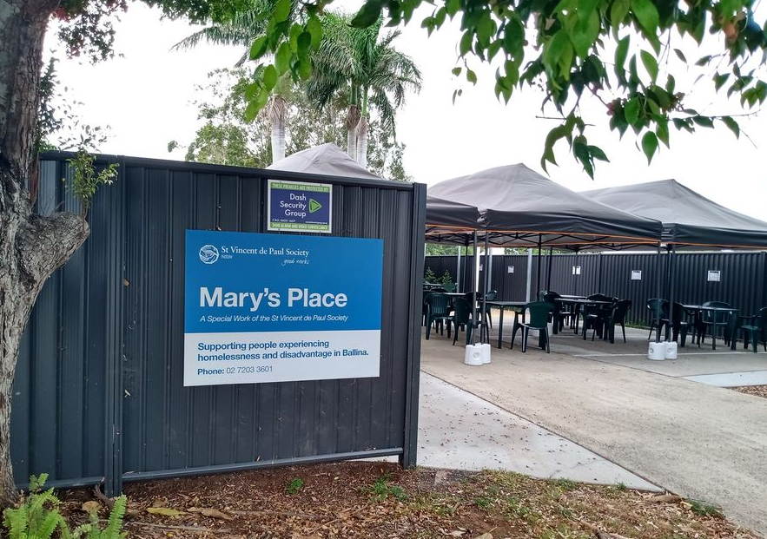
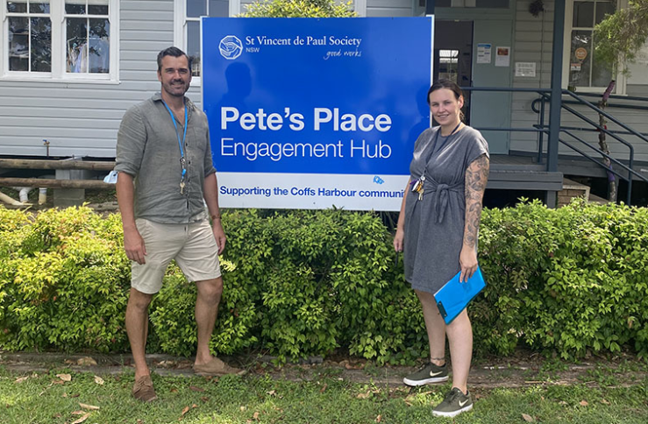
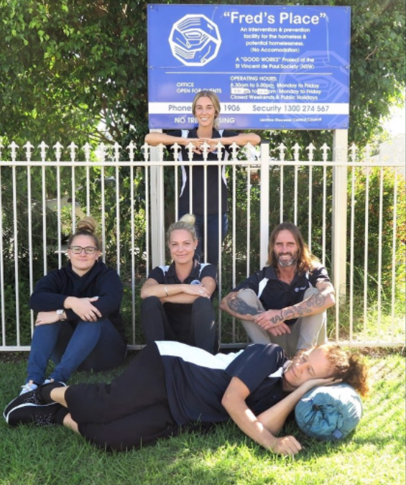
Community Engagement Hubs
Our community drop-in centres are a safe place for people experiencing homelessness or at risk of homelessness.
Access to food, hygiene and clothing needs.
Spaces provide case management through Vinnies staff, and bring in mental health specialists, GPs, AOD supports, Aboriginal medical services and legal services to co-locate, providing a multi-disciplinary response.
We have 3 engagement centres:
Pete’s Place in Coffs Harbour
Fred’s Place in Tweed Head
Mary’s Place in Ballina

Slide 15
Health Services
Alcohol and Other Drug Services
Frederic House Aged Care
Matthew Talbot Clinic

Slide 16
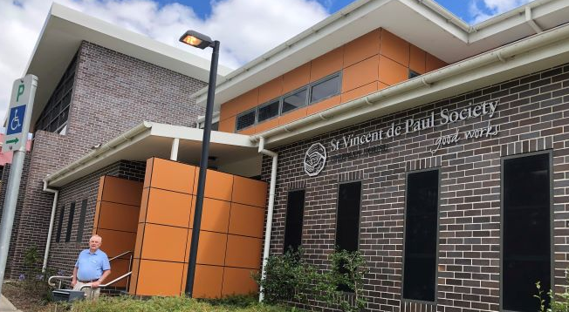
We provide a diverse range of treatment options and supports to people wishing to reduce the harms related to alcohol and substance: Residential rehabilitation at Freeman House in Armidale and Adele House in Coffs Harbour. Outreach and day programs available through Rosalie House in Tamworth and Rendu House in Campbelltown, Freeman House Armidale. AOD Continuing Coordinated Care Program (CCCP), provides care coordination and intensive outreach in 11 locations within NSW.
Alcohol and Other Drugs

Slide 17
Matthew Talbot Clinic and Frederic House
Matthew Talbot Clinic
Co-located with the Matthew Talbot Hostel for men who are homeless, The Matthew Talbot Primary Health Clinic in Woolloomooloo is a nurse-led health service and accredited General Practice that provides free health care for men who are at risk of or experiencing homelessness.
Frederic House is an aged care service in Waterloo for 61 men who have had a history of homelessness and have complex issues such as mental health and substance use. Frederic House has a focus on dignity of risk as well as harm minimisation.

Slide 18
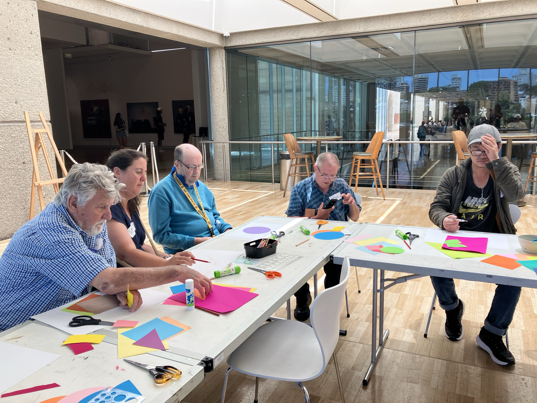
Disability and Inclusion Services:
We partner with people living with disability to help them achieve their goals and live safe, meaningful lives
Accommodation Services: Greene Villa in Coonamble, Jim Da Silva Farm in Shoalhaven
Supports in Employment program
Australian Disability Enterprise model at Castlereagh Industries, located in Coonamble
Mobile Community Development project team that supports identified projects that a community development or inclusion support such as Albury SAHF sights
Vinnies Connect, a mentoring program across Sydney Metro
Men’s Shed located in Haberfield
North Coast Settlement Services located in Coffs Harbour, providing culturally appropriate settlement support to new Migrant entrants
Ozanam Learning Centre in Woolloomooloo, Creative Space in Southern Highlands

Slide 19
Vinnies Assist Line: 131813 Find a Service portal via website: https://www.vinnies.org.au/nsw/find-help or reach out to the Vinnies Services State Leads: Homelessness Anna.Scott@vinnies.org.au Health Monica.Yanni@vinnies.org.au Disability and Inclusion Laura.Frangelli@vinnies.org.au
How to refer or get further information:

Slide 20



Thank you and Questions

