Slide 1





Beyond Food Assistance
Kerry Muir
Lissa Votano
Brendan Watson
Rosemarie Navarro

Slide 2
Acknowledgement of Country

Slide 3



Vinnies Assist

Slide 4
Vinnies Assist
Vinnies Assist provides one centralised access point to those reaching the Society.
Bridging the gap of support opportunities relating to internal and external referrals across NSW
Referral to TA accommodation
Referral to Crisis Accommodation
Advocacy – case management
Refer to Link2Home
Referral to crisis DV services
I need some help with safety planning
I don’t know what to do
Referral to Conference
Food assistance
Help with paying my utility bills
Help with paying for medication
I need help with moving house
I need furniture for my new home
I am Homeless or escaping DV
I need assistance
I need help with Housing
I need help with my addiction
Referral to Case Management
Tenancy Bond support
Advocacy
Referral to Link2Home
Referral to internal or external DV services
I am unsure of what to do or who can help me
Referral to our conferences for financial support
Referral to our internal AOD services
Referral to external services
Referral to detox services
I have no one to help me

Slide 5
Vinnies Assist
Vinnies Assist call volumes for 2024 – 2025 by month and IVR Option

Slide 6
Vinnies Assist
Bridging the gap of support opportunities relating to internal and external referrals across NSW.

Slide 7
Types of referrals
Identifying referrals for wrap around services:
COLD
Self
WARM
On behalf of a person
HOT
Connecting the person by phone or face to face
Step 1
Identify the problem
Step 2
Assess the information
Step 3
Identify & assess potential solutions
Step 4
Identify additional information needed
Step 5
Make the Referral
7

Slide 8
No Interest Loans Program (NILs)
Brendan Watson – Manager NILS Program

Slide 9
:
Up to $2000. ($3000 for bond loans and natural disaster victims)
No fees, no interest, no costs, ever: only have to repay the amount borrowed.
Repaid over 12 months (can be up to 24 months).

Slide 10
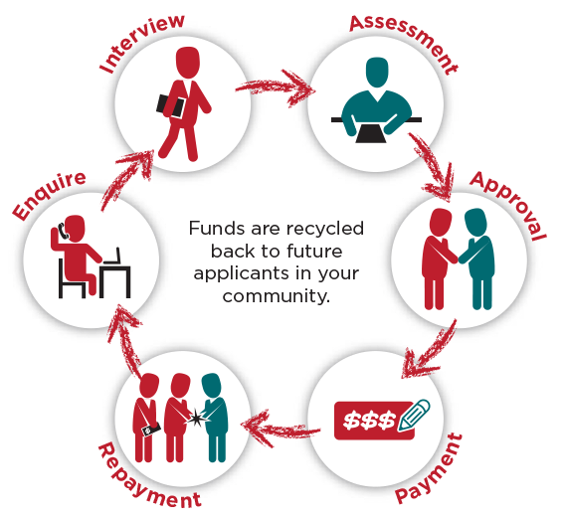
SVDP NILS PROGRAM
How it works
‘Circular Community Credit’: Pool of funds provided by NAB.
Supported by the NSW Department of Fair Trading & the Federal Department of Social Services (through Good Shepherd Microfinance).
Guidelines and Lending Criteria are provided by Good Shepherd Microfinance.

Slide 11






LOAN PURPOSES
Vehicle Registrations & Repairs – 31%
Whitegoods – 19%
Can also do:
Medical & Dental
Education
Vet Costs
Bond Loans
Funeral Expenses
Electronics and Technology – 17%
Household Furniture – 12%

Slide 12
LOAN PURPOSES WE CANNOT FUND
Rent or rental arrears
Vehicle purchases
Food & Clothing
General bills & utilities
Debt repayments
Moving expenses – removalist & storage
Second-hand electrical goods
Large lists of smaller items
*Speak to one of the team about anything not on the list

Slide 13

NILS TRENDS
What are we seeing?
Number of NILS enquiries are growing
Less disposable income
Higher rents
Higher electricity bills
More working individuals/families

Slide 14
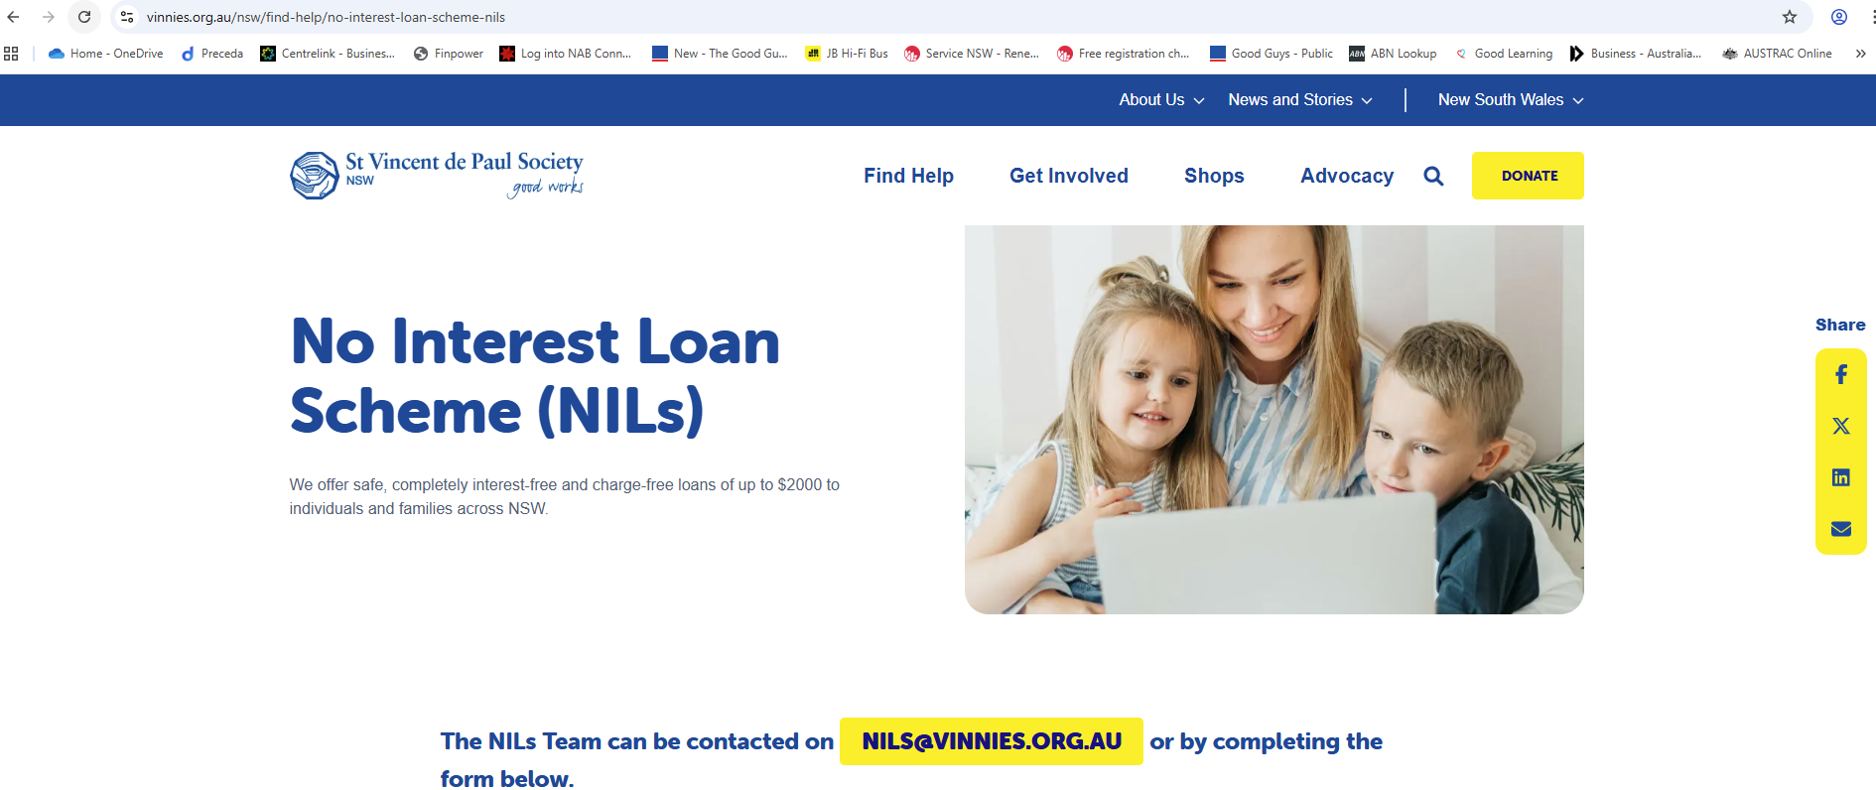
What’s New?
www.vinnies.org.au/nils
WHAT’S NEW?

Slide 15

What’s New?
Be sure to grab a supply of new NILS brochures before you leave!

Slide 16
Energy Accounts Payment Assistance (EAPA)
Kerry Muir

Slide 17


Energy Accounts Payment Assistance (EAPA)
NSW Government program supporting households in financial crisis
Provides $50 digital vouchers for electricity or gas bills
Helps people stay connected to essential energy services
Short-term crisis support, not ongoing assistance

Slide 18
To be eligible for EAPA the Person We Assist (PWA) must:
Live in NSW
Home electricity or gas account
Be the account holder
Have an open account with an unpaid, active energy bill
Be in financial hardship or crisis and unable to pay current energy bill
1
2
3
4
5

Slide 19

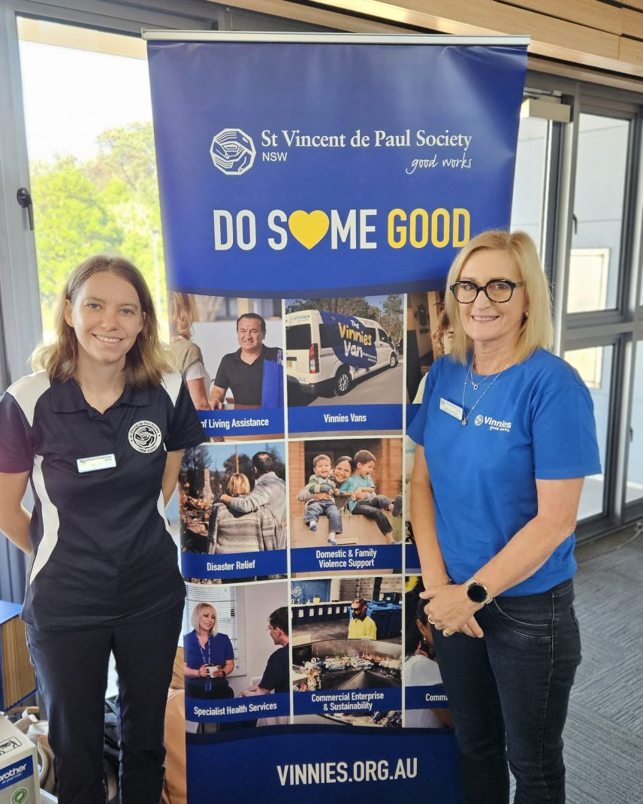
What is a Crisis?
A Decrease in Income
  e.g. loss of income or decreased work hours, changes in family circumstances
An Increase in Expenditure
  e.g. unexpected essential household expenses such as replacing white goods,
Domestic Family Violence
  e.g. recent or current domestic family violence.

Slide 20
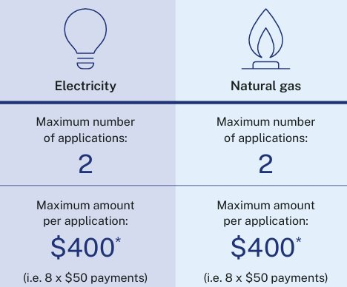
How much assistance can be provided?
Eligible households can apply for a new allocation of EAPA vouchers after the new financial year begins.

Slide 21
Current Status of EAPA in the Society NSW
Active EAPA Conferences (NSW): 25 (6%)
Voucher Allocation: $145,000 (July – December FY25-26)
Vouchers Issued to Date: $137,950 (FY-25-26)
People We Assist (Primary Recipients): 460

Slide 22
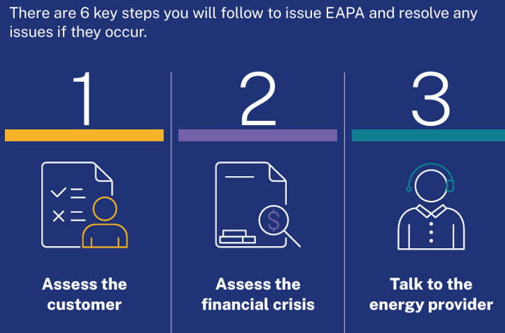
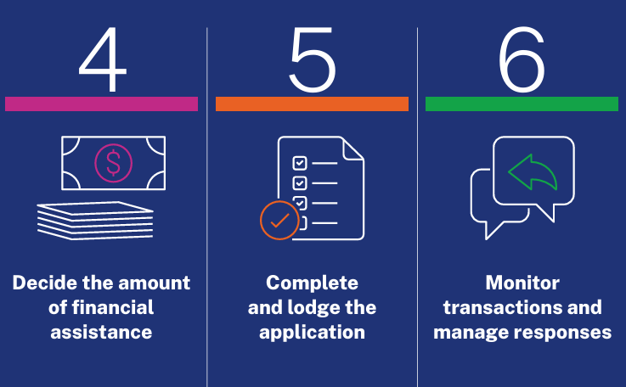
Assessing a customer and applying for EAPA

Slide 23
Considerations
Opportunities to expand EAPA participation across all Central Councils.
EAPA is government funded, allowing the Society to assist in other support needs.
EAPA process is now more simplified and streamlined.
Challenge
Can you help us increase Conference and Member participation to deliver this valuable assistance without impacting Society funds?

Slide 24


Slide 25
What is Twinning?
Twinning is a partnership between Vincentian Conferences or Councils in different countries.
NSW is twinned with 8 countries across Oceania and Asia.
NSW Conferences are twinned with 628 Overseas Conferences.

Slide 26
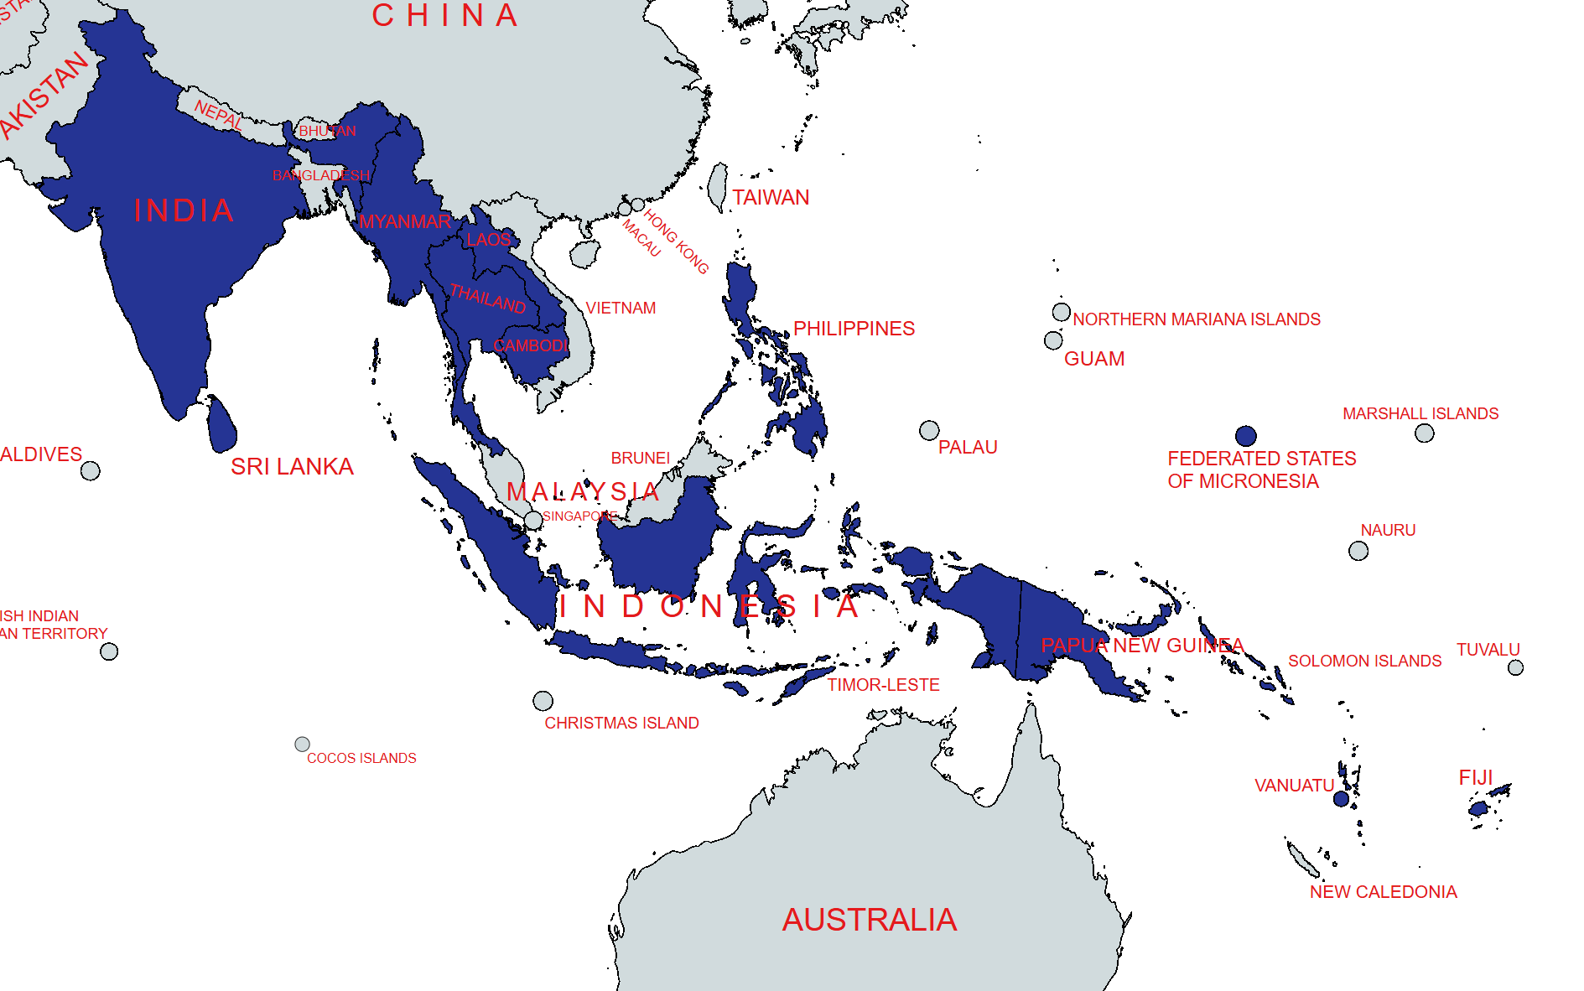
Cambodia
Federated States of Micronesia (CHUUK)
Fiji
India
Indonesia
Kiribati
Laos
Myanmar
Papua New Guinea
Philippines
Soloman Islands
Sri Lanka
Thailand
Timor-Leste
Vanuatu

Slide 27
What is Assist a Student?
An educational program focused on helping individuals reach their full potential.
Funded entirely by donations.
Cover education-related expenses.
Breaking the cycle of poverty through access to education.
NSW donated $13,580 (FY24-25).

Slide 28
Rosemarie Navarro
Member of St Mary’s Our Lady of the Rosary Conference
Philippines Twinning trip
May 2025

Slide 29

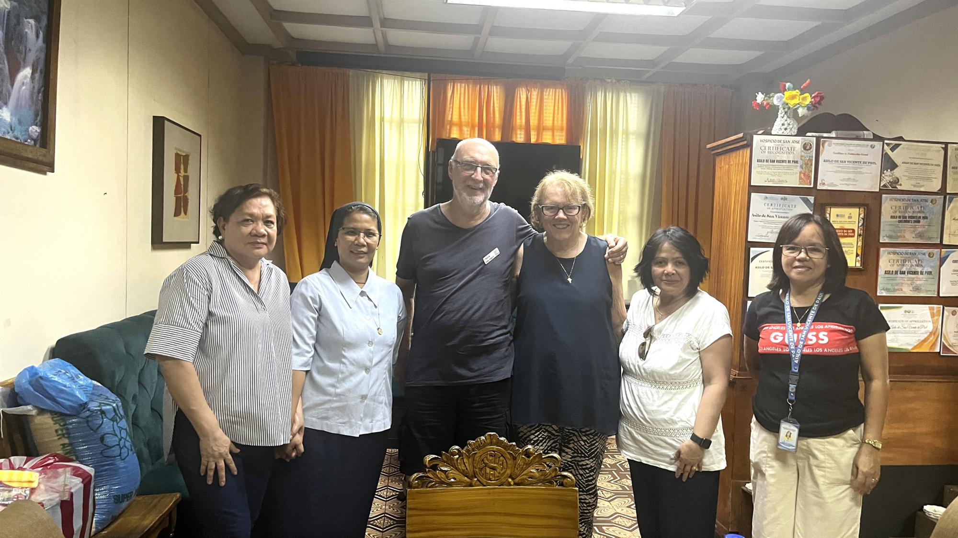
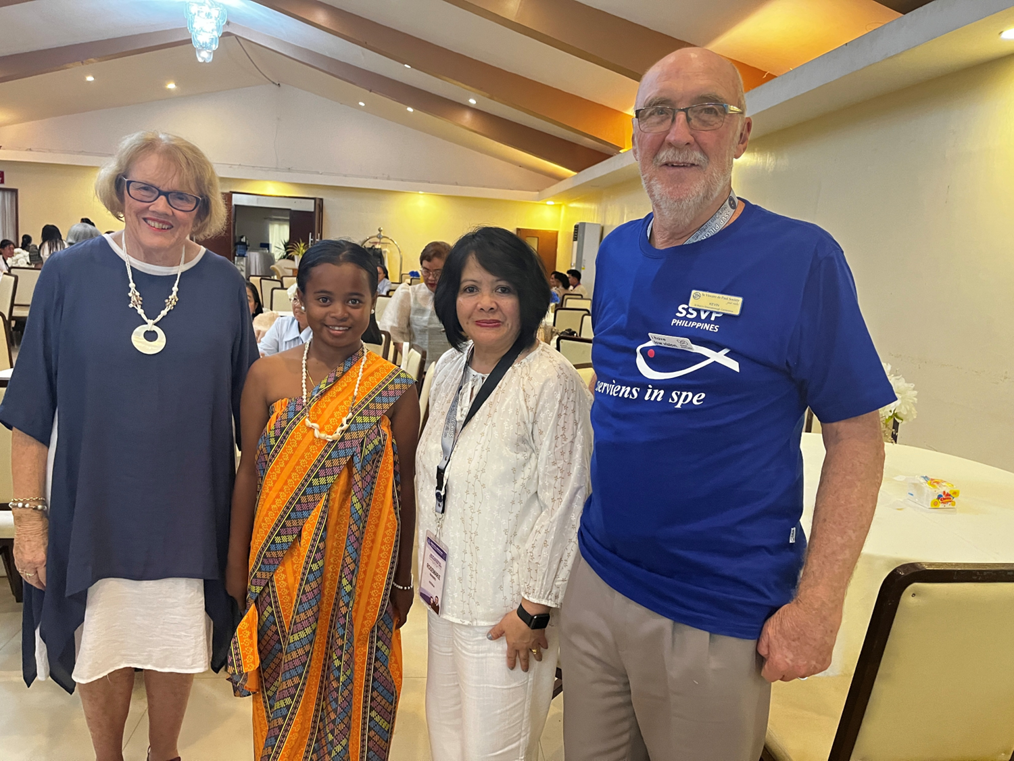


Slide 30
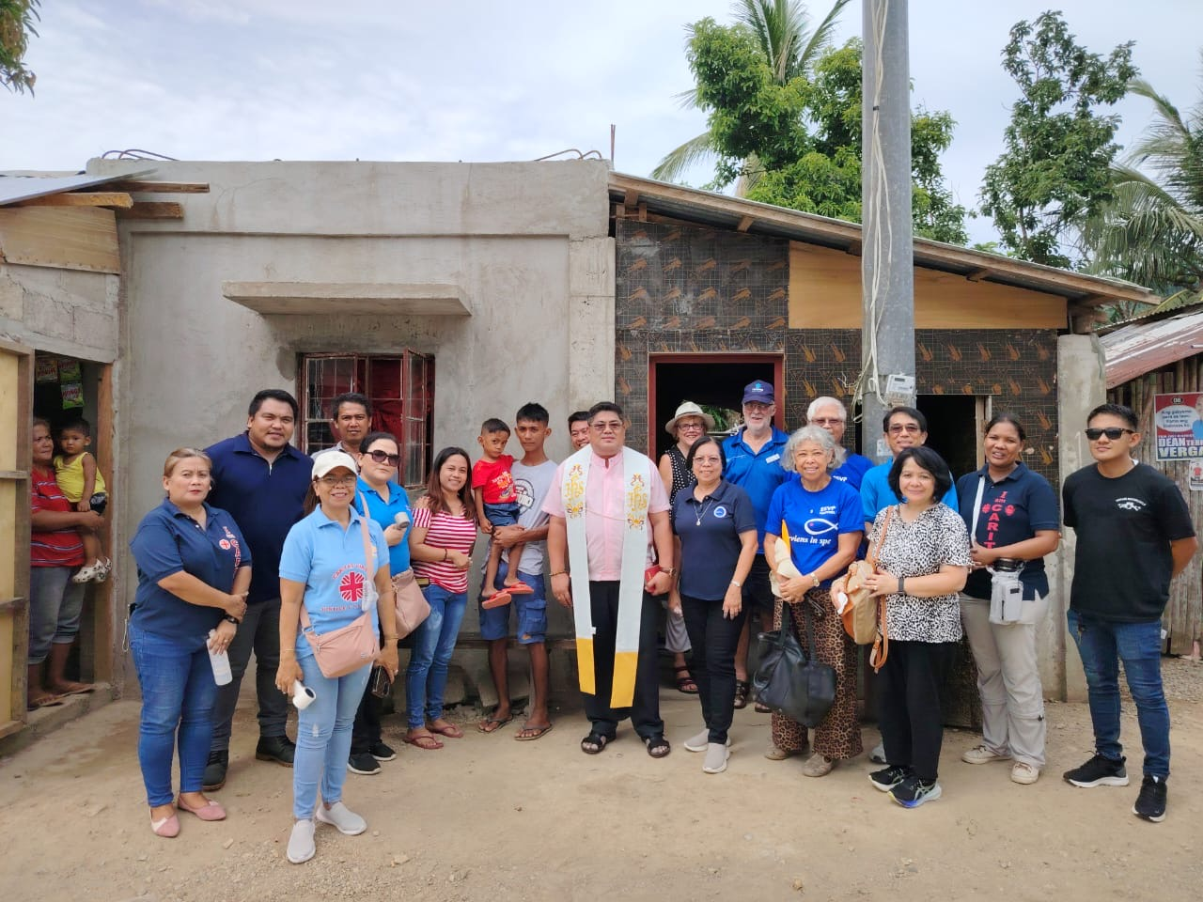
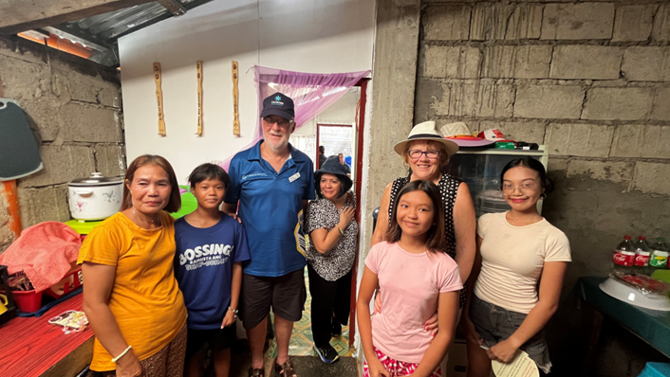

Slide 31

Scenarios

