Slide 1

Vinnies Vans Services NSW

Slide 2
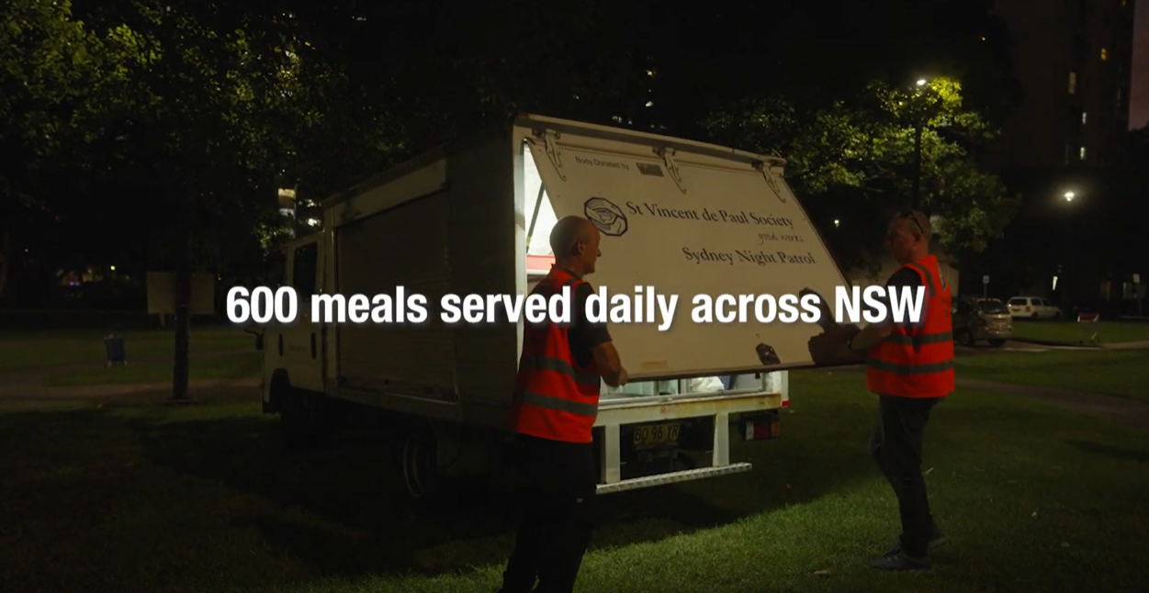
Video: Vinnies NSW – Night Patrol

Slide 3
Vinnies Vans Mission More than Food service
Promote friendship, compassion and community
Provide a meal, drinks, blankets and basic toiletries
Offer a ‘hand up’ to the people we assist through referrals and collaborations with agencies.
SEE | THINK| ACT

Slide 4
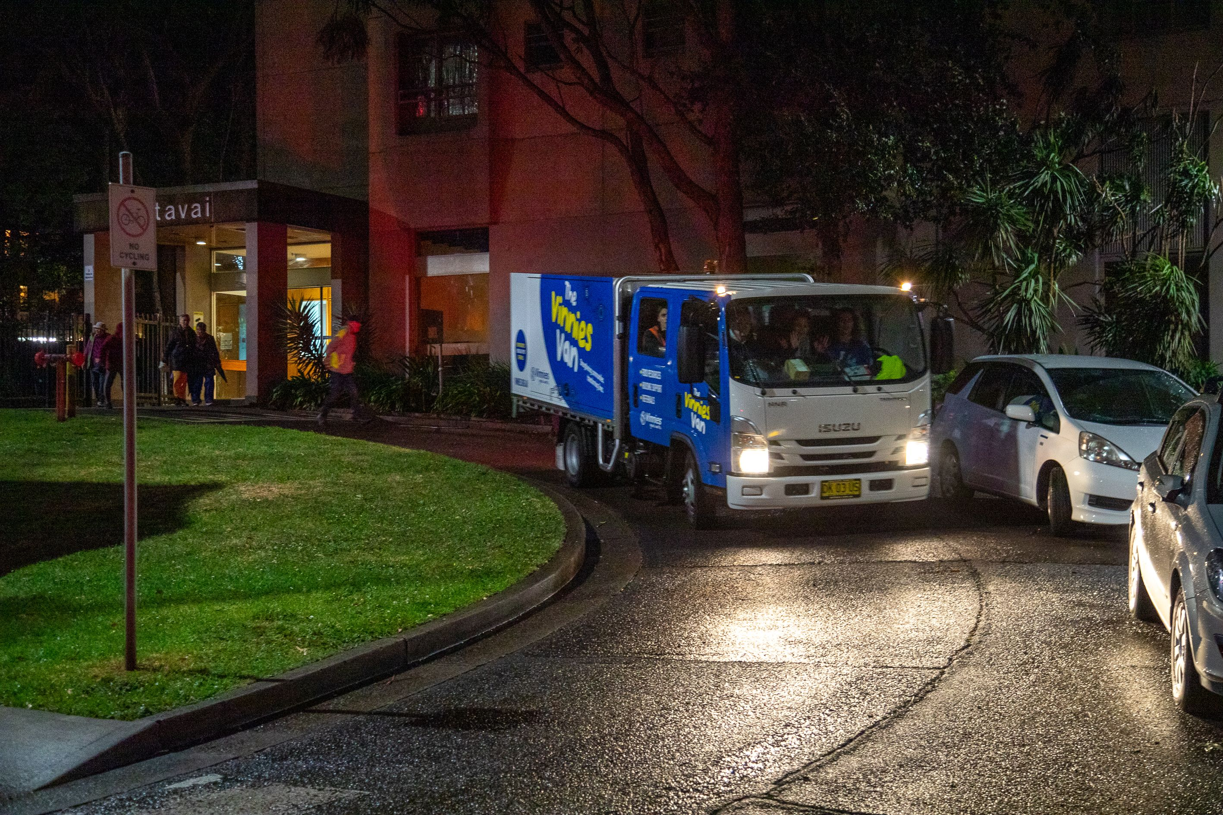
Vans Services:
Sydney Vinnies Vans
Bayside Vinnies Vans
Liverpool Vinnies Vans
Cumberland/Ryde Vinnies Vans
Greater Western Sydney Vinnies Vans
Woy Woy Vinnies Vans
Brekky Van
Newcastle Van
Coffs Harbour Van
Lismore Van
Illawarra Van
Campbelltown Van
Wagga Wagga Truck
Orange Van

Slide 5

Vinnies is here for you
We cater to those in need of a meal, hot drink, blanket, toiletries, sleeping bag, referrals, and most importantly, companionship.
Financial Assistance
Vinnies Vans provide referrals to local community services
that provide food vouchers, fuel vouchers, and other assistance
Material Aid
Vinnies Vans provide referrals for material aid, such as clothing, blankets, toiletries, and other household items
Housing Support
Vinnies Vans provide referrals to homeless and housing services, that offer support for people in crisis, or who need assistance sustaining tenancies
Community Connection
Vinnies Vans provide referrals to services that support
connecting you and others to the local community

Slide 6
HELP US DRIVE CHANGE...
Join the Vinnies Vans team and help bring support and connection to people in need.

Slide 7
Thank you for making a difference

