Slide 1

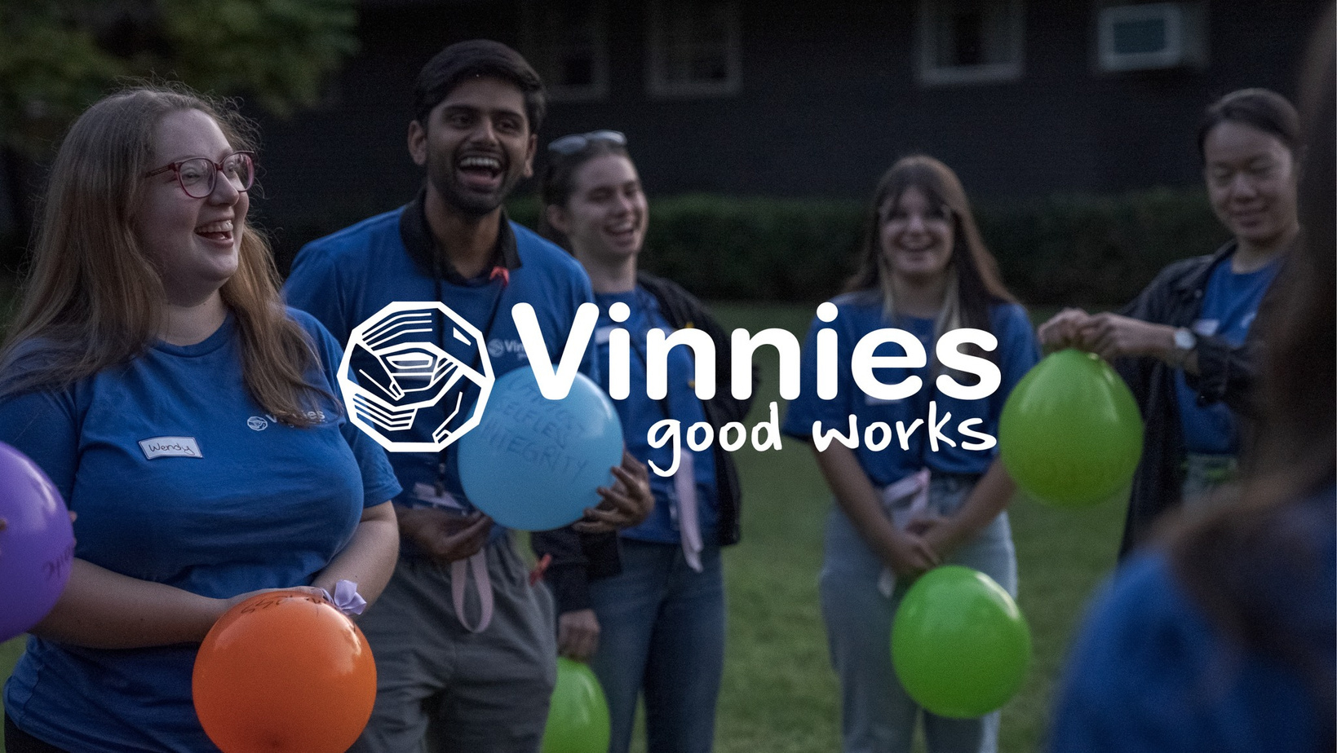


Good Works Summit: Youth Spotlight

Slide 2
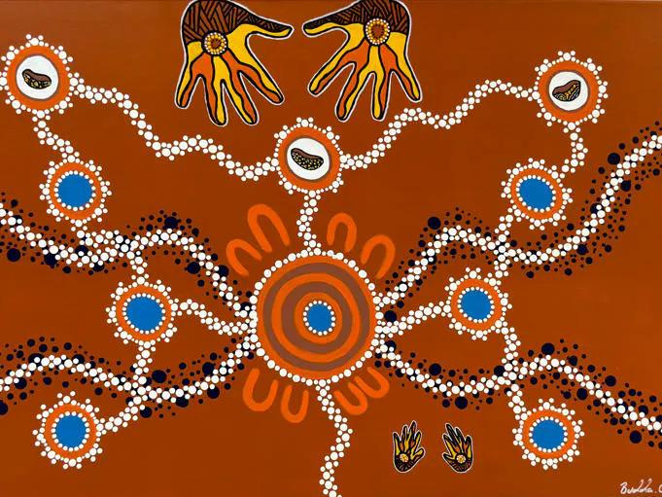
Acknowledgment of Country

Slide 3
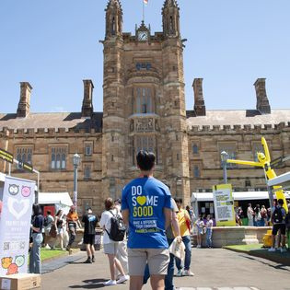

Welcome!
"Let us do without hesitation whatever good lies at our hands."
Frédéric Ozanam

Slide 4
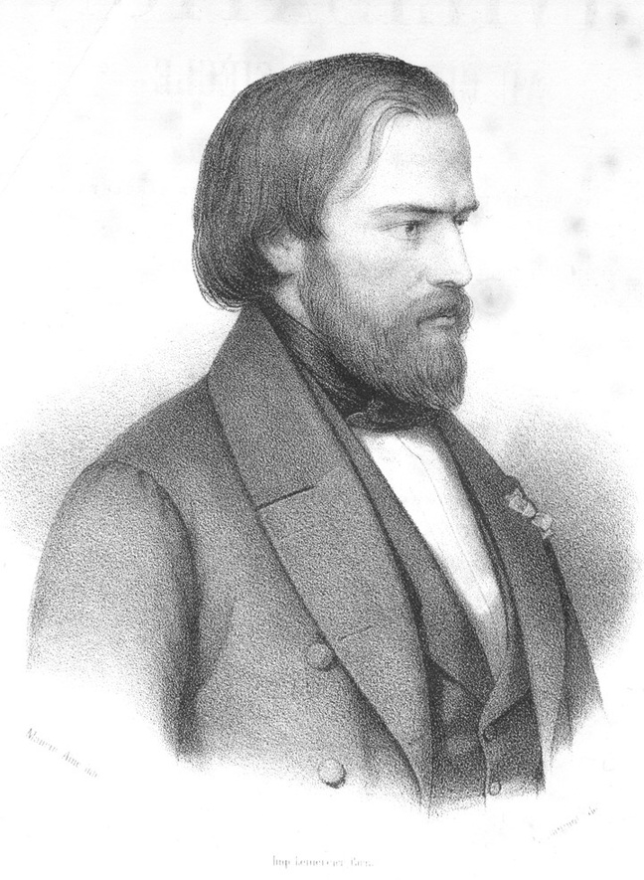
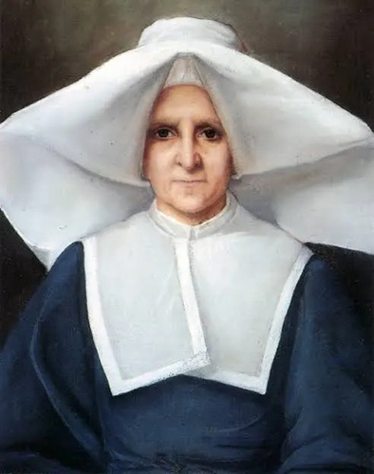
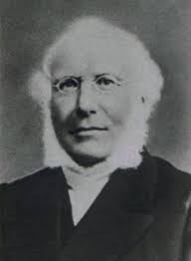
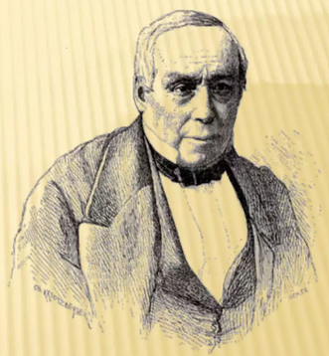
Then and Now: Youth Leading Through the Ages
Sister Rosalie Rendu
François Lallier
"It is our vocation to set people’s hearts ablaze." Frédéric Ozanam
Emmanuel Bailly
Notes:
Sister Rosalie Rendu: was a Daughter of Charity in the slums of Paris and acted as a crucial guide. She introduced them to needy families and taught them the art of serving the poor with compassion through home visits.
Her guidance established home visitation as a hallmark of the Society's mission.
Father Noirot : A priest who served as Ozanam's spiritual mentor during his time at Lyons College. He provided encouragement and a space for Ozanam to discuss his doubts and develop his faith.
“God gave me the grace to be born in the Faith. Later the confusion of an unbelieving world surrounded me. I knew all the horror of the doubts that torment the soul. It was then that the instructions of a priest and philosopher (Abbé Noirot) saved me. I believed thenceforth with an assured faith, and touched by so rare a goodness. I promised God to devote my life to the services of the truth which had given me peace”.
Emmanuel Bailly played a crucial mentoring and leadership role in the early Vinnies Conference. He offered a meeting space, community links, and financial support, giving the group legitimacy and stability. With his experience, he guided them through social and church challenges, shared knowledge of St Vincent de Paul, and helped shape The Rule to ensure the group’s orderly growth. “You have accustomed us to look upon you as the rallying point, the advisor and friend of Christian youth.
Your past favors have given us the right to count on future ones. Those you have done for me encouraged me to hope for the same for my friends.”
– Frederic Ozanam,
written to Emmanuel Bailly
November 3, 1834.
François Lallier - Co-founder of the St. Vincent de Paul Society and its first Secretary.
Ozanam formed a deep, lifelong friendship with Lallier, who remained a close colleague throughout his life.

Slide 5
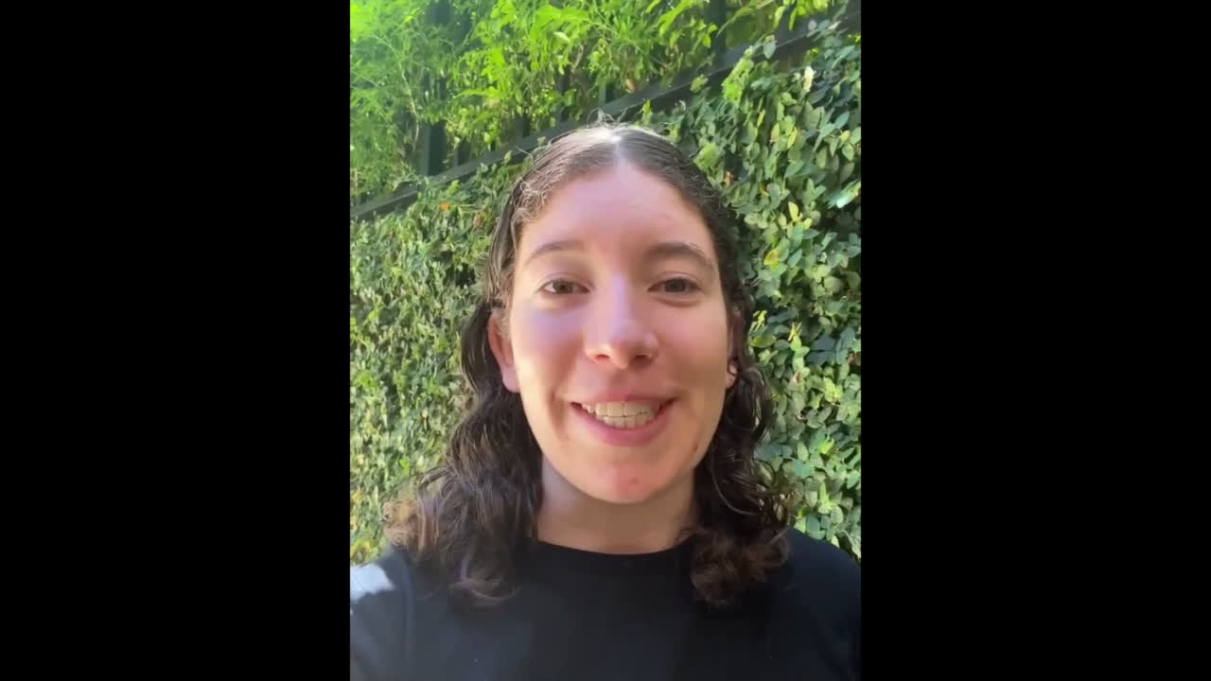
Youth: Who We Are

Slide 6
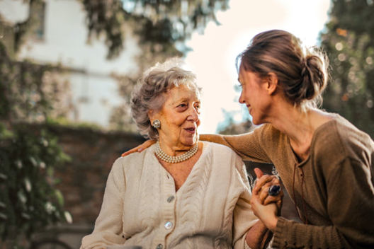
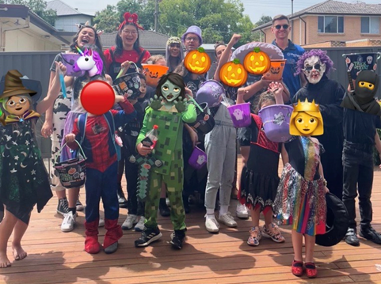
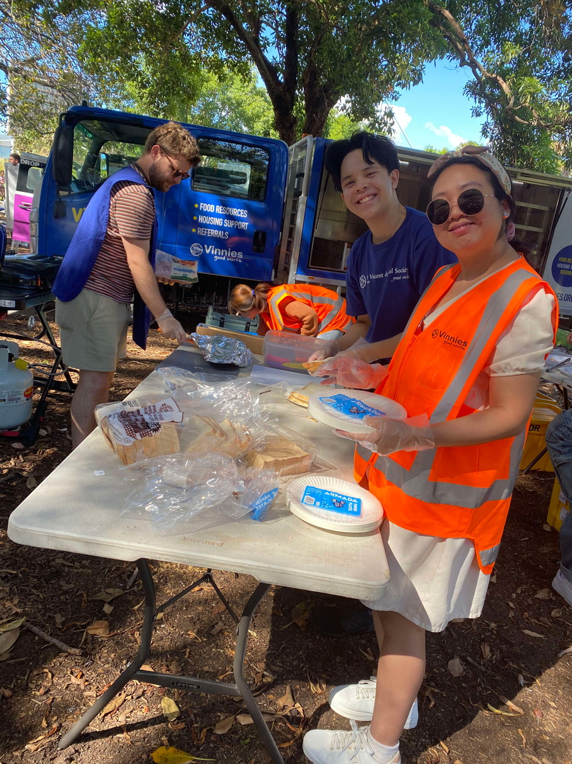
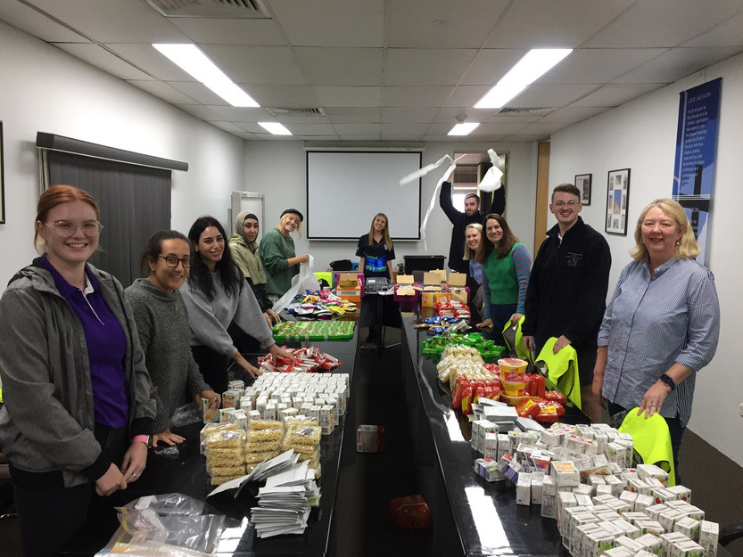
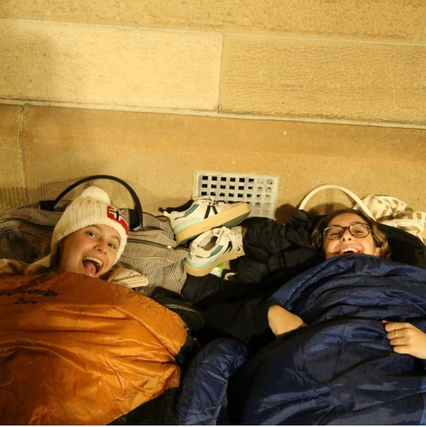
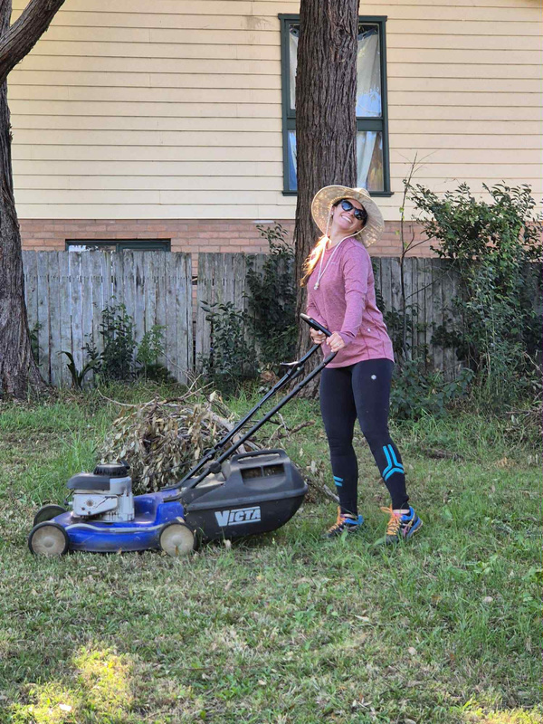
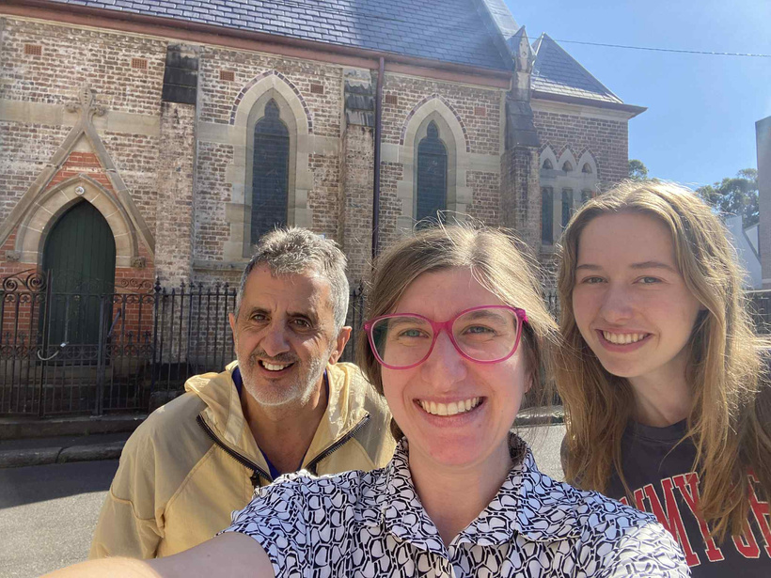
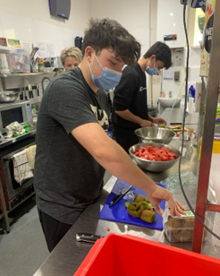
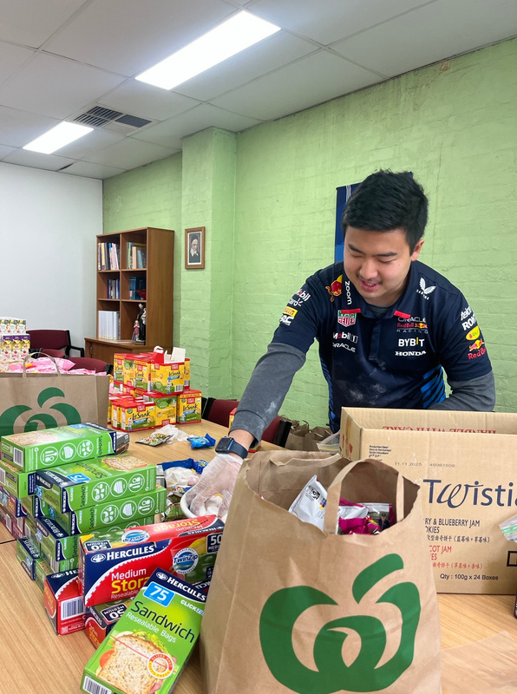
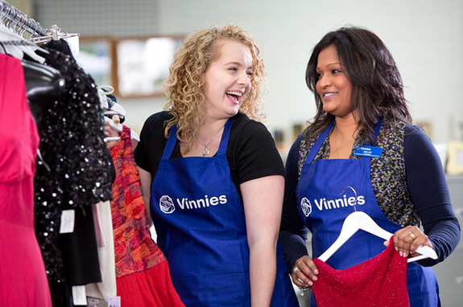
Youth: What We Do
Listening Ears
Buddies and Teens Days
Snack Packing
Green Team
Fundraising
Van Services
Home Visits
Retail Stores
VSC
Gift from the Heart

Slide 7
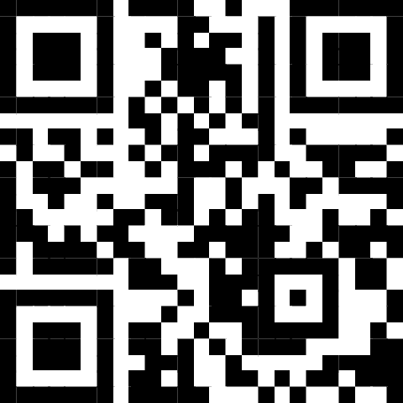


Slide 8
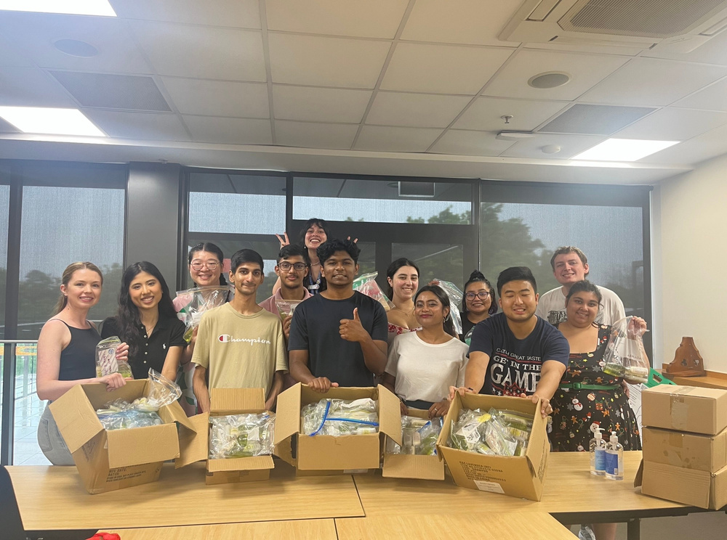
Wisdom + Youth = Growth
The Centre for Volunteering
Volunteering introduces young people to the adult world.
Teaches responsibility, maturity, and accountability.
Provides practical “how to adult” life skills.
Helps develop abilities they may not have learned elsewhere.
Being treated as equals and having their ideas respected builds confidence.
Contributes to stronger self-esteem and a sense of value.
Notes:
“Often, this experience was one of the first introductions into the adult world. Volunteering gave practical experience in “how to adult.” Through volunteering, they engaged in tasks that required maturity and accountability, developing skills they may not have previously been exposed to. Furthermore, being treated as equals and having their ideas respected made young people feel valued and improved their self-esteem.”
The Centre for Volunteering

Slide 9
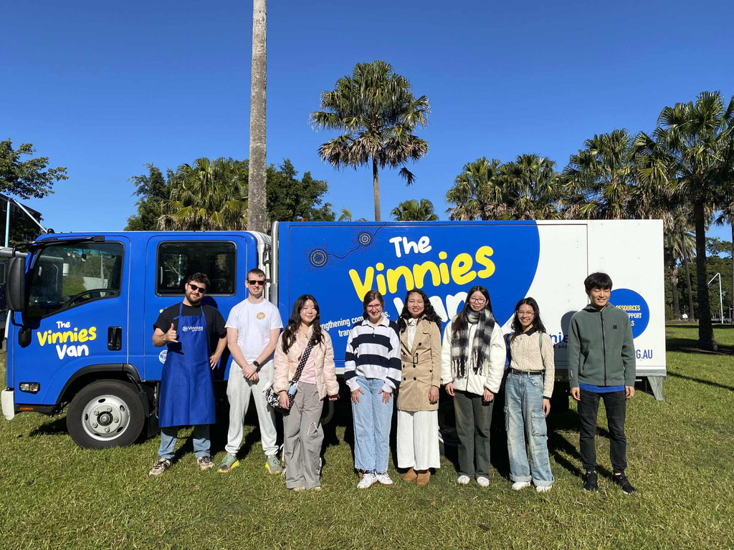
Wisdom + Youth = Growth
The Rule:
Young members bring fresh energy and new perspectives to the Society.
The Society actively includes young people.
Being part of a caring, faith-based community deepens youth spirituality and drives them to help others.
Senior members mentor and guide youth, respecting their individuality and service goals.
This intergenerational support helps young members grow personally and spiritually.
Notes:
“Young members keep the Society young. They see with new eyes and often look far ahead. The Society works constantly to form Youth Conferences and welcomes young members into all Conferences. Their experience in a community of faith and love and their exposure to poverty deepens their spirituality, spurs them to action and helps them to grow as human beings. The senior members assume the responsibility of assisting them along their path of training, respecting their personal choices and their aspirations of Vincentian service.”

Slide 10
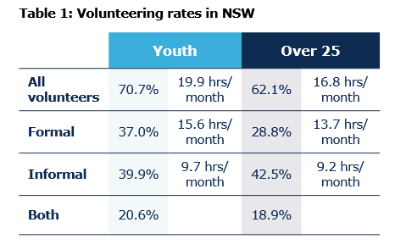
Youth: Snapshot NSW
In NSW over 730,000 young people (15-24) contributed to the community as volunteers.
The value of volunteering in NSW is $178 billion so for every dollar invested, approximately $5.50 is returned.

Slide 11
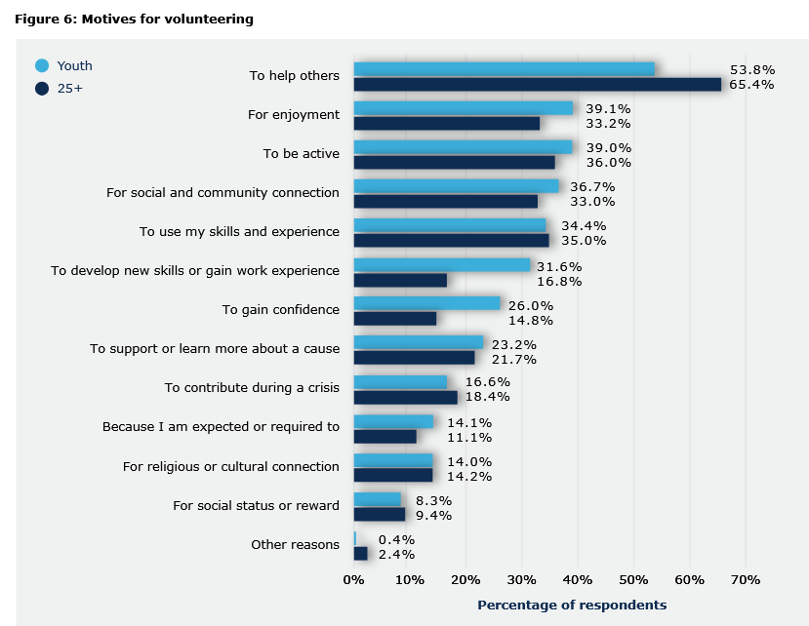

Youth: Snapshot NSW
Reasons youth volunteer:
They want to help people
Enjoyment
To be active members of society

Slide 12
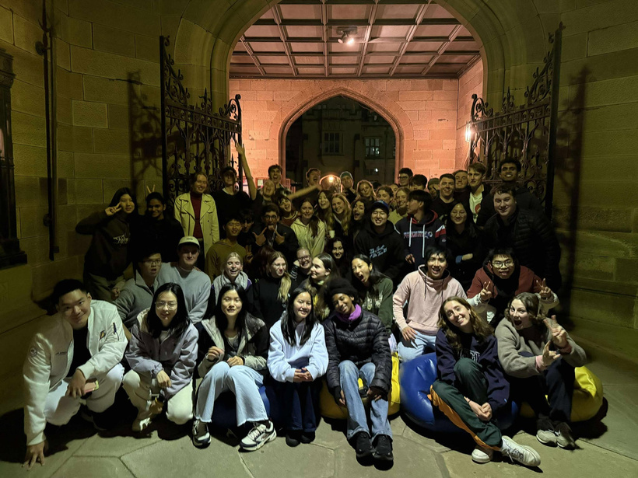
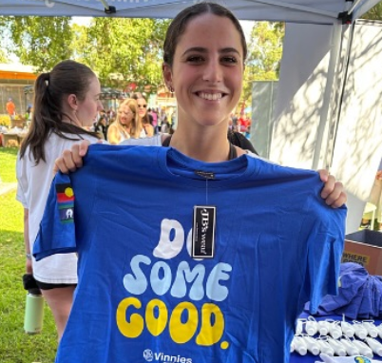
Youth Volunteering: Barriers
Time constraints: Volunteering often clashes with study, work or caring commitments.
Cost: Financial stress, transport costs, and housing pressures.
Opportunities: Many youth find roles too administrative or disconnected, preferring person-centred activities where they can see their impact.
Burnout: Young volunteers who take on too much too quickly often experience fatigue or disengagement from over-commitment.
Confidence: Limited experience and fear of “not being good enough”.

Slide 13
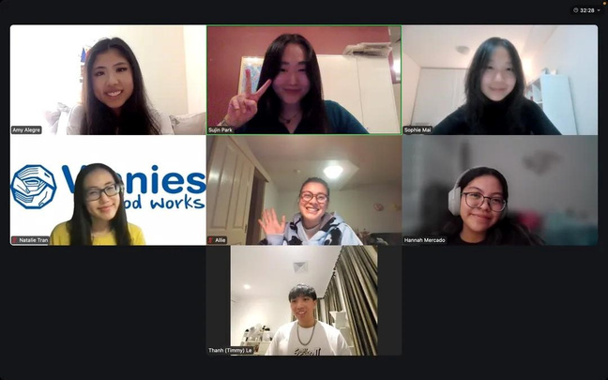
Traditional Conference | Youth Conference
Meet weekly in person | Communicate via technology Meet monthly/bimonthly at volunteering programs, social events or virtually for meetings
Core work: Home Visits | Core work: volunteering on Buddies Day, Vans Services, Sleep Out
Parish based | Special Works or University based
What’s in a
conference?

Slide 14
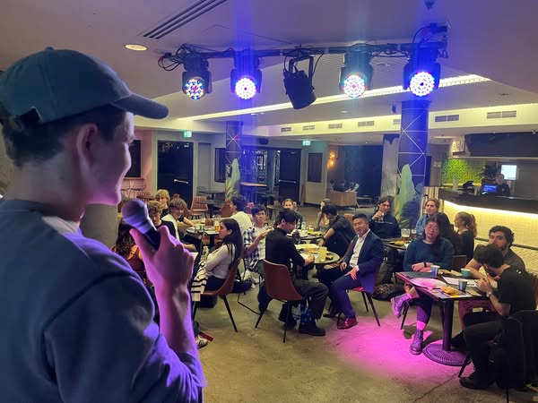

Survey Responses: Youth Voices in Action
“There are no age barriers to membership of the Society.” The Rule

Slide 15

Survey Responses: Youth Voices in Action
When you hear the word “Conference,” what comes to mind?
Most associated the word with volunteering and doing good works.
Some saw it as a group of people working together for the greater good.
A few noted it felt formal, like an organised group and community.
Several respondents didn’t know much about what a Conference actually was.
Others viewed it as an opportunity to connect and communicate with fellow volunteers.
“A group of people working together for the greater good”

Slide 16
Survey Responses: Youth Voices in Action
What makes you feel most connected or inspired to volunteer?
Making a positive impact on others.
Seeing the difference their work makes in people’s lives.
Shared passion and community among volunteers.
Personal fulfilment from helping others.
Gratitude from the people they support.
Friendship and belonging within the volunteer group.
“The knowledge that I am in a position to help others, and all it takes is a choice to sacrifice the time”

Slide 17
Survey Responses: Youth Voices in Action
What challenges or barriers make it harder for young people to join or stay involved?
Lack of awareness and limited communication about opportunities.
Few young members in local conferences, making it harder to find community.
Life balance and time constraints.
Administrative red tape and complicated on-boarding processes.
Preference for virtual engagement, some feel awkward with in-person events.
“The lack of young people involved in local conferences means they are less able to get instant community, and the admin of signing up is daunting and long”

Slide 18
Survey Responses: Youth Voices in Action
If you could re-imagine a “Conference” for the next generation, what would you keep, change or create?
Keep: the sense of community and shared purpose.
Change: make it more inclusive and accessible, reduce admin barriers.
Create: better visibility, simpler, one-off volunteering options like clean-up days, fun, virtual engagement opportunities.
“Everyone wants to do good, if you lower the barrier for needing to do that you’ll find more people able to give up their time to help out”

Slide 19
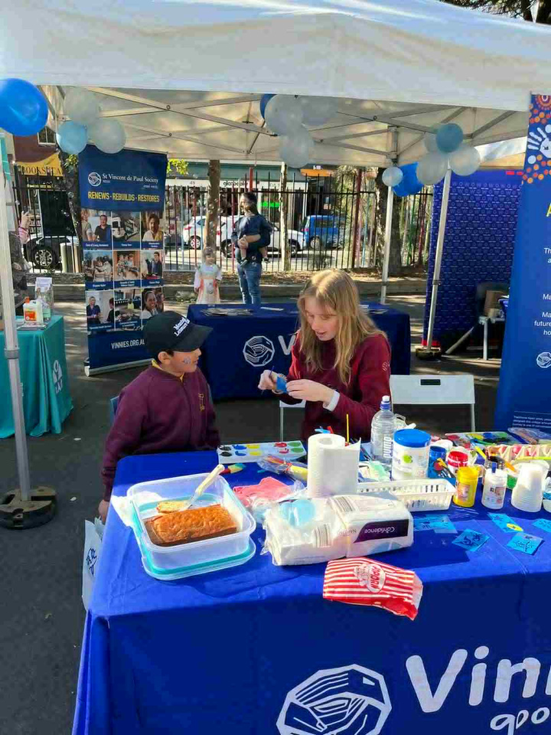
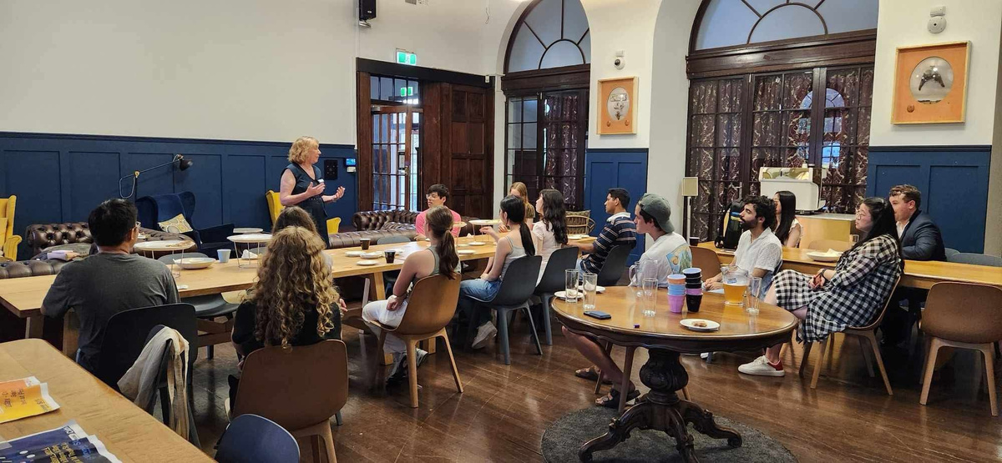

Collaboration: Impact Spotlights
Glebe Conference x University of Sydney Youth Conference
“I have really appreciated the ongoing relationship between the Vinnies Glebe Conference and USYD’s Vinnies Society. The generosity of older conference members in sharing their experiences with a younger generation of volunteers has been truly inspiring. Home visitations are one example of an otherwise daunting task, that is accessible to younger volunteers through the encouragement of older conference members. Personally I have gained a lot of perspective and rewarding experience from visitations with the guidance of the Glebe Conference members.” - Isabella
USYD Conference President

Slide 20
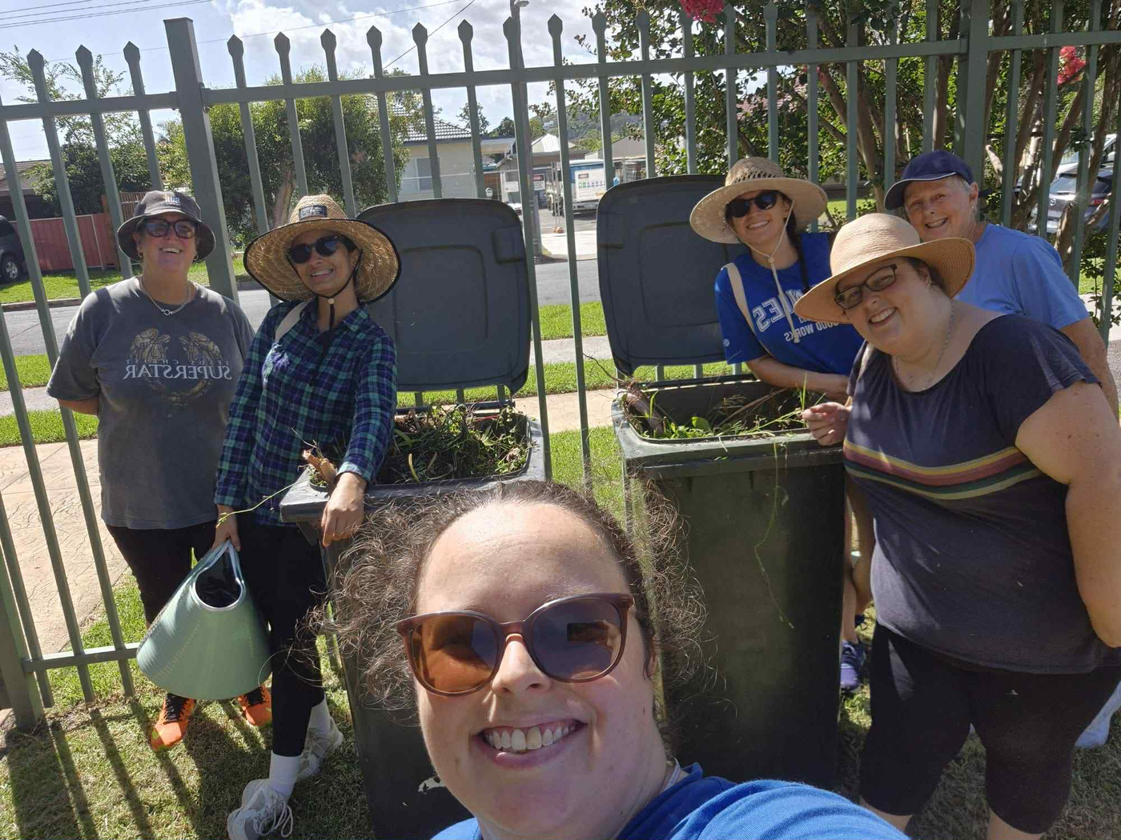
Collaboration: Impact Spotlights
Wollongong Youth Conference x St Therese’s Conference Collaboration

Slide 21
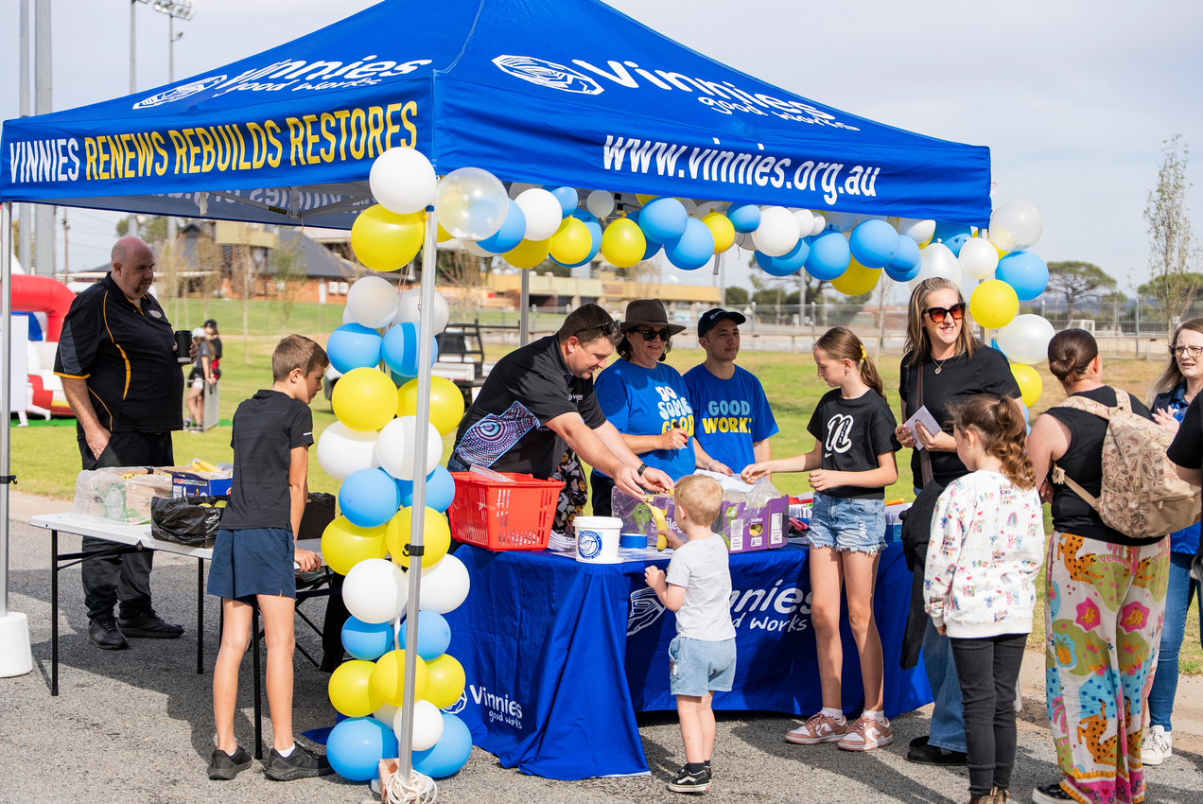
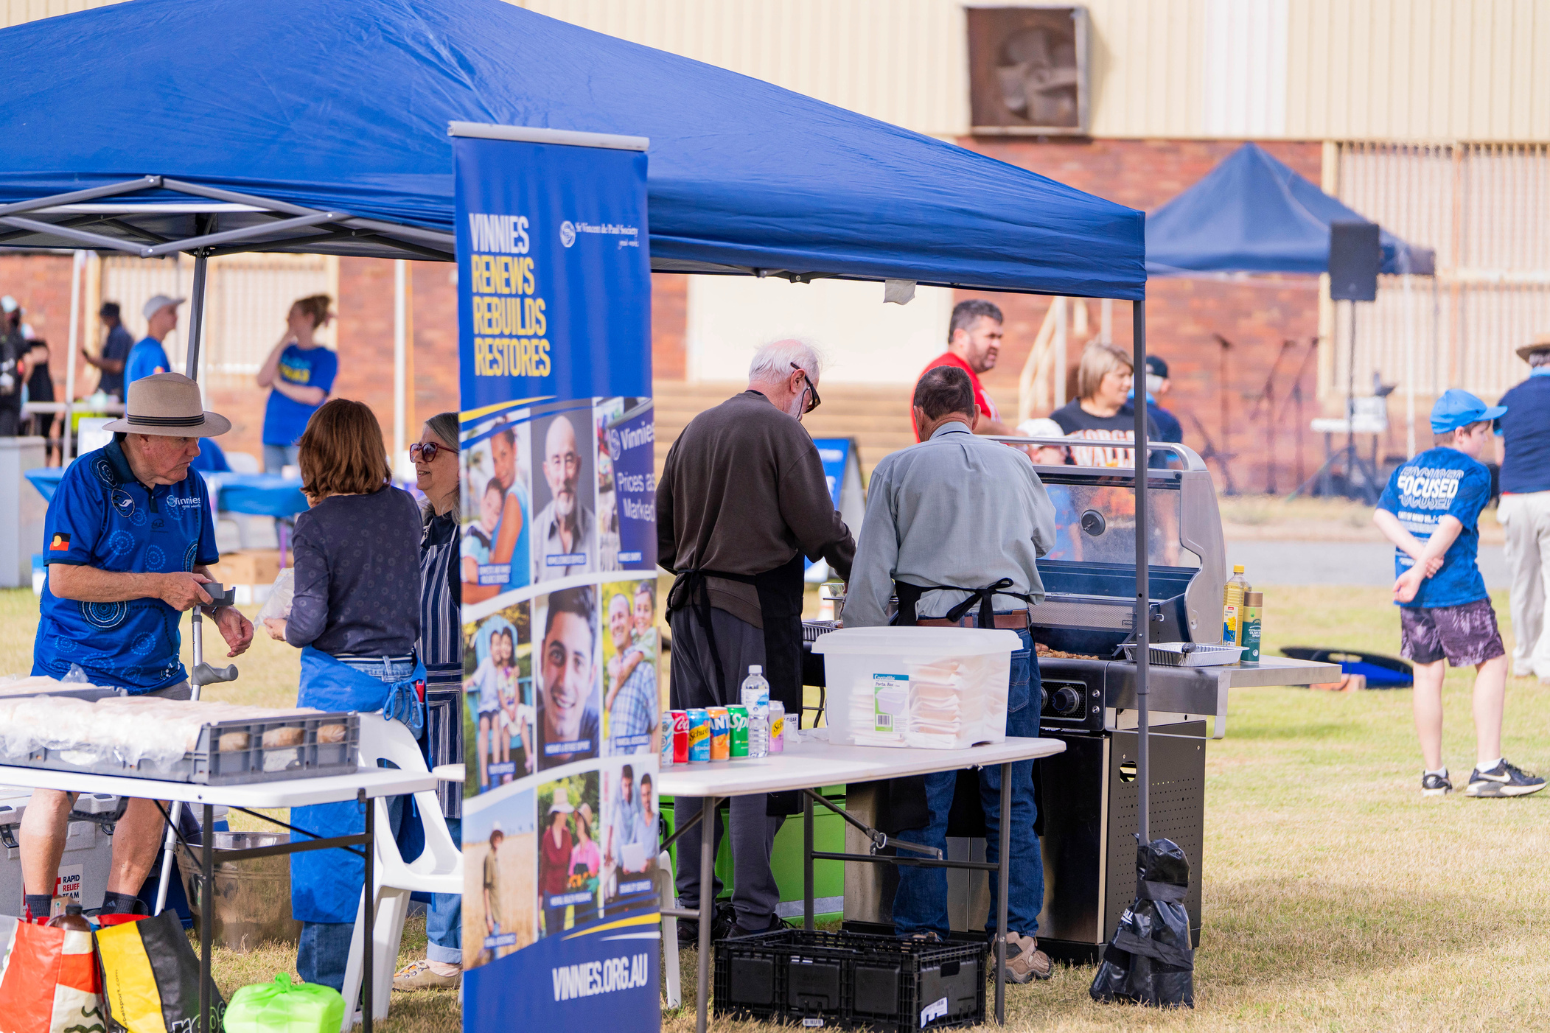
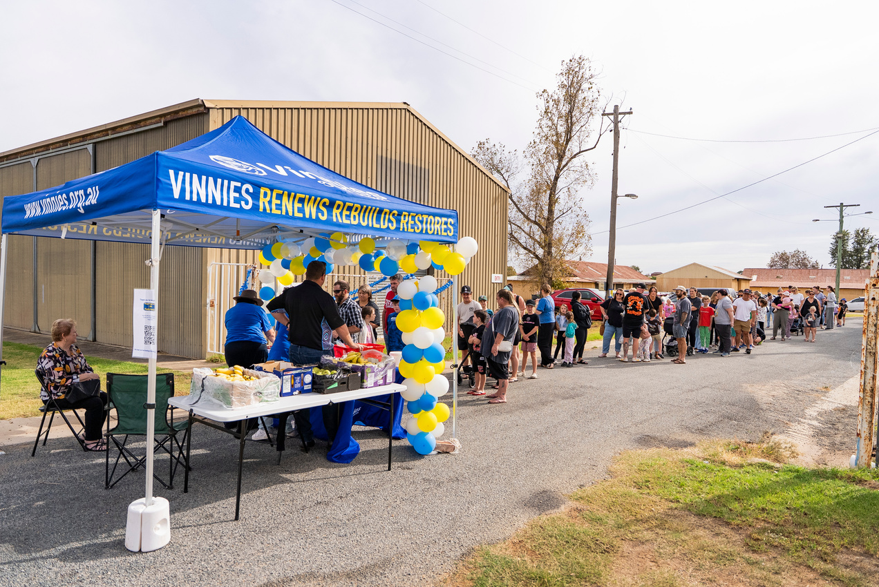
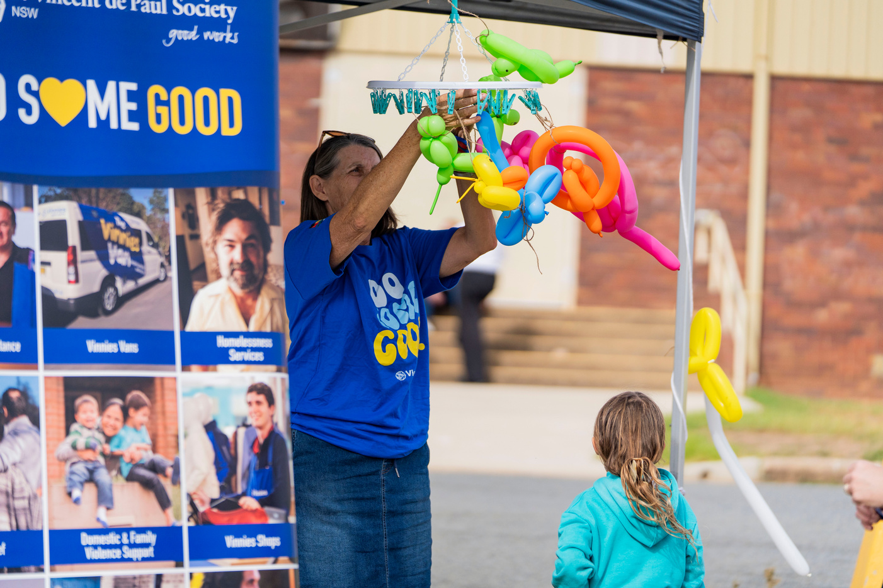
Collaboration: Impact Spotlights
Wagga Wagga Youth Conference St. Sebastians, Wagga Regional Council Conferences and NILs - Family Fun Day
“The Family Fun Day was a true symbolism of The Society, how we work in with each other, and support those who need it the most” - Warwick, Kooringal Conference Member

Slide 22
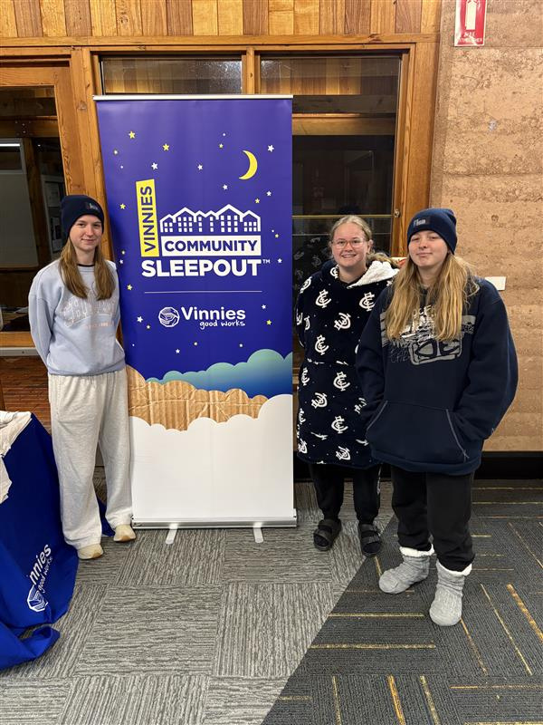
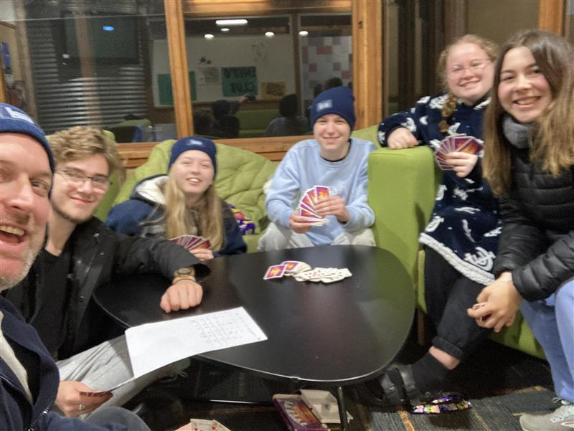
New Youth Conference:
Albury Charles Sturt University (CSU) Young Adult Conference

Slide 23

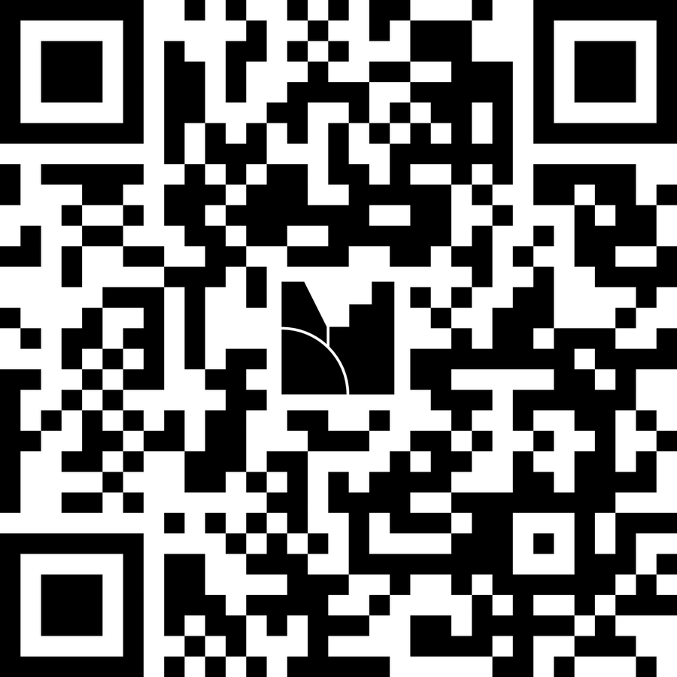

Discussion
Mentimeter Code:
7349 8002

Slide 24
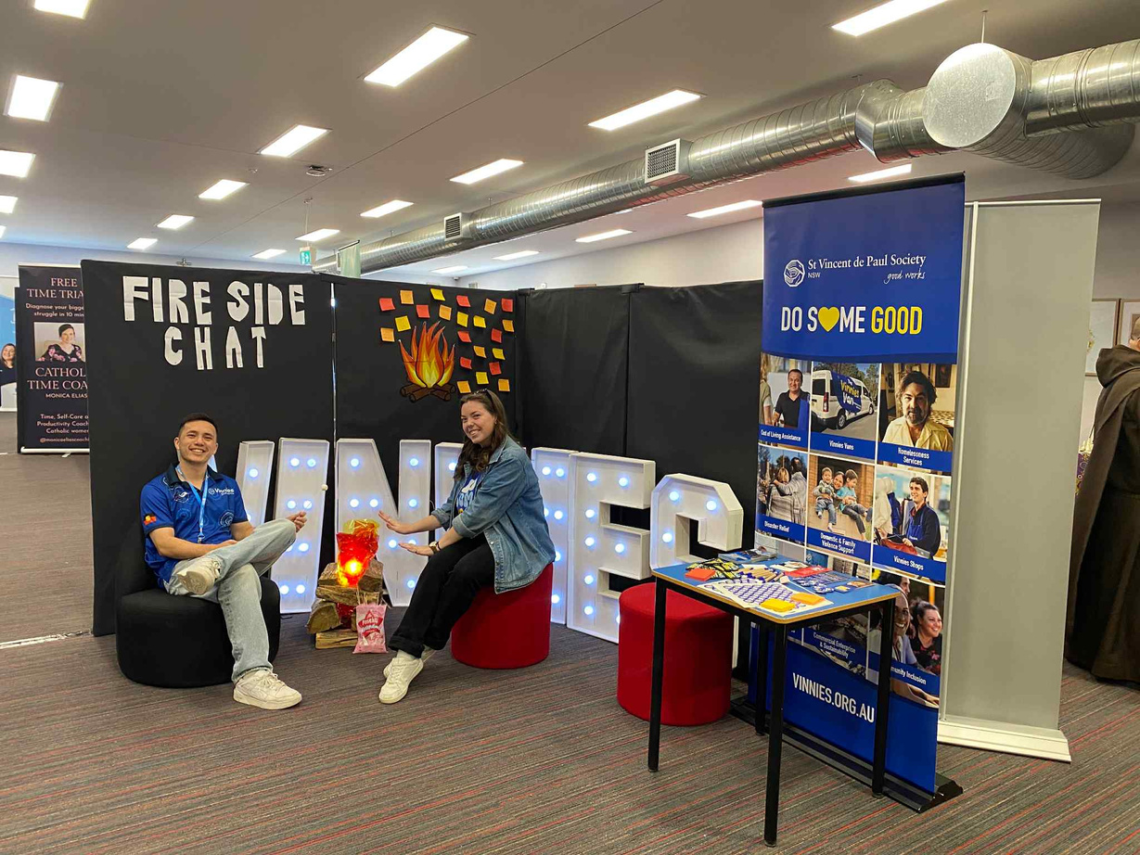
Planning
What are three strategies you can implement that will invite youth members into your regions conferences?

Slide 25
Planning: Consider
The 8 suggested techniques to recruit and maintain youth volunteers include:
Digital volunteering –external volunteering opportunities that can be done remotely via the internet.
Skill based volunteering – addressing volunteers’ skills for specific projects.
Micro volunteering – more ADHOC volunteer opportunities for time poor people.
Corporate volunteering – collaborating with big or well-known organisations to widen volunteer pool.
Inclusive volunteering –ensuring the space is accessible for all people, including: people who are neurodivergent, people with diverse needs/abilities as well as being culturally responsive and respectful of religion and individuals identity.
Impactful measurement – using case studies, testimonies and observation to communicate our ‘good works’.
Leadership development – having more mentoring opportunities to broaden these skills.
Flexible scheduling – having good technology to support booking shifts and rostering as well as for record keeping.

Slide 26



