Slide 1





Together, we are more
“The Hubs”
Sarah Kemp
Manager, Member and Community Engagement
NORTH EAST

Slide 2




Our Hub Spaces – Maitland and Newcastle
The Concept
A Regional Space for community support to be delivered to the people we assist in Maitland and Newcastle
Why
Gives community an opportunity to access assistance where service gaps have been identified, complex needs, higher density areas and greater demands for service
Who
Members, Volunteers, Students, Staff and Services have come together in a collaborative effort to provide support and assistance
The Impact
In the last 18 months, Maitland has held over 500 interactions and in 12 months, Newcastle 890 Interactions
With close to 50 personnel on the frontline

Slide 3
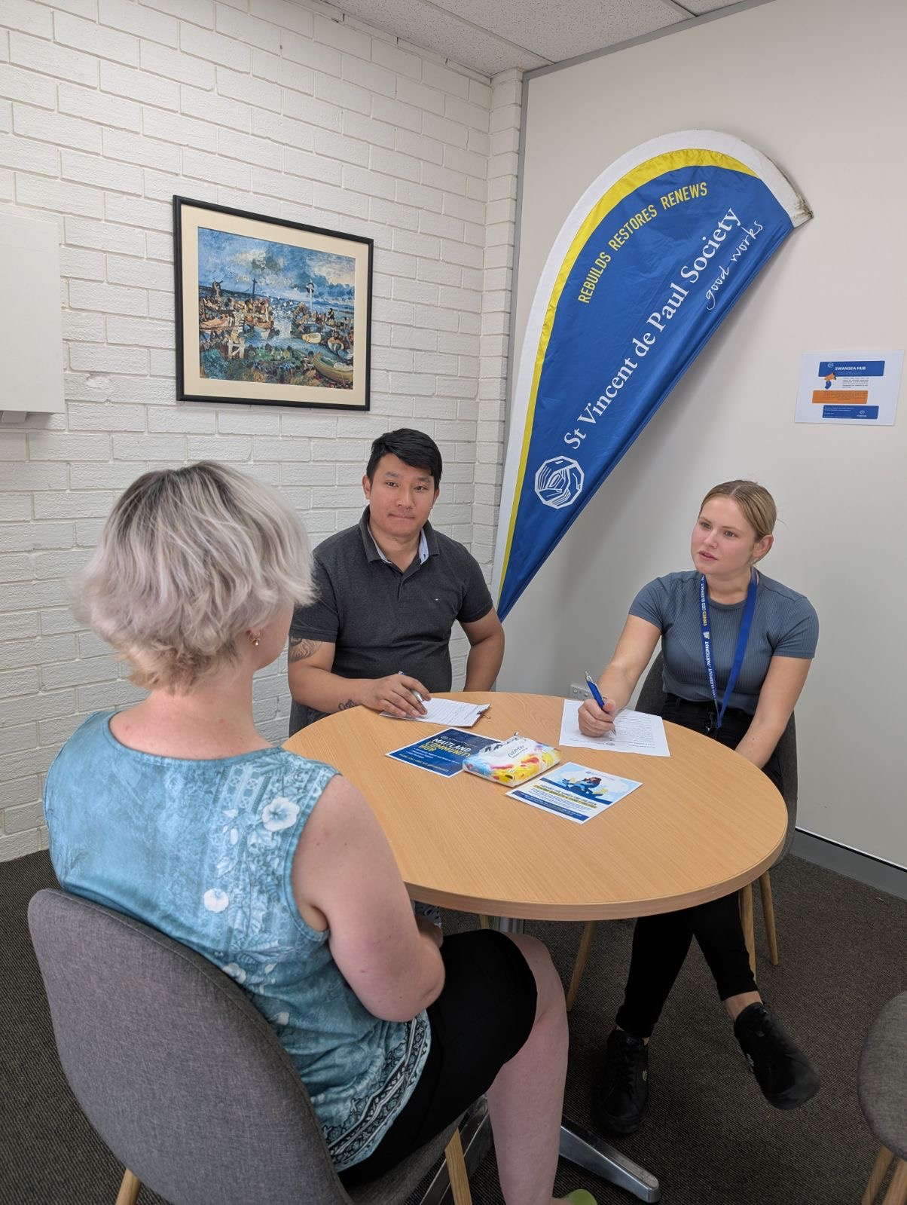
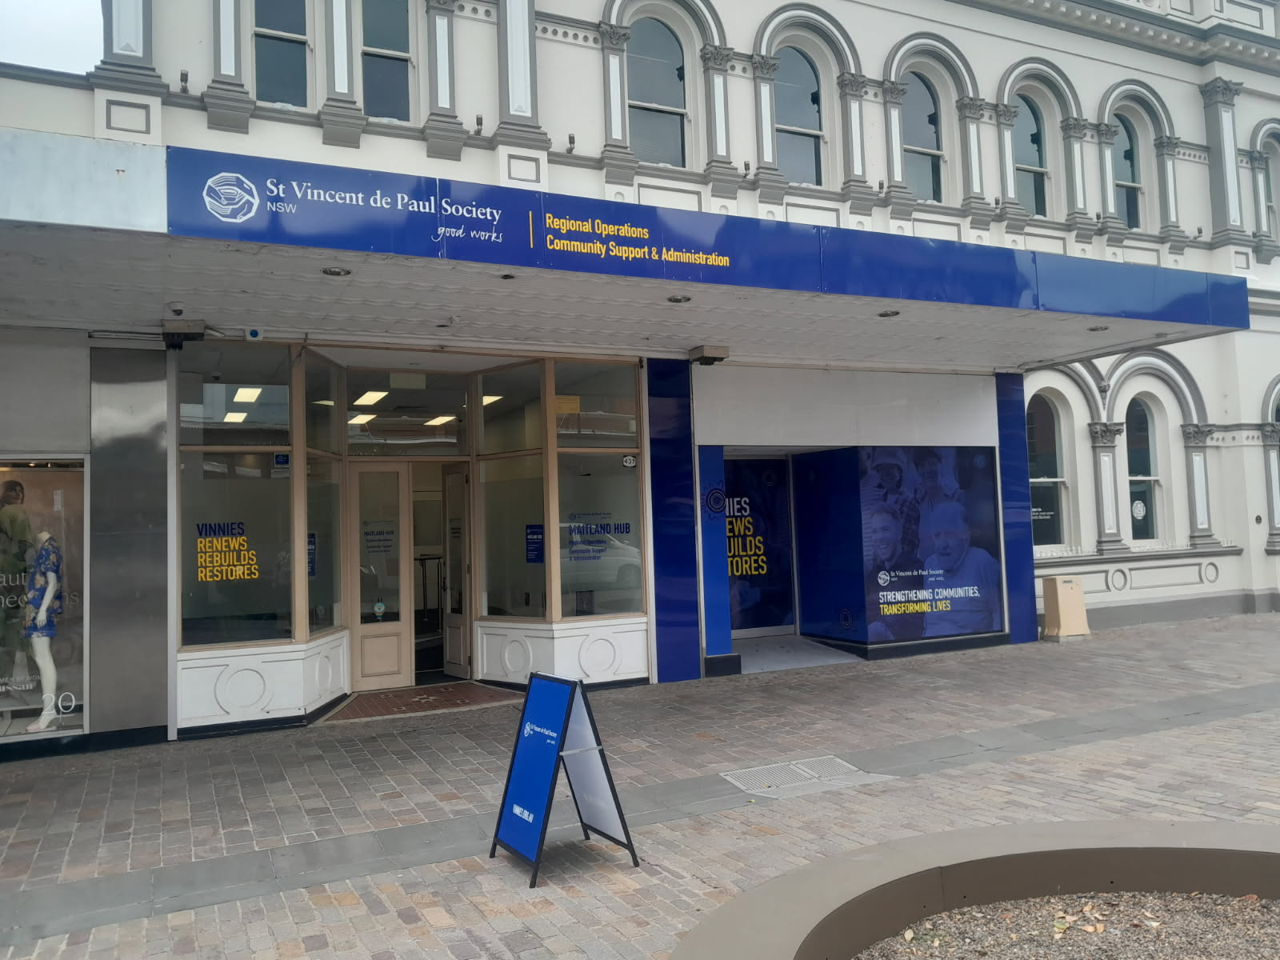
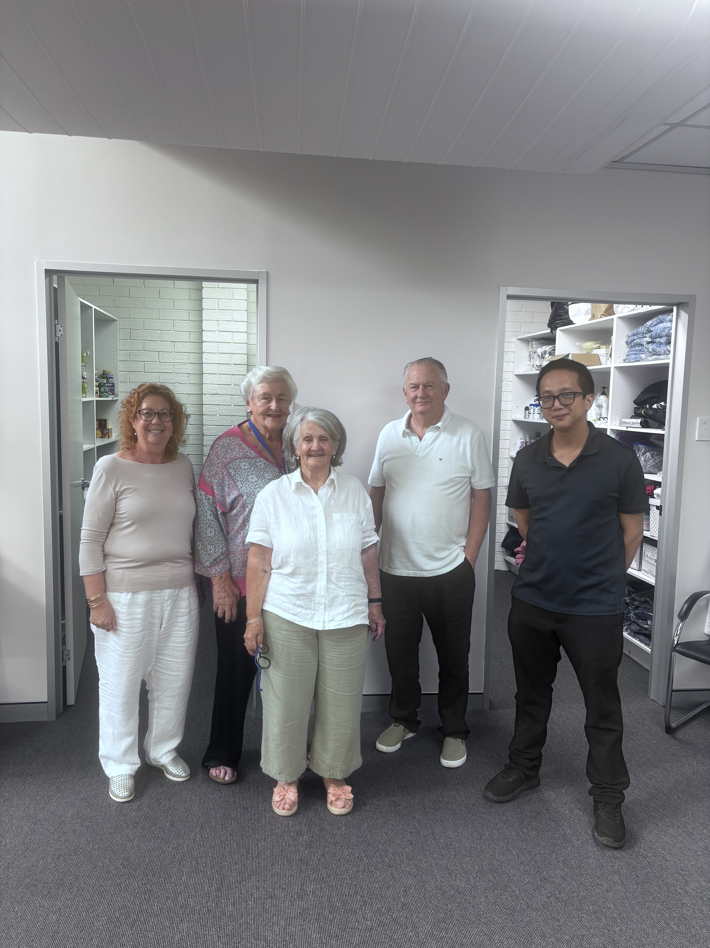
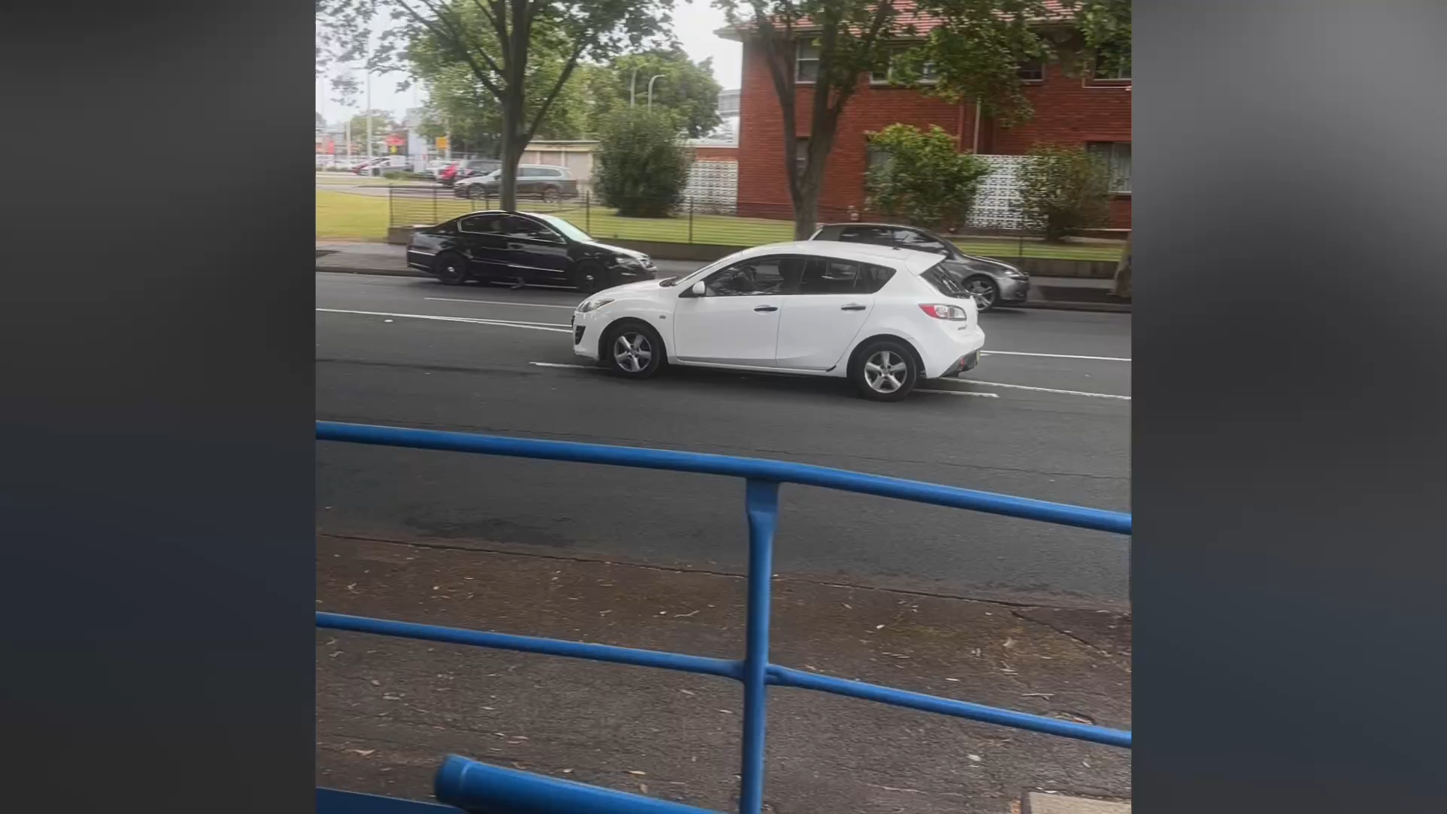
From the inside!

Slide 4
A word from a Regional President!
Meet Daryl, our Lower Hunter Regional President. The Maitland Hub falls in Daryl’s Region and is predominantly manned by two Conferences, Rutherford and Maitland however Daryl’s home Conference, East Maitland also fill the roster gaps to ensure that the doors remain open and the support can be provided.
This hub also provides a space for Regional meetings to be held and has allowed training events to be undertaken across the Hunter Region.

Slide 5
In a Nutshell
The Hubs are a welcoming space for the people we assist to gain access to vital services.
Through collaboration between Members, Volunteers, Staff and Vinnies Services such as NILS and CCCP (AOD), we are able to open the doors for longer and meet the demands on our services.
Our Members are carrying out the good works of St Vincent de Paul passing on valuable skills and experience to our students completing their placement hours in Community Services and Social Work degrees.
The staff work closely with the hub volunteers meaning additional support is available where needed.

