Slide 1






Relationships
Pat Cudmore

Slide 2
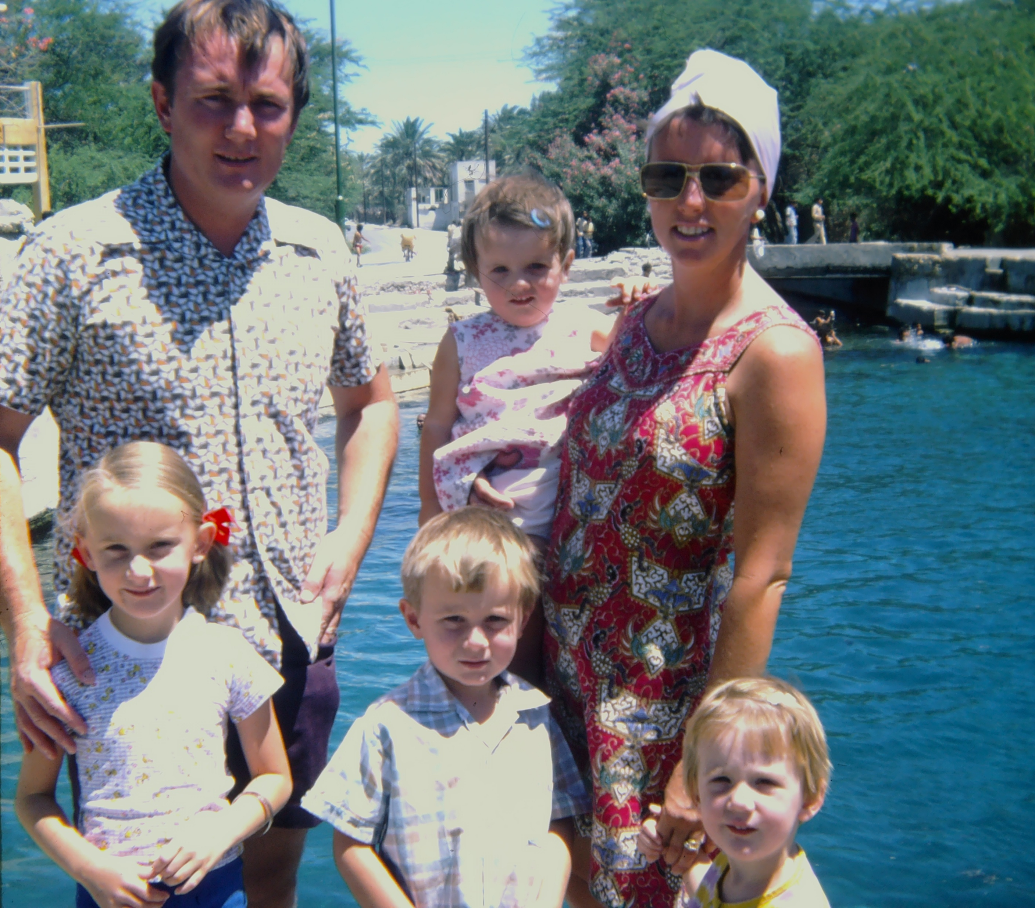

Slide 3
Good relationships are built on a foundation of mutual respect, trust, open communication where both individuals feel safe, supported, and valued.

Slide 4

Faith
Hope
Charity
‘Love one another as I have loved you’ John 13:31–34

Slide 5
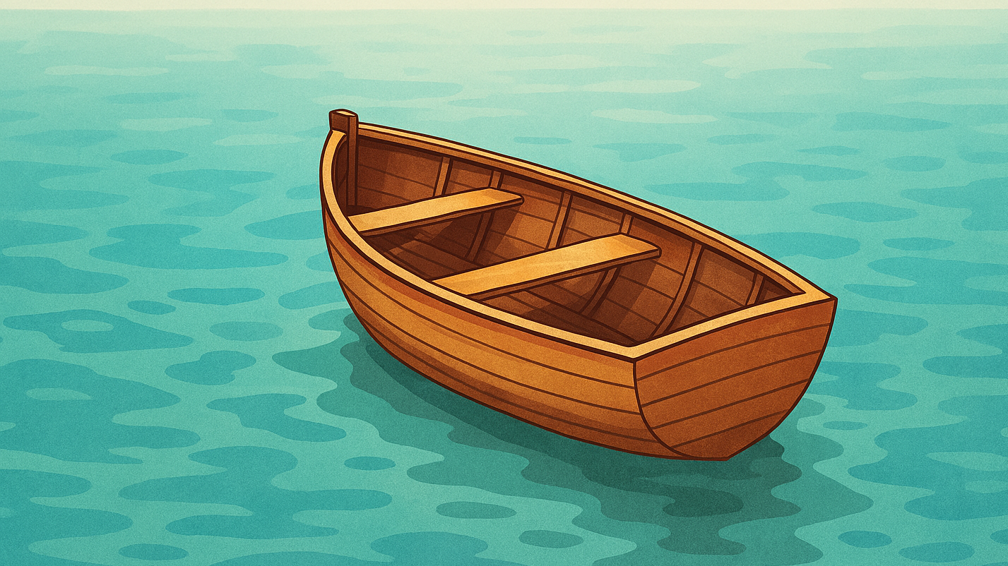
Our mission
"Attitude is the 'little' thing that makes a big difference.“ Winston Churchill

Slide 6
Our mission
The St Vincent de Paul Society is a lay Catholic organisation that aspires to live the gospel message by serving Christ in the poor with love, respect, justice, hope and joy, and to bring about a more just and compassionate society.
.
“I have come so that you may have life and have it to the fullest.” John 10:10

Slide 7
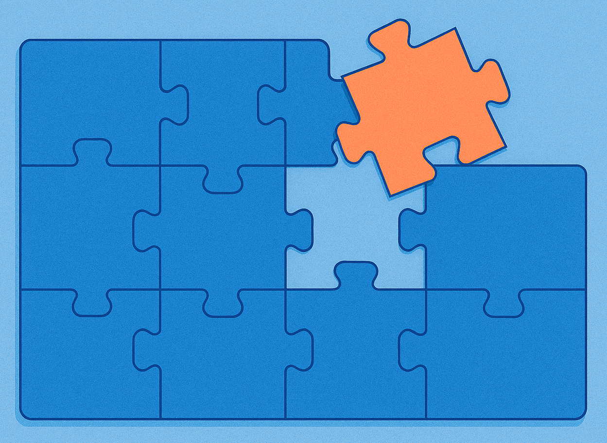
We all play a role in the bigger picture
Healthy relationships are so important that God didn't just suggest we treat others well; He commanded it. Matthew 22:34-40

Slide 8
We work as a team
Sutherland Region
“Overcoming poverty is not a task of charity; it is an act of justice.” Nelson Mandela

Slide 9
Building effective relationships together
Sutherland Shire Region
Regional Council
Nine Conferences reach across the Shire
“Alone we can do so little; together we can do so much.” Helen Keller

Slide 10









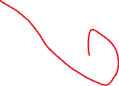




Song: Paul Kelly
“From little things big things …… …….GROW

Slide 11
Know one another
If you had to describe yourself in three words, what would they be?
If you could live anywhere in the world, where would it be and why?
Who’s somebody you admire and why?
What is something you’re proud of?

