Slide 1





Collaboration for Good
Kate Scholl

Slide 2
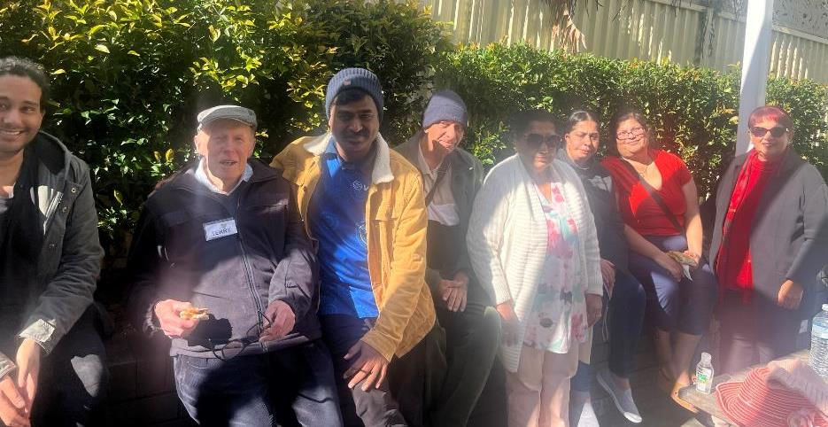
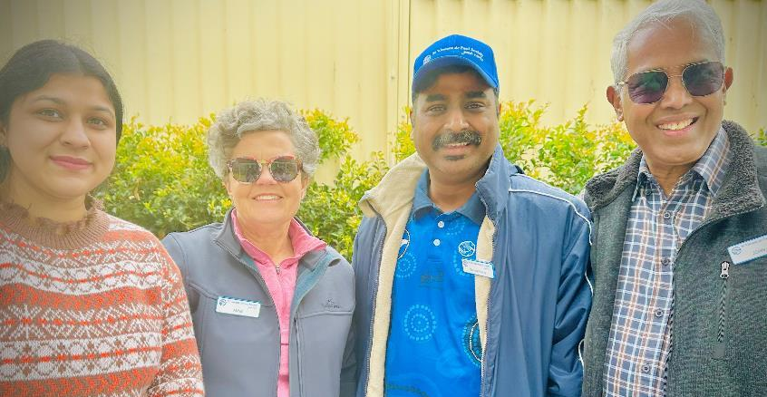
Conference members collaborating with employees and Councils across NSW to engage with SVdP Society Housing tenants in locally lead social activities

Slide 3

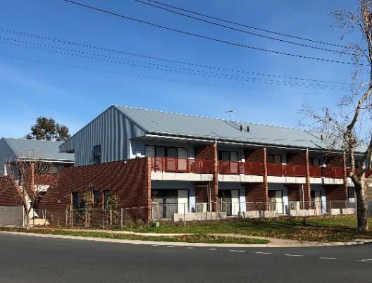
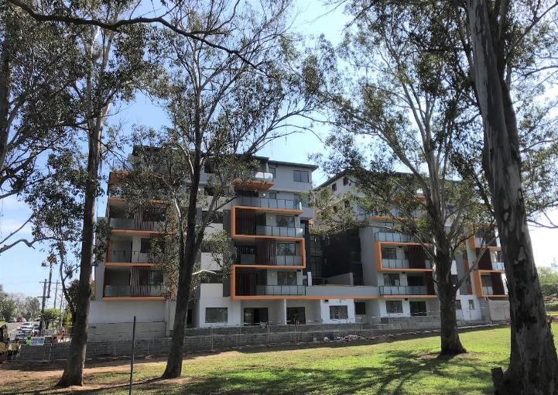
Social and affordable housing: A Social Justice initiative of the St Vincent de Paul Society
SVdP Society Housing Australia (formerly Amélie Housing) is a national body
St Vincent de Paul Housing (operates in NSW).
Special Works providing housing and services supporting the most vulnerable

Slide 4
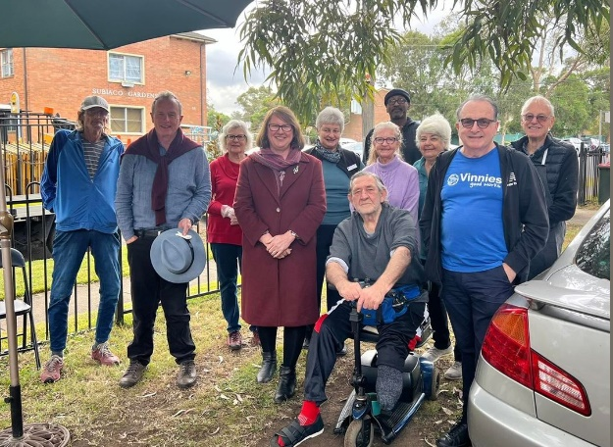
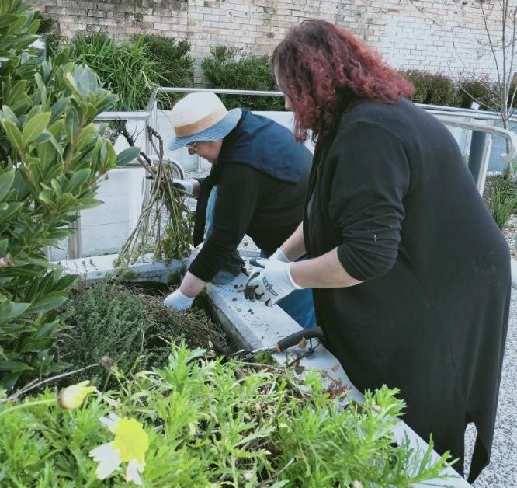
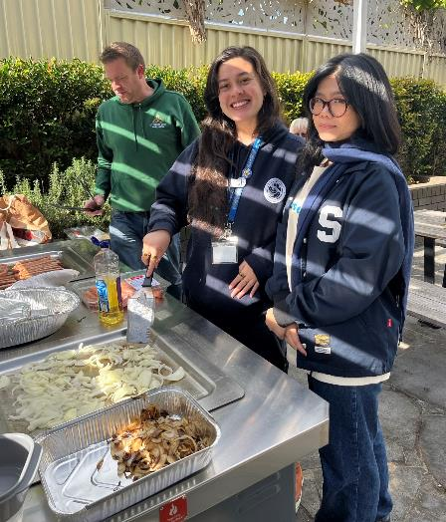
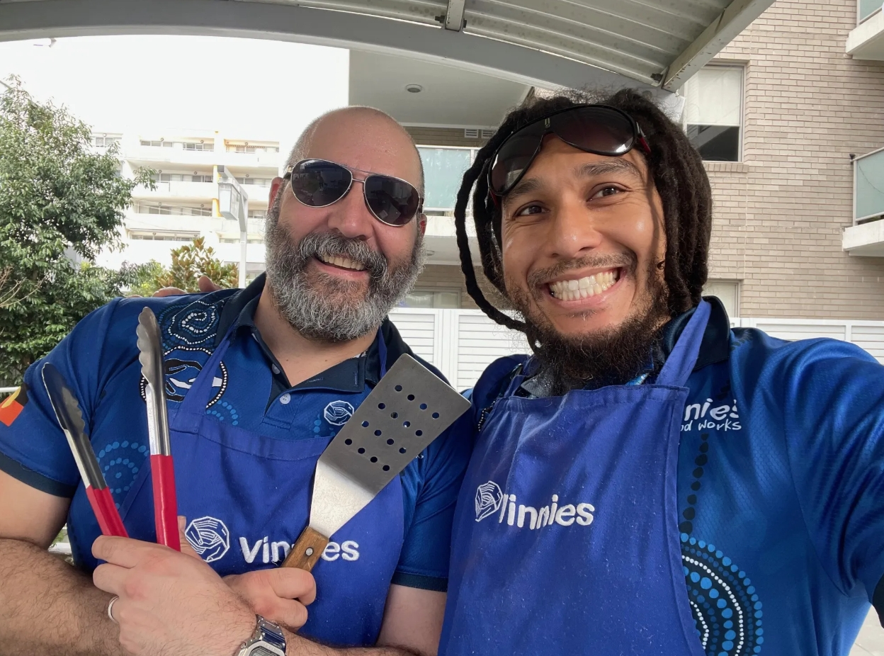
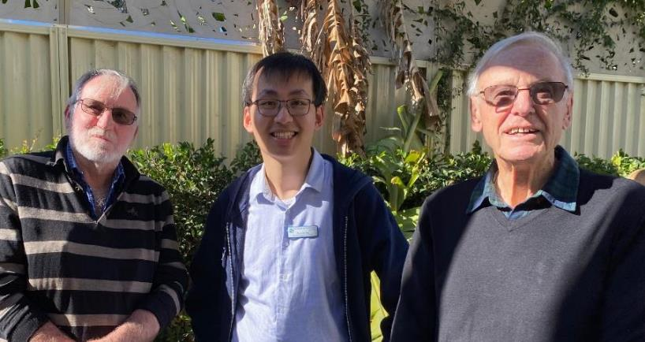
Collaborators
Housing, Membership, and Vinnies Services Employees
Conference Members and Councils
State Council and Housing Boards
Member engagement Committee to support and communicate opportunities
Positive outcomes for tenants

Slide 5
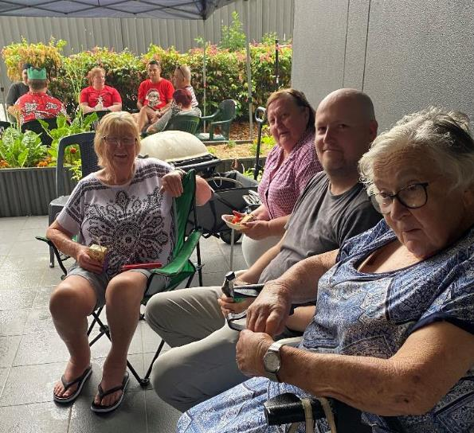
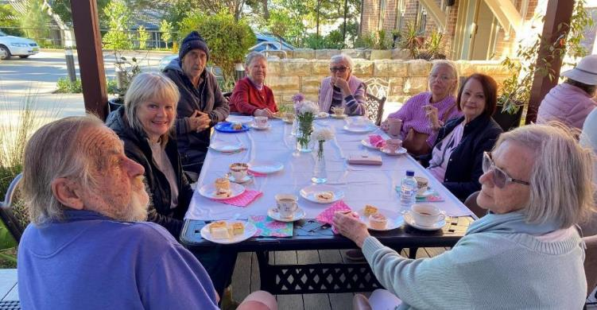
Committee to advance this engagement
Member Engagement with SVdP Housing Tenants committee collaborate to
Grow awareness of the Society’s Housing company
‘Road show’ at Central and RC meetings
Share the opportunity to serve our tenants
Engage current and potentially new Conference members

Slide 6
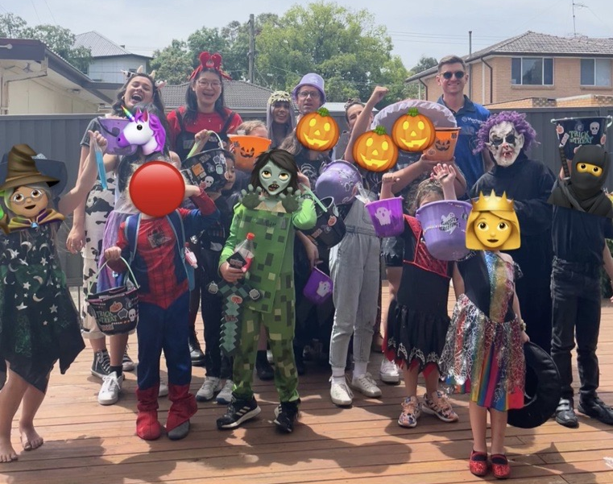
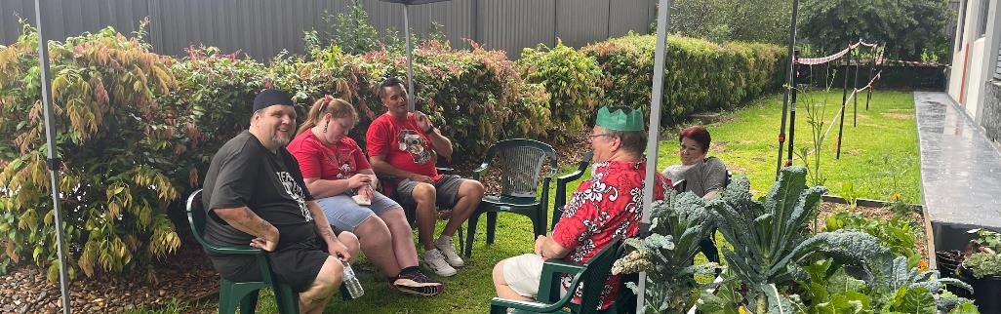
Collaborating to engage at Penrith
Nepean Regional Council invited to engage in 2022
TEAMS meeting for interested members OCT 2022
Vinnies Housing Staff spoke at that meeting
Morning Tea was first event
Halloween Buddies Day onsite in October run by the Vinnies Youth Team.
Christmas Party organised by the members in the Region.

Slide 7
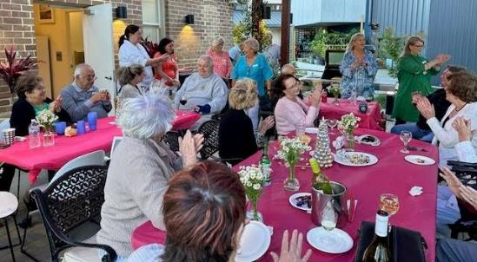
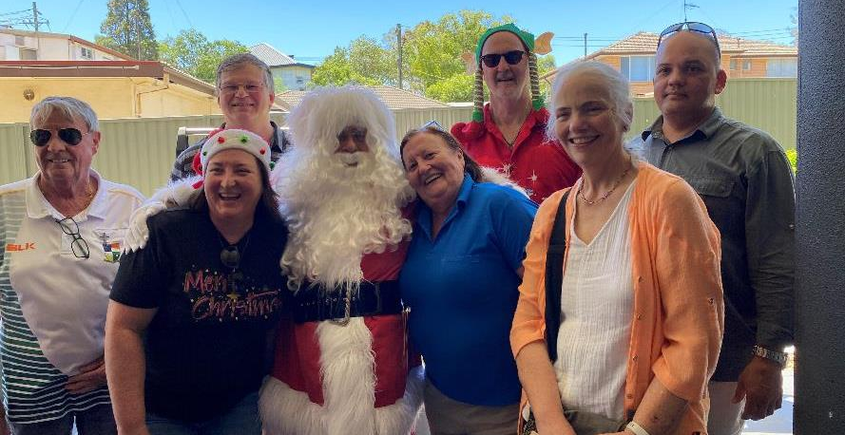
Vinnies and Housing Staff communicate with the tenants. Provide site access and help source resources.

Slide 8
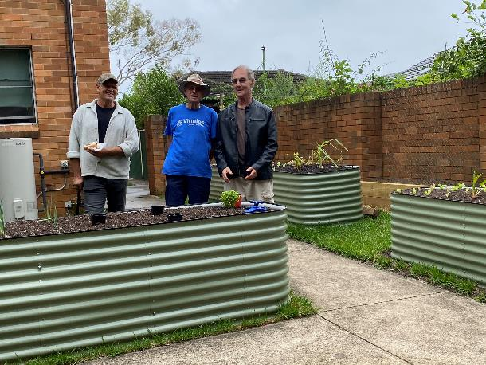
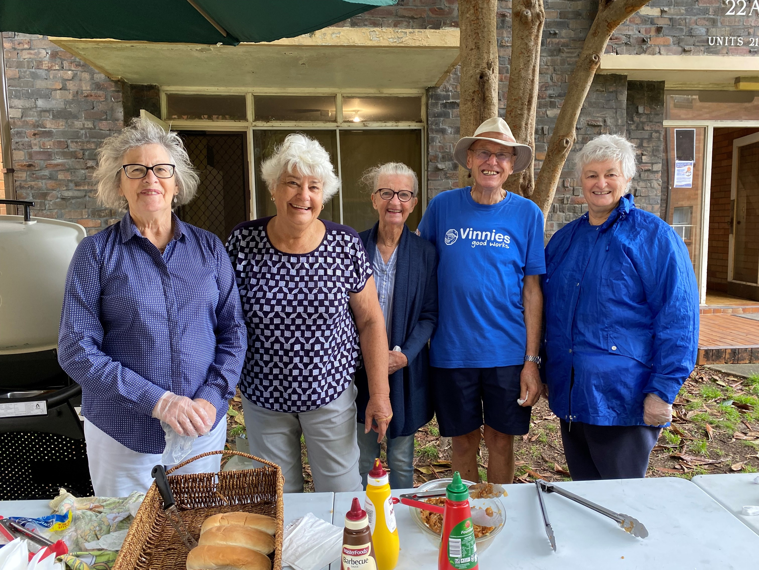
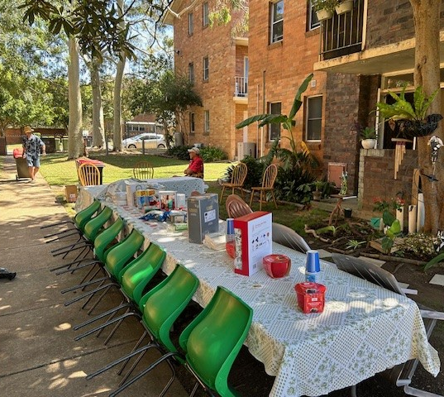
Rydalmere Conference with Ermington tenants began in 2019
BBQ’s and lunches
Community Garden Project
Residents ran the Christmas party 2024

Slide 9
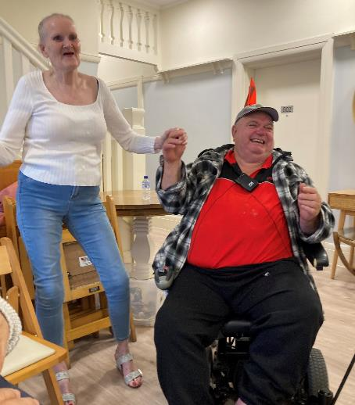
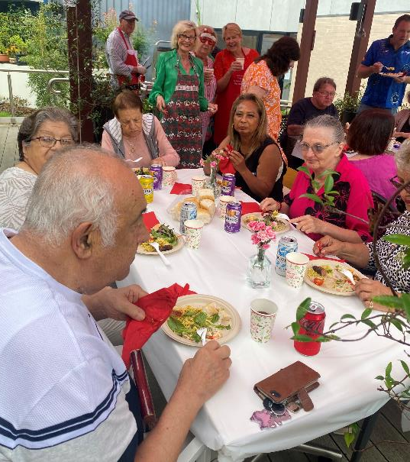
Caringbah Conference (Sydney Arch) with Burraneer Residents 2022 – now
BBQ’s and lunches
Musical evening
High Tea

Slide 10
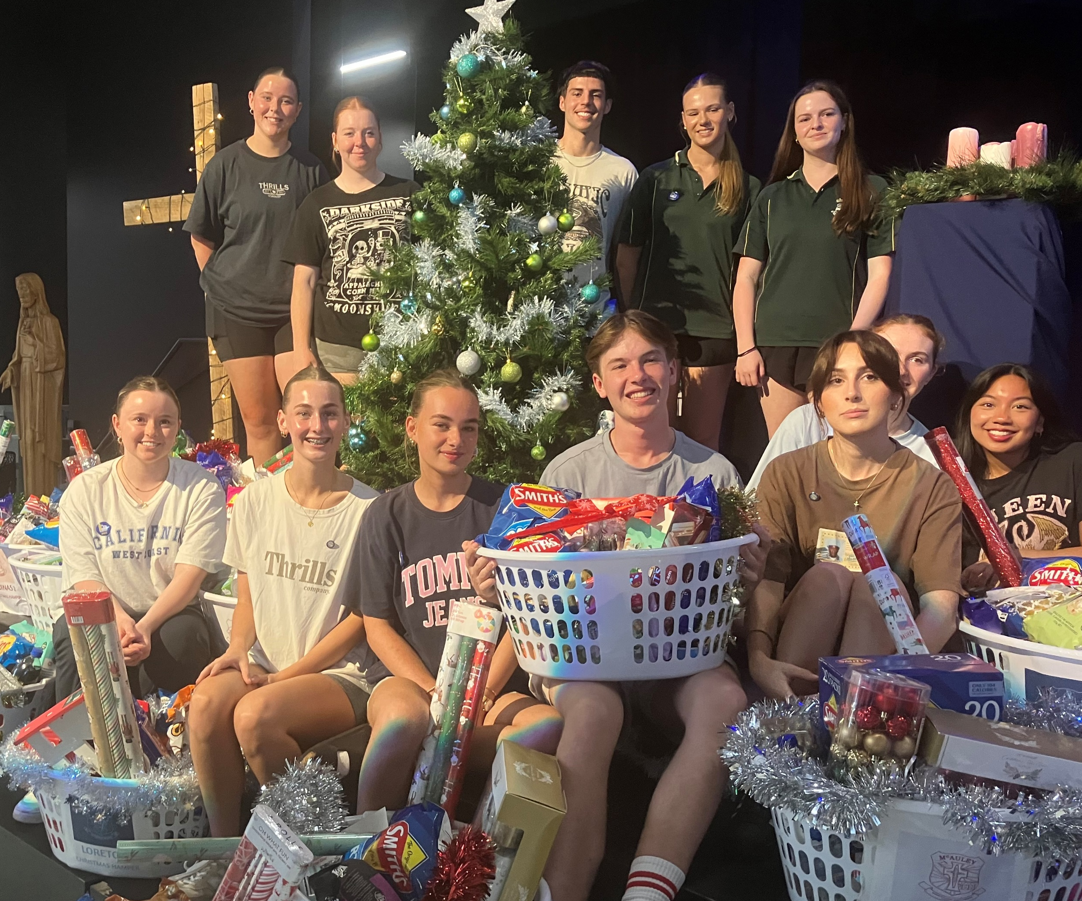
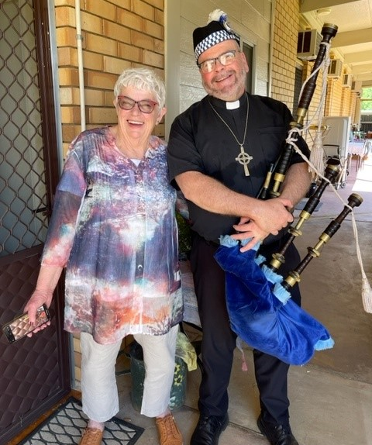
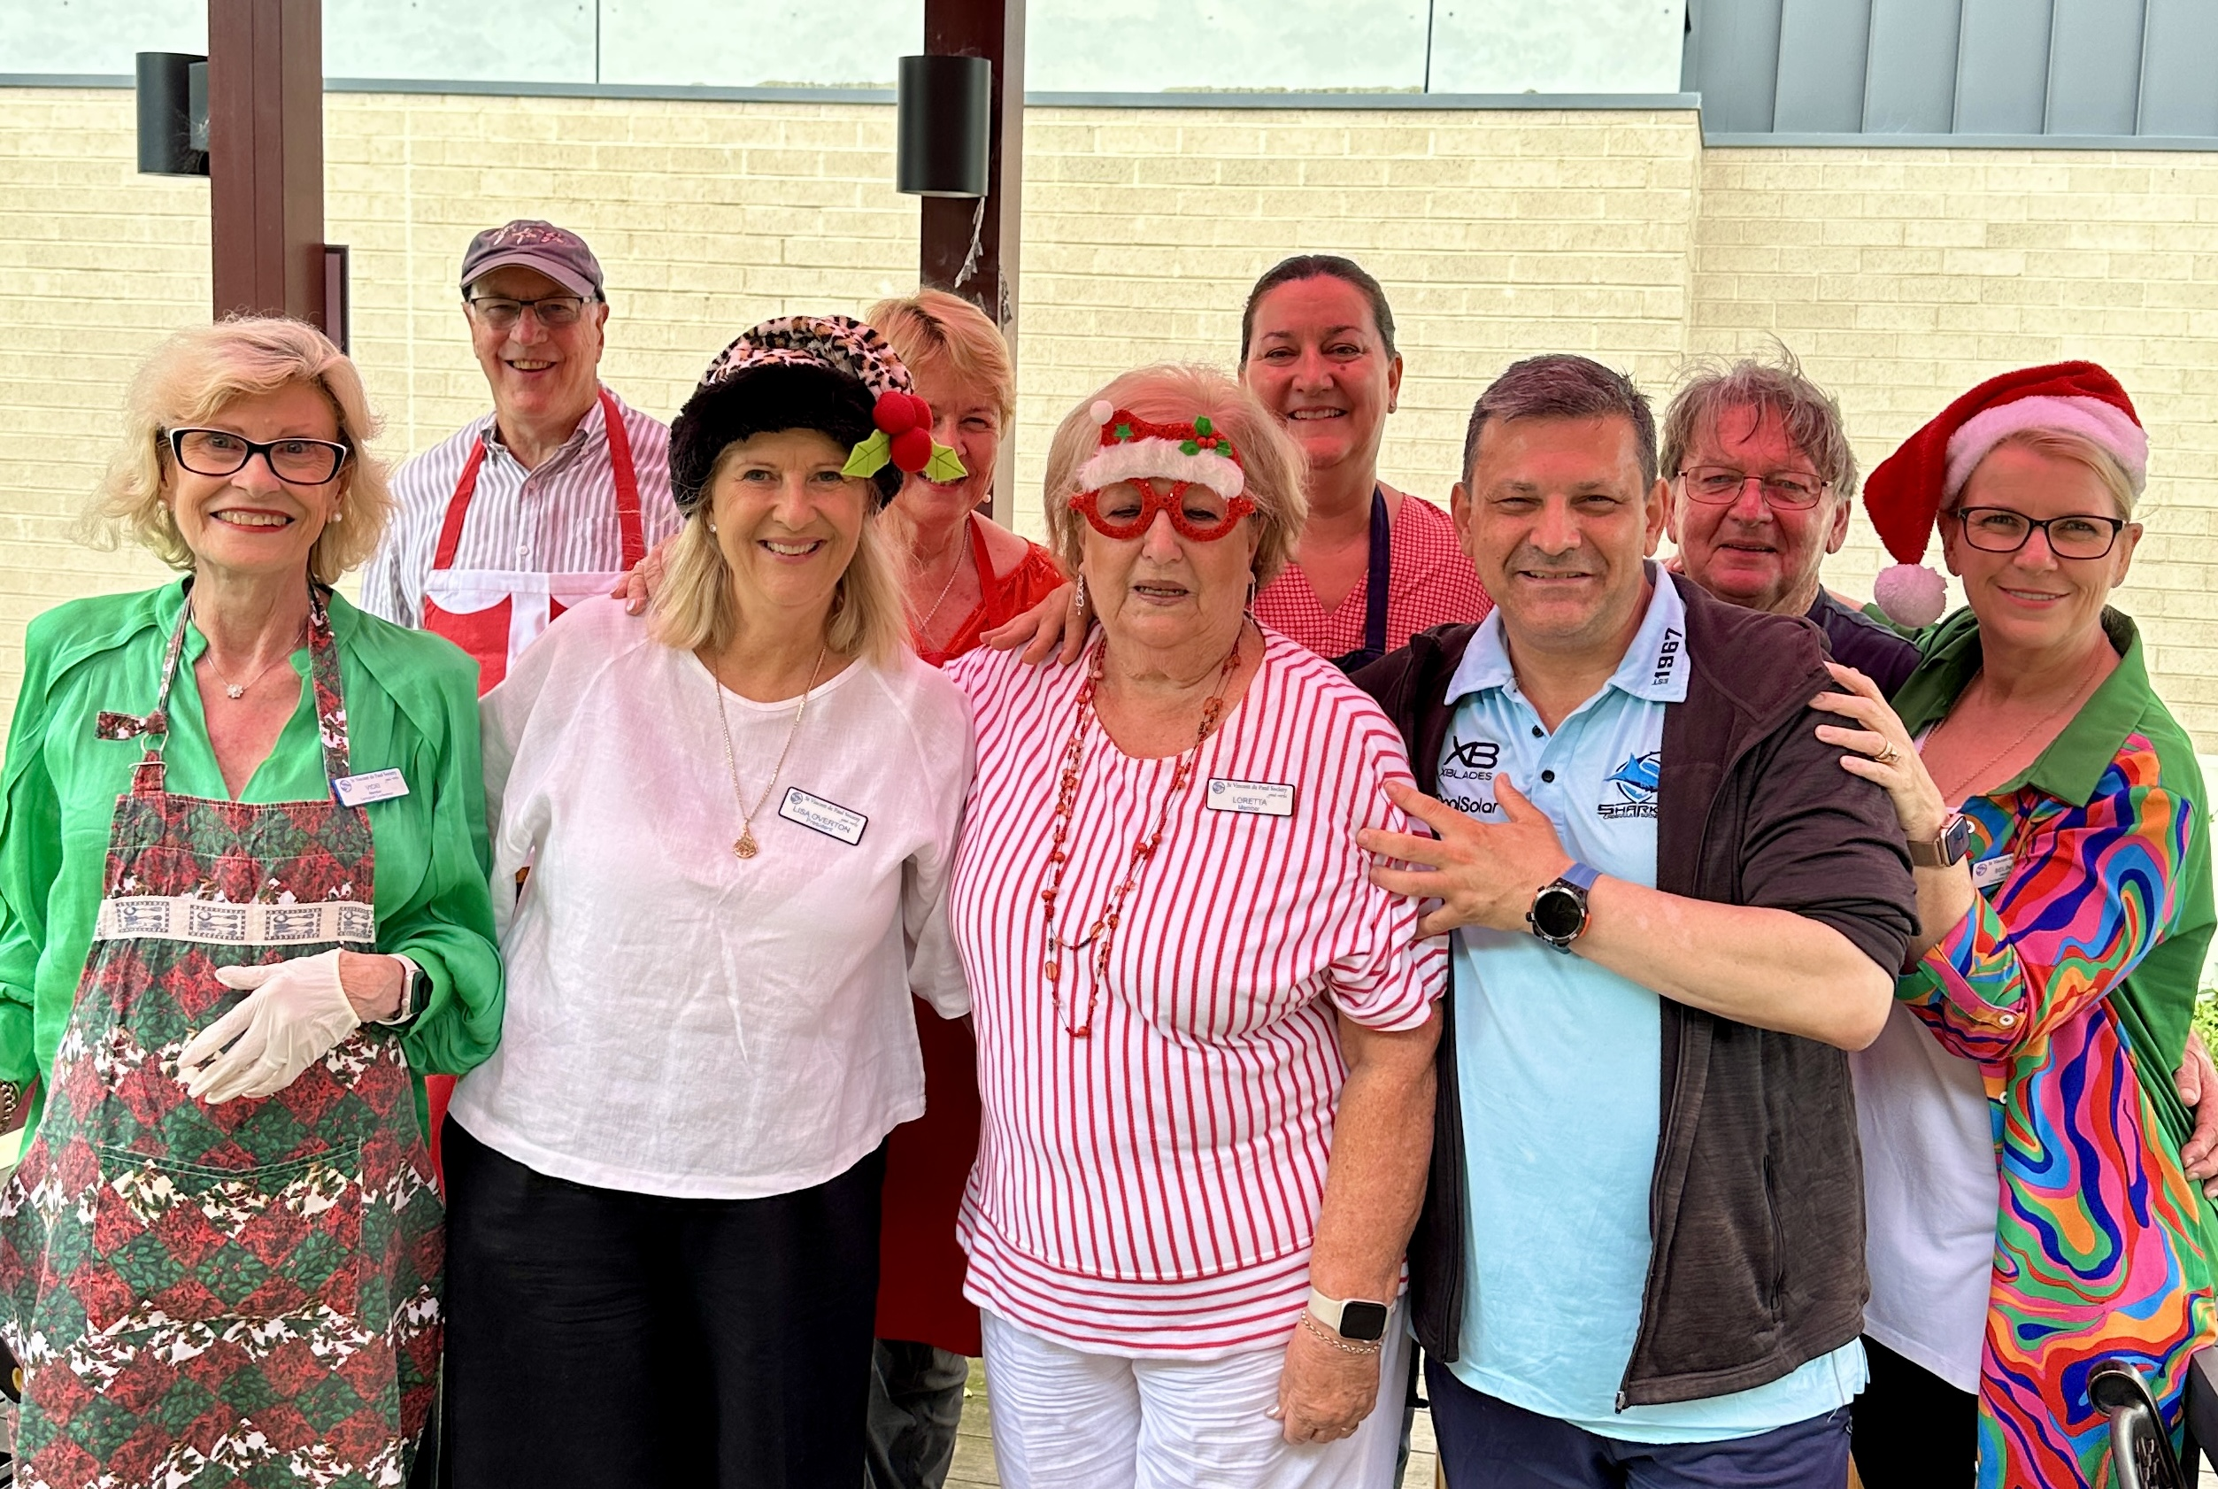
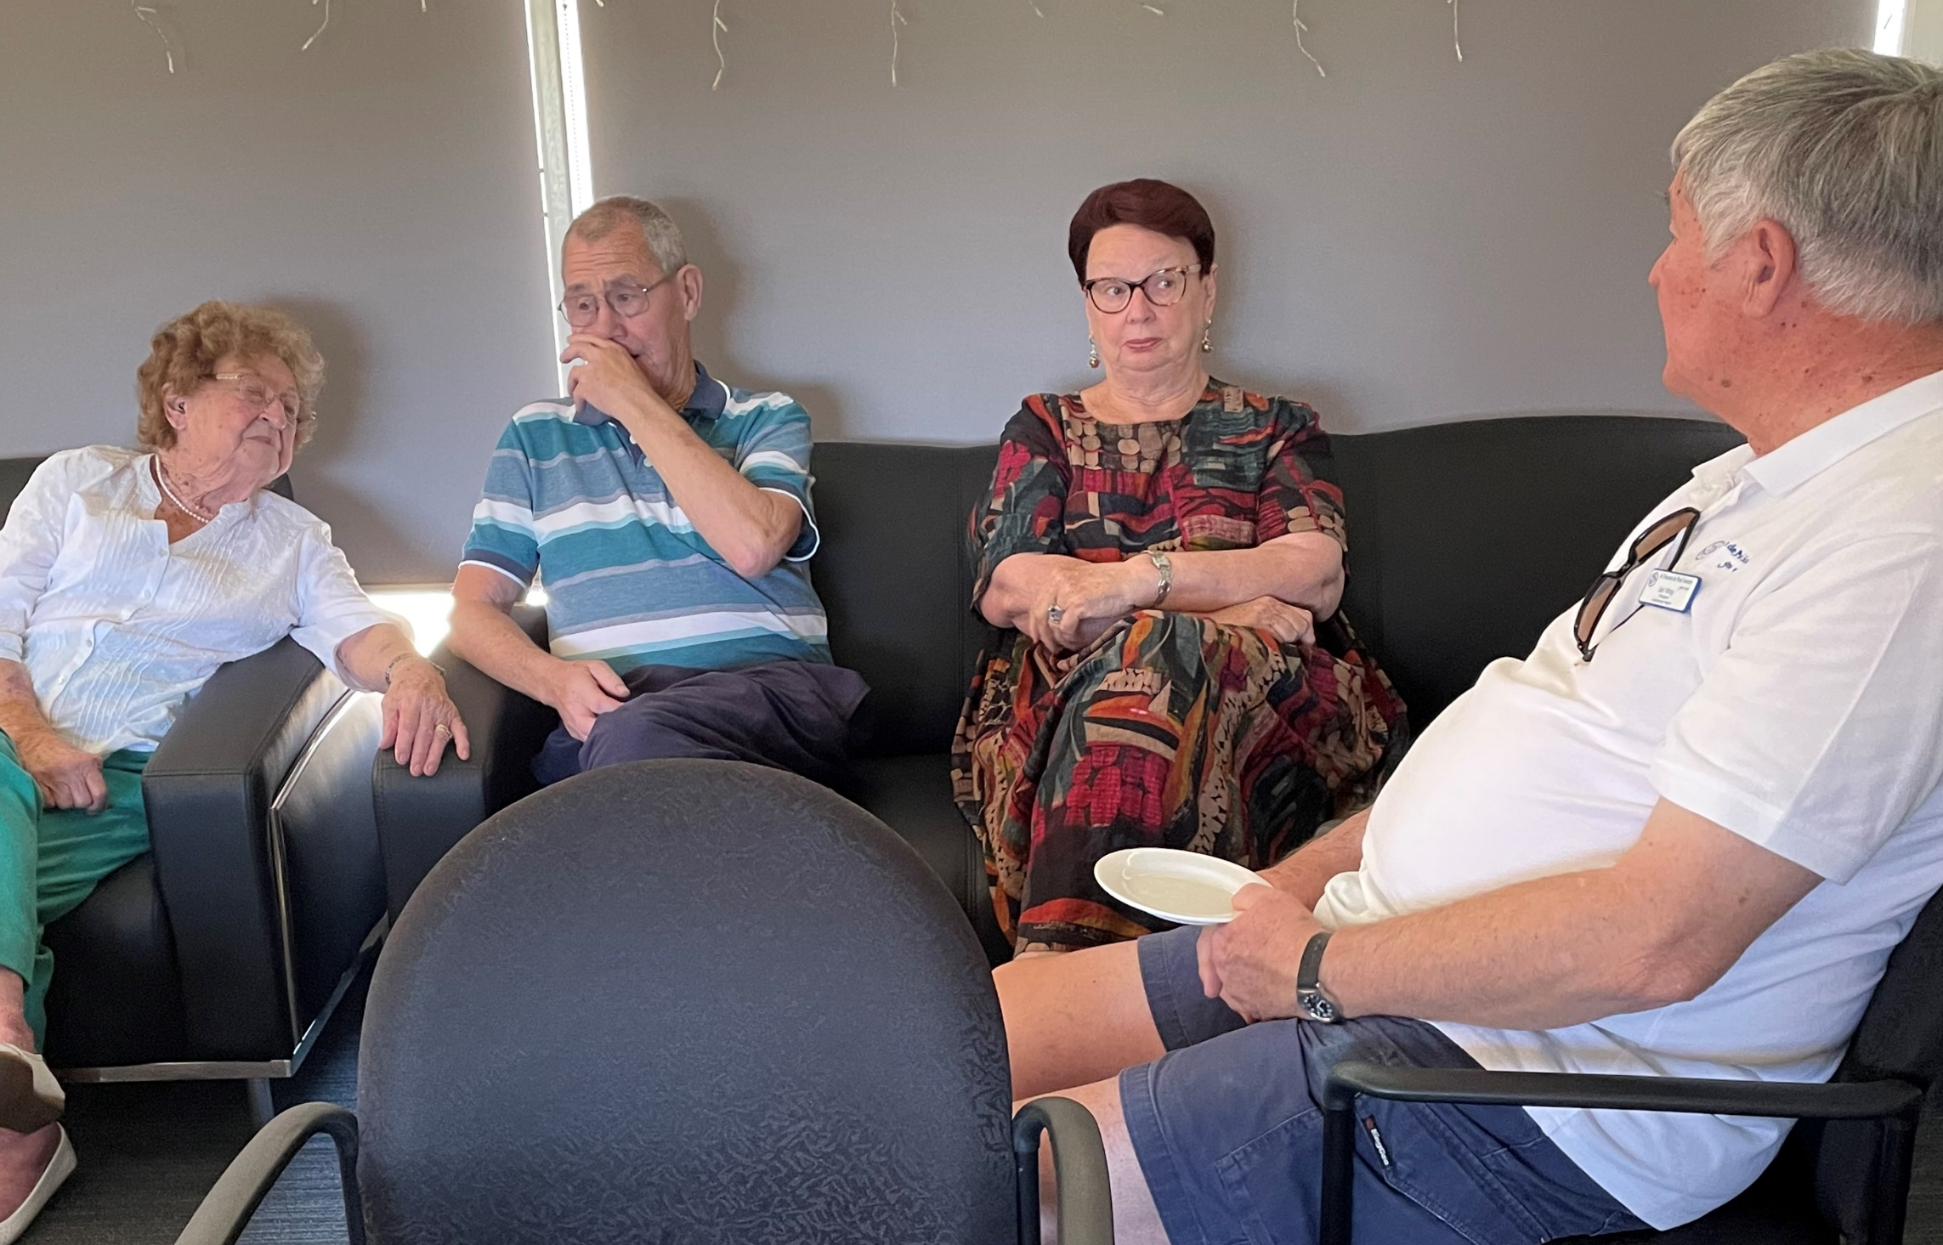
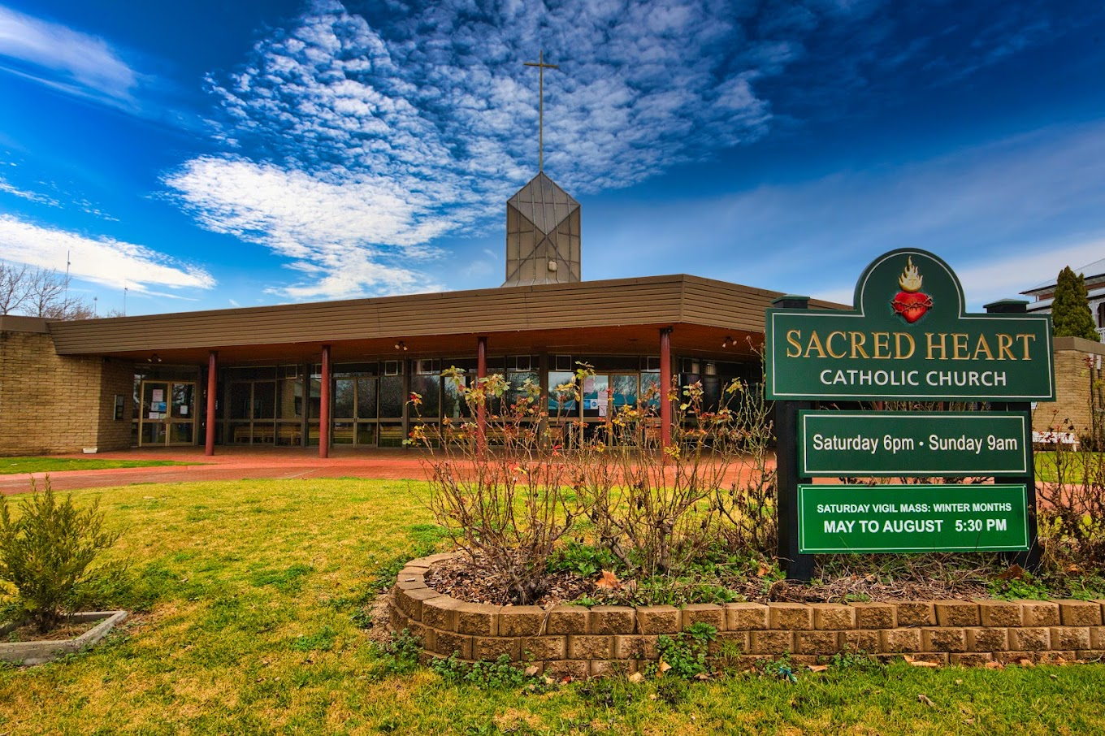
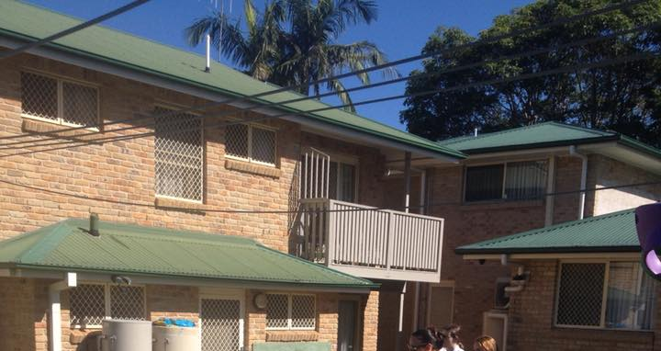
Conference Engagement across NSW
Caringbah Conference at Burraneer
Albury HS Conference
Forbes
McClosker House, Port Macquarie
Dubbo
Inverell

Slide 11
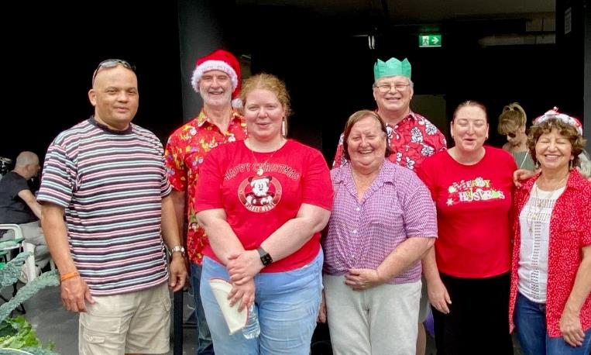
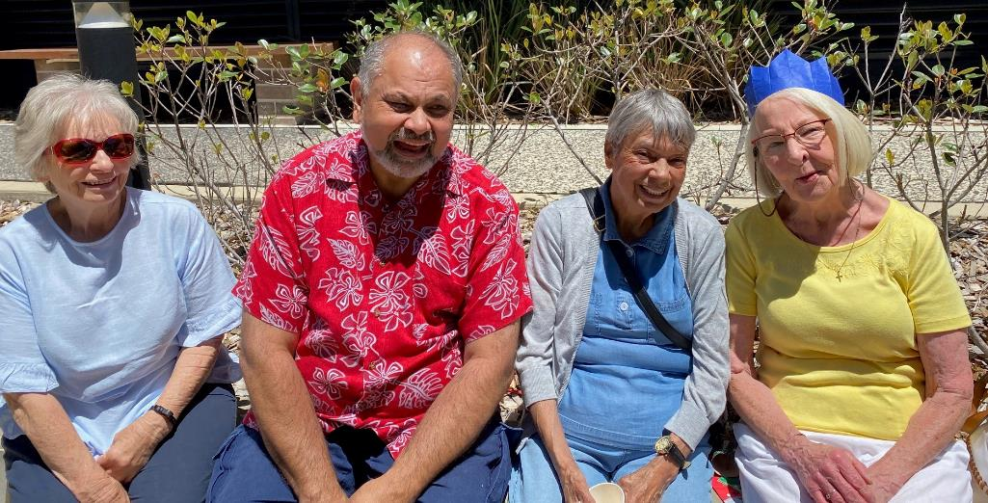
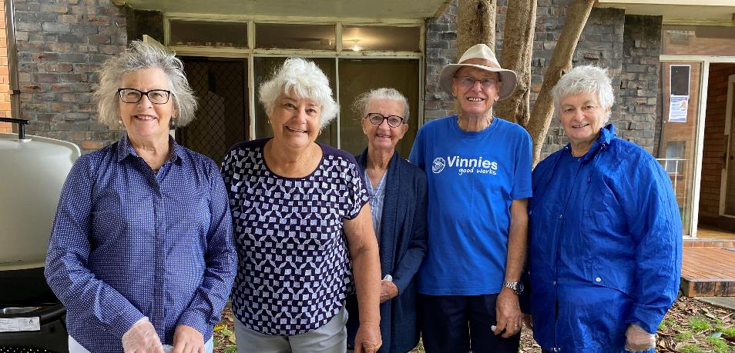
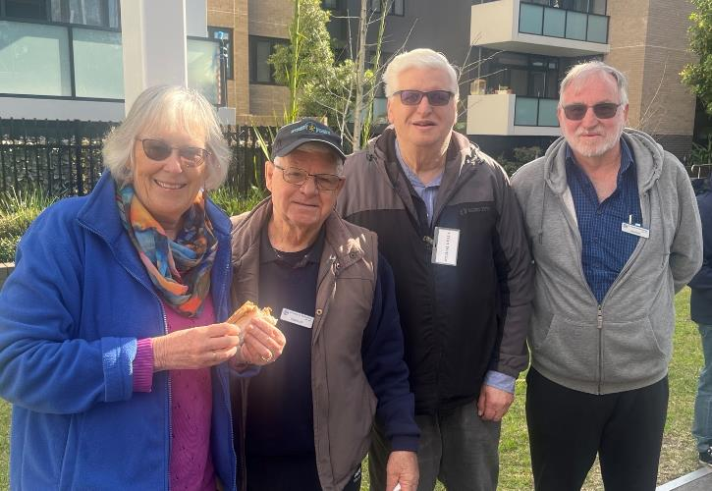
GWS Conferences Engagement
Katoomba Weekly Bread delivery
Nepean Region Members at Penrith
Rydalmere members at Ermington
Cumberland Region members at Merrylands

Slide 12
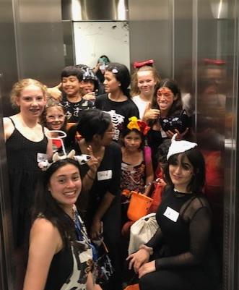
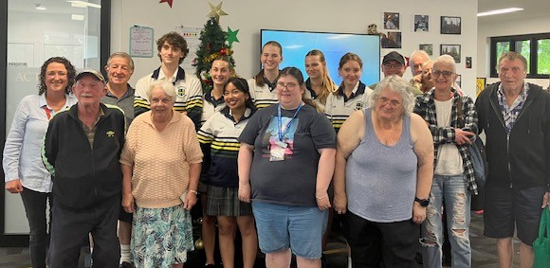
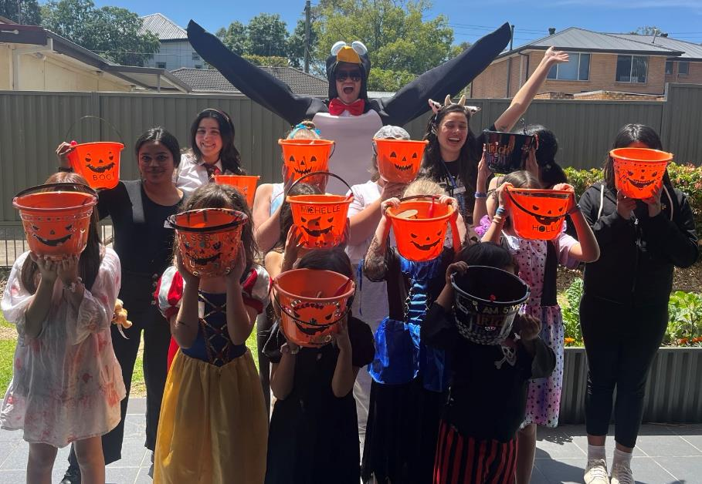
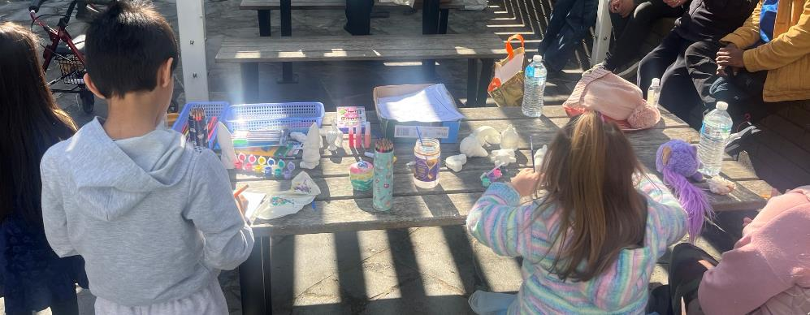
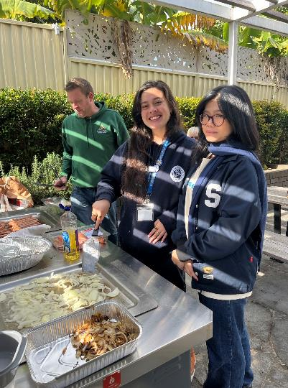
Youth Engagement Penrith Halloween events, Merrylands BBQs, and Albury High School Conference with residents
Albury
Penrith
Penrith
Merrylands
Merrylands

Slide 13
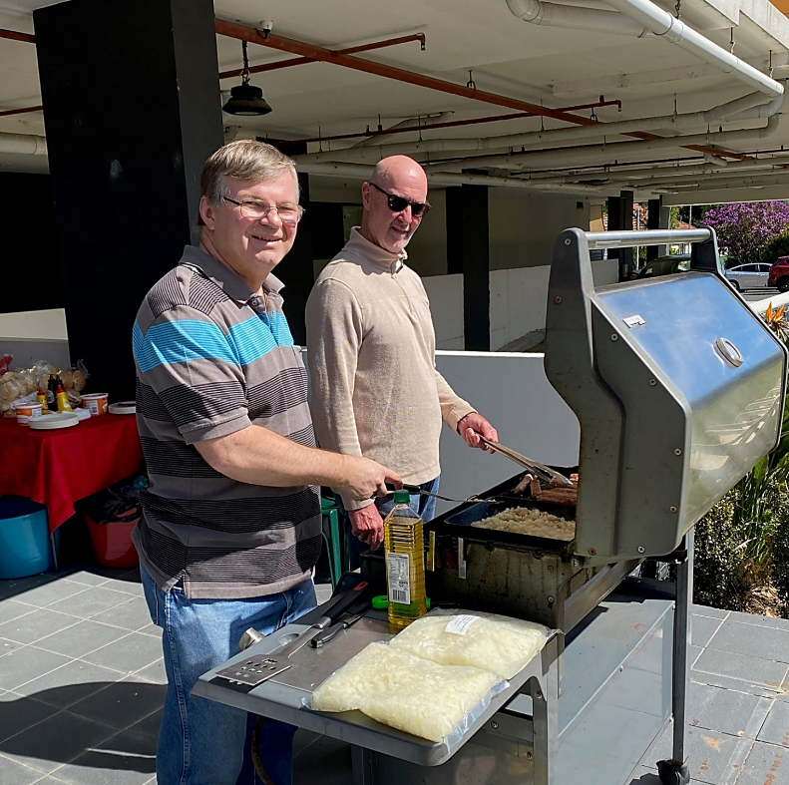
Benefits of Member engagement
With Housing tenants
Making a difference in the lives of others
Collaboration among Conferences in the Region and with Society Staff.
Satisfying to see people engage and connect with other tenants
Opportunity to engage with Youth staff and volunteers

Slide 14
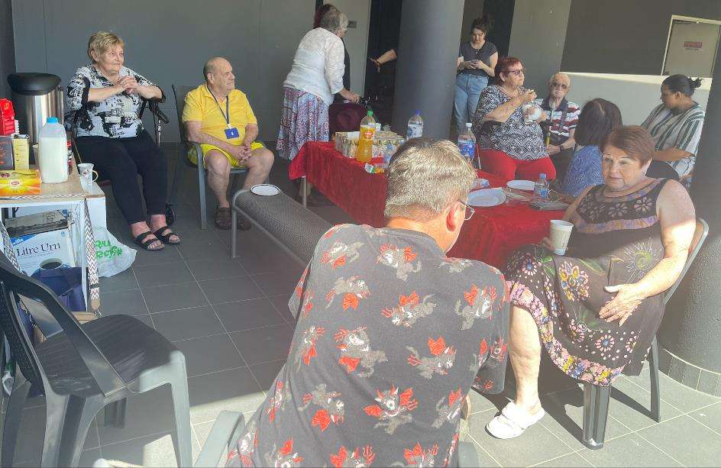
Making a difference
“At the morning teas at Penrith people tell me that they are meeting some of their neighbours for the first time, even though they have lived here for several years. So, these events are incredibly important”
-- Melissa Topp

