Slide 1



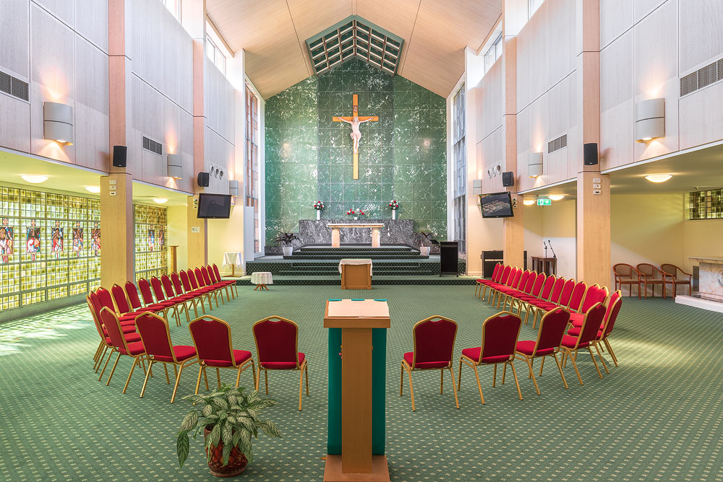


Reflection on Visitations Meeting those we serve…
Leo Tucker, Spiritual Adviser – NSW State Council and
Executive Director of Mission & Spirituality
Leonie Duck, Mission Partner, South Region
Nirmal Nanayakkara, Mission Partner, North Region
Corinne Lindsell, Mission Partner, Metro Region

Slide 2
Mission Litmus test

Slide 3
1. Who founded the St Vincent de Paul Society?

Slide 4
2. Where & what year was the Society founded?

Slide 5
3. Does the Society have a spiritual patron? If so, who would that be?

Slide 6
4. Who assisted and supported Frederic Ozanam & the works of the first Conference?

Slide 7
5. The Society is a “lay Catholic” organisation. True or False?

Slide 8
6. Where was the first establishment of the Society in Australia?

Slide 9
7. What year did the Society begin in Sydney?

Slide 10
8. Who established the Society in NSW?

Slide 11
9. Home visitation is core to Vincentian Good Works? True or False

Slide 12
1. Who founded the St Vincent de Paul Society? 2. Where & what year was the Society founded? 3. Does the Society have a spiritual patron and if so, who would that be? 4. Who assisted and supported Frederic Ozanam & the works of the first Conference? 5. The Society is a “lay Catholic” organisation – True or False? 6. Where was the first establishment of the Society in Australia? 7. What year did the Society begin in Sydney? 8. Who established the Society in NSW? 9. Home visitation is core to Vincentian Good Works? True or False
Mission Litmus test

Slide 13

Definition of Visitation
A formal visit, a visit for the purpose of making an official examination or inspection
A visitation often includes some kind of evaluation or inspection or has some other formal aspect.

Slide 14
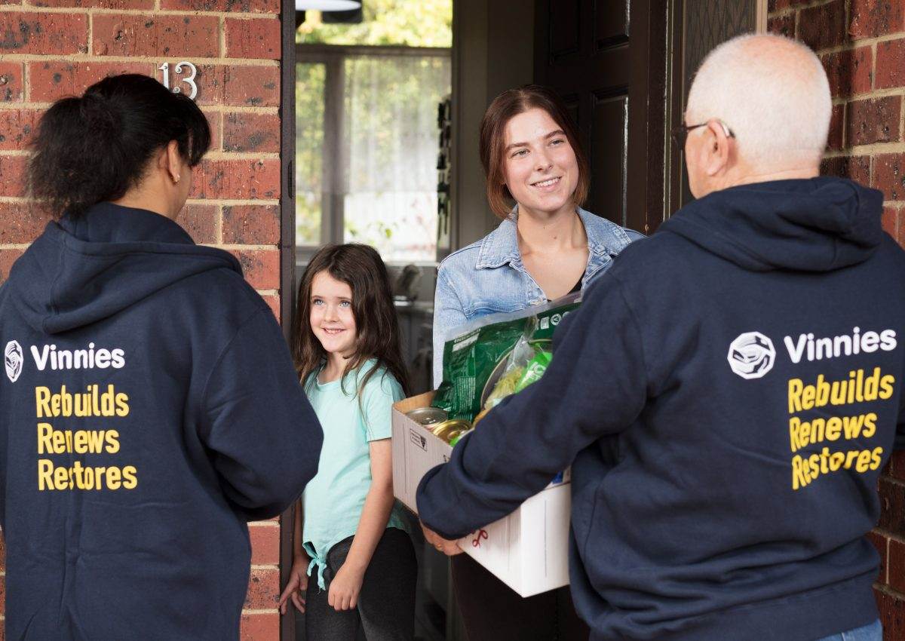
What does a visitation look like?

Slide 15
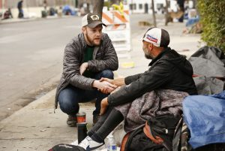
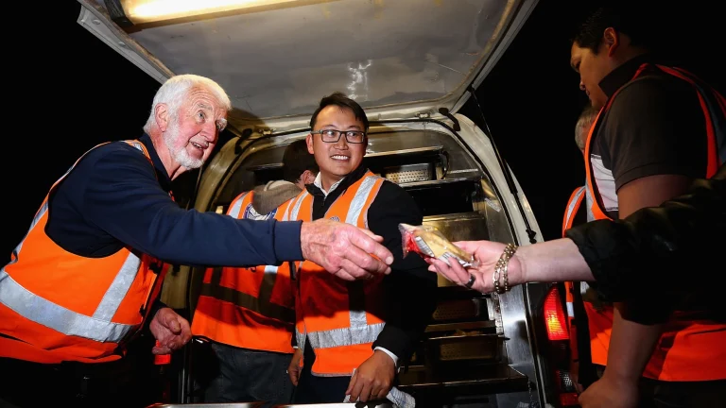
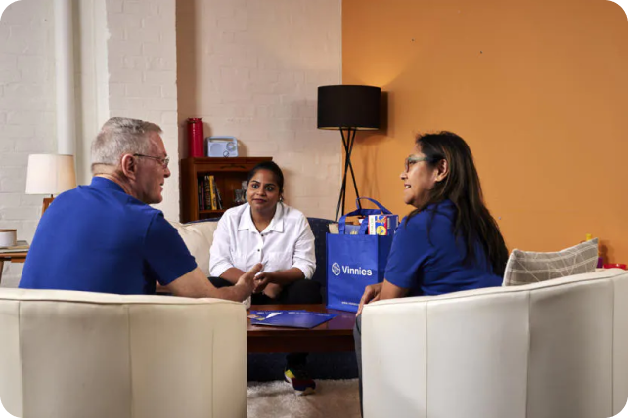
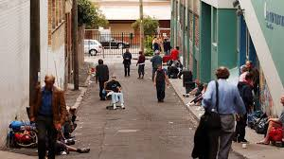
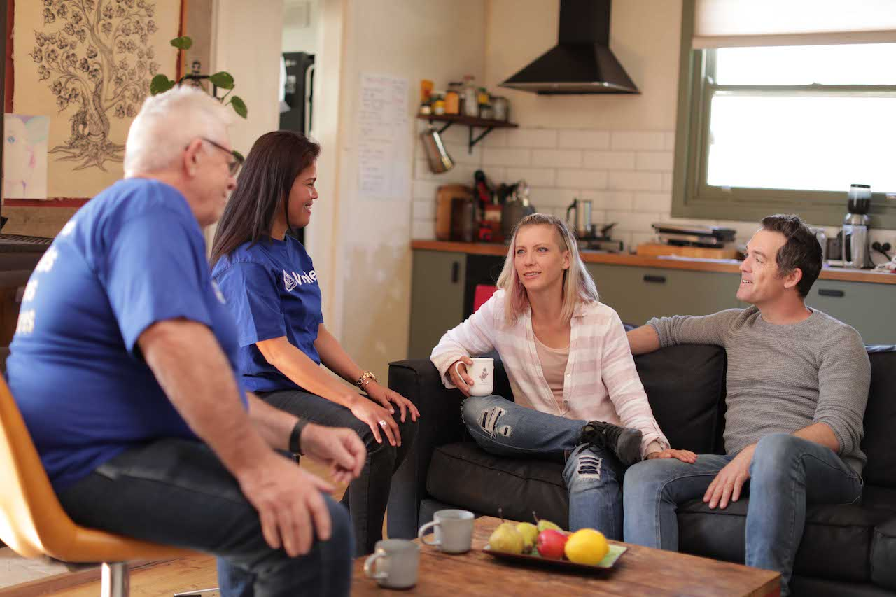
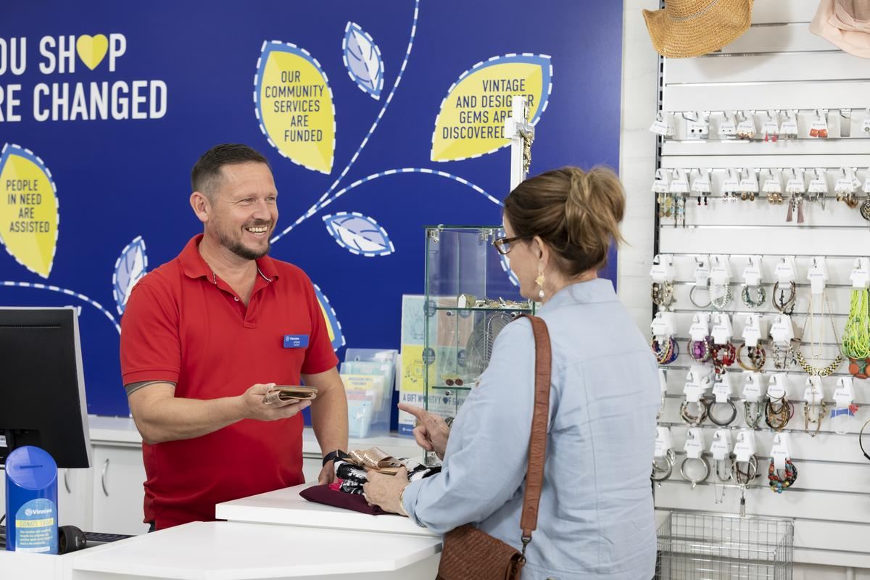
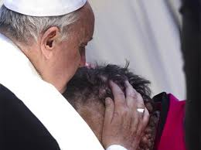
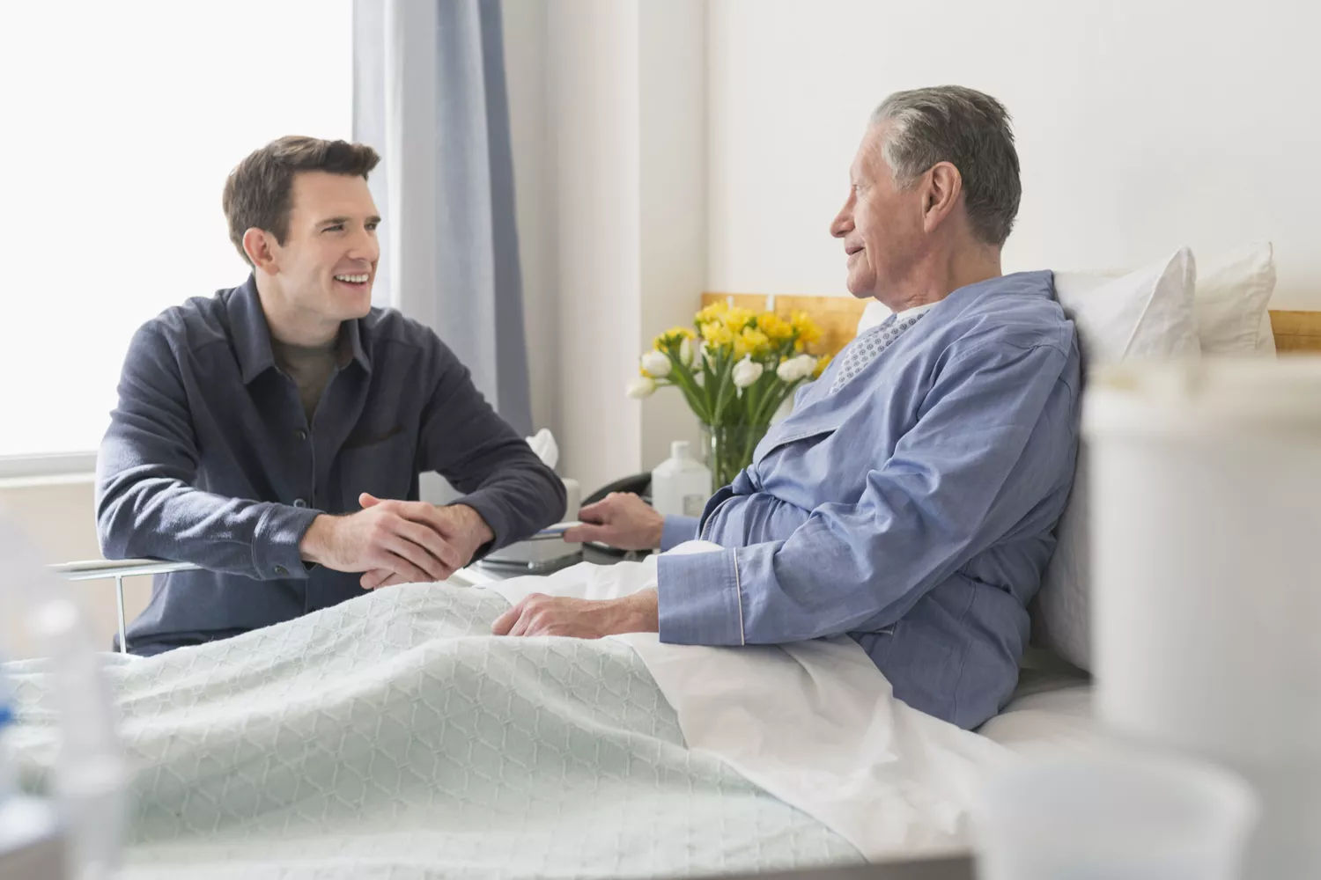
Visitations?

Slide 16
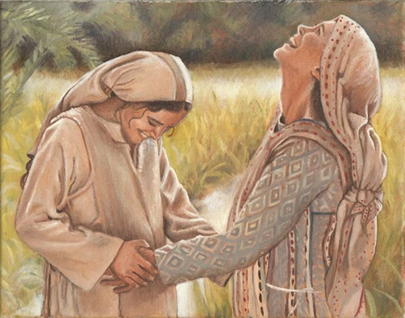
Mary & Elizabeth
Luke 1.39-40
“In those day, Mary set out and went with haste to a Judean town in the hill country, where she entered the house of Zachariah and greeted Elizabeth.”

Slide 17
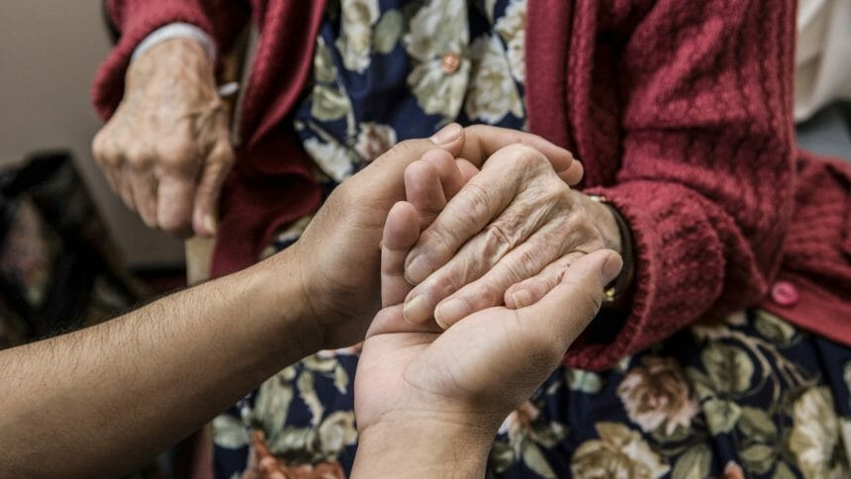
How do we meet?
How do we recognise a Visitation?
How do we become a Visitation?

Slide 18
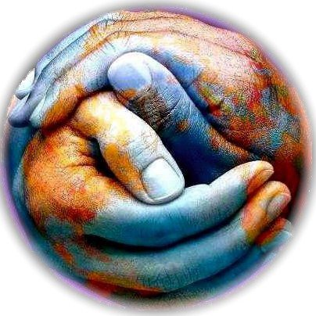
Catholic Social Principles and teachings
Catholic Social Teachings is best described as teaching “found at the crossroads where Christian life and conscience come into contact with the real world".

Slide 19

This page is for long form content
Principle | Short Definition | Why
Dignity of the Human Person | Every person has inherent dignity which is inviolable | “Because everyone matters everyday”
The Common Good | Concern for our neighbour to enable human flourishing | “Because we are all connected”
Preferential option for the poor | Priority for the needs of people in most disadvantage | “Because we care for the most marginalised”
Participation & Community | Enabling active roles for social, economic and political processes | “Because everyone deserves a voice in society”
Solidarity | Commitment to stand with and for others and advocate for change | “Because when one person suffers, we all suffer”
Subsidiarity | Respecting local autonomy, community voice at all levels | “Because our people know their own communities”
Care for the Earth | Environmental stewardship and responsible use of our common home | “Because we are stewards of creation”
Content goes in here.
Content goes in here.
Content goes in here.
Content goes in here.
Content goes in here.
Content goes in here.
Content goes in here.

Slide 20

The principle of Dignity of the Human Person.
“Every human being is created in the image and likeness of God and therefore is invaluable and worthy of respect as a member of the human family.”

Slide 21
What are our Visitations about?
Hand out vs hand up
Transactional assistance
Relationships
Hospitality
Conversations
Companionship
Presence
1.6 Adaptation to a Changing World
Faithful to the spirit of its founders, the Society constantly strives for renewal, adapting to changing world conditions. It seeks to be ever aware of the
changes that occur in human society and the new types of poverty that may be identified or anticipated. It gives priority to the poorest of the poor and to those who are most rejected by society.
“Be kind and love, for love is your first gift…” Blessed Rosalie Rendu
“The greatest disease today is loneliness …” St Teresa of Kolkata

Slide 22
The Rule on serving…
Vincentians serve with hope…
Vincentians never forget the many blessings they receive from those they visit.
Serves with the values of simplicity, humility, gentleness, selflessness, and a passion for the flourishing and happiness of every person.
Visiting and dedicating themselves to the poor, whose faith and courage often teach Vincentians how to live
Vincentian assume the needs of the poor as their own

Slide 23
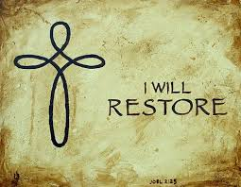
Dignity of the Human Person is the foundation of our Mission and the mission of Jesus Christ
Radical inclusivity, restoration and accompaniment
We aspire to live the gospel message by serving Christ in the poor with love, respect, justice, hope and joy, and to bring about a more just and compassionate society.

Slide 24
From the Preface to The Rule
It is difficult to understand service within Conferences without accepting the need to serve the poor on a person-to-person basis in their own homes or wherever they feel most comfortable.
Since the beginning, Conferences went out to the poor rather than waiting for the poor to come to them. In other words, as the Rule points out, Vincentians need to help the marginalized precisely where they feel most at ease.
The St Vincent de Paul Society has worked so hard to make this the normal means of contact that the concept of the “visit” has become the classic expression of what is most intimate in our commitment.
The “home visit” to people who are poor is the expression of a meeting that is always personal.
This is well understood by all Vincentians as well as by those we seek to serve.

Slide 25


Slide 26
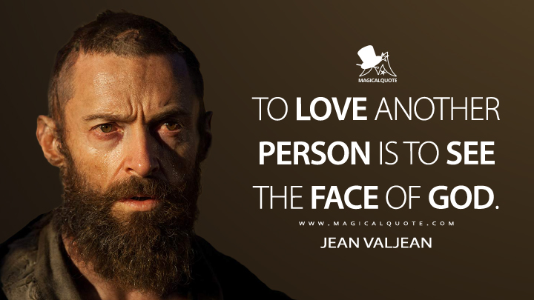

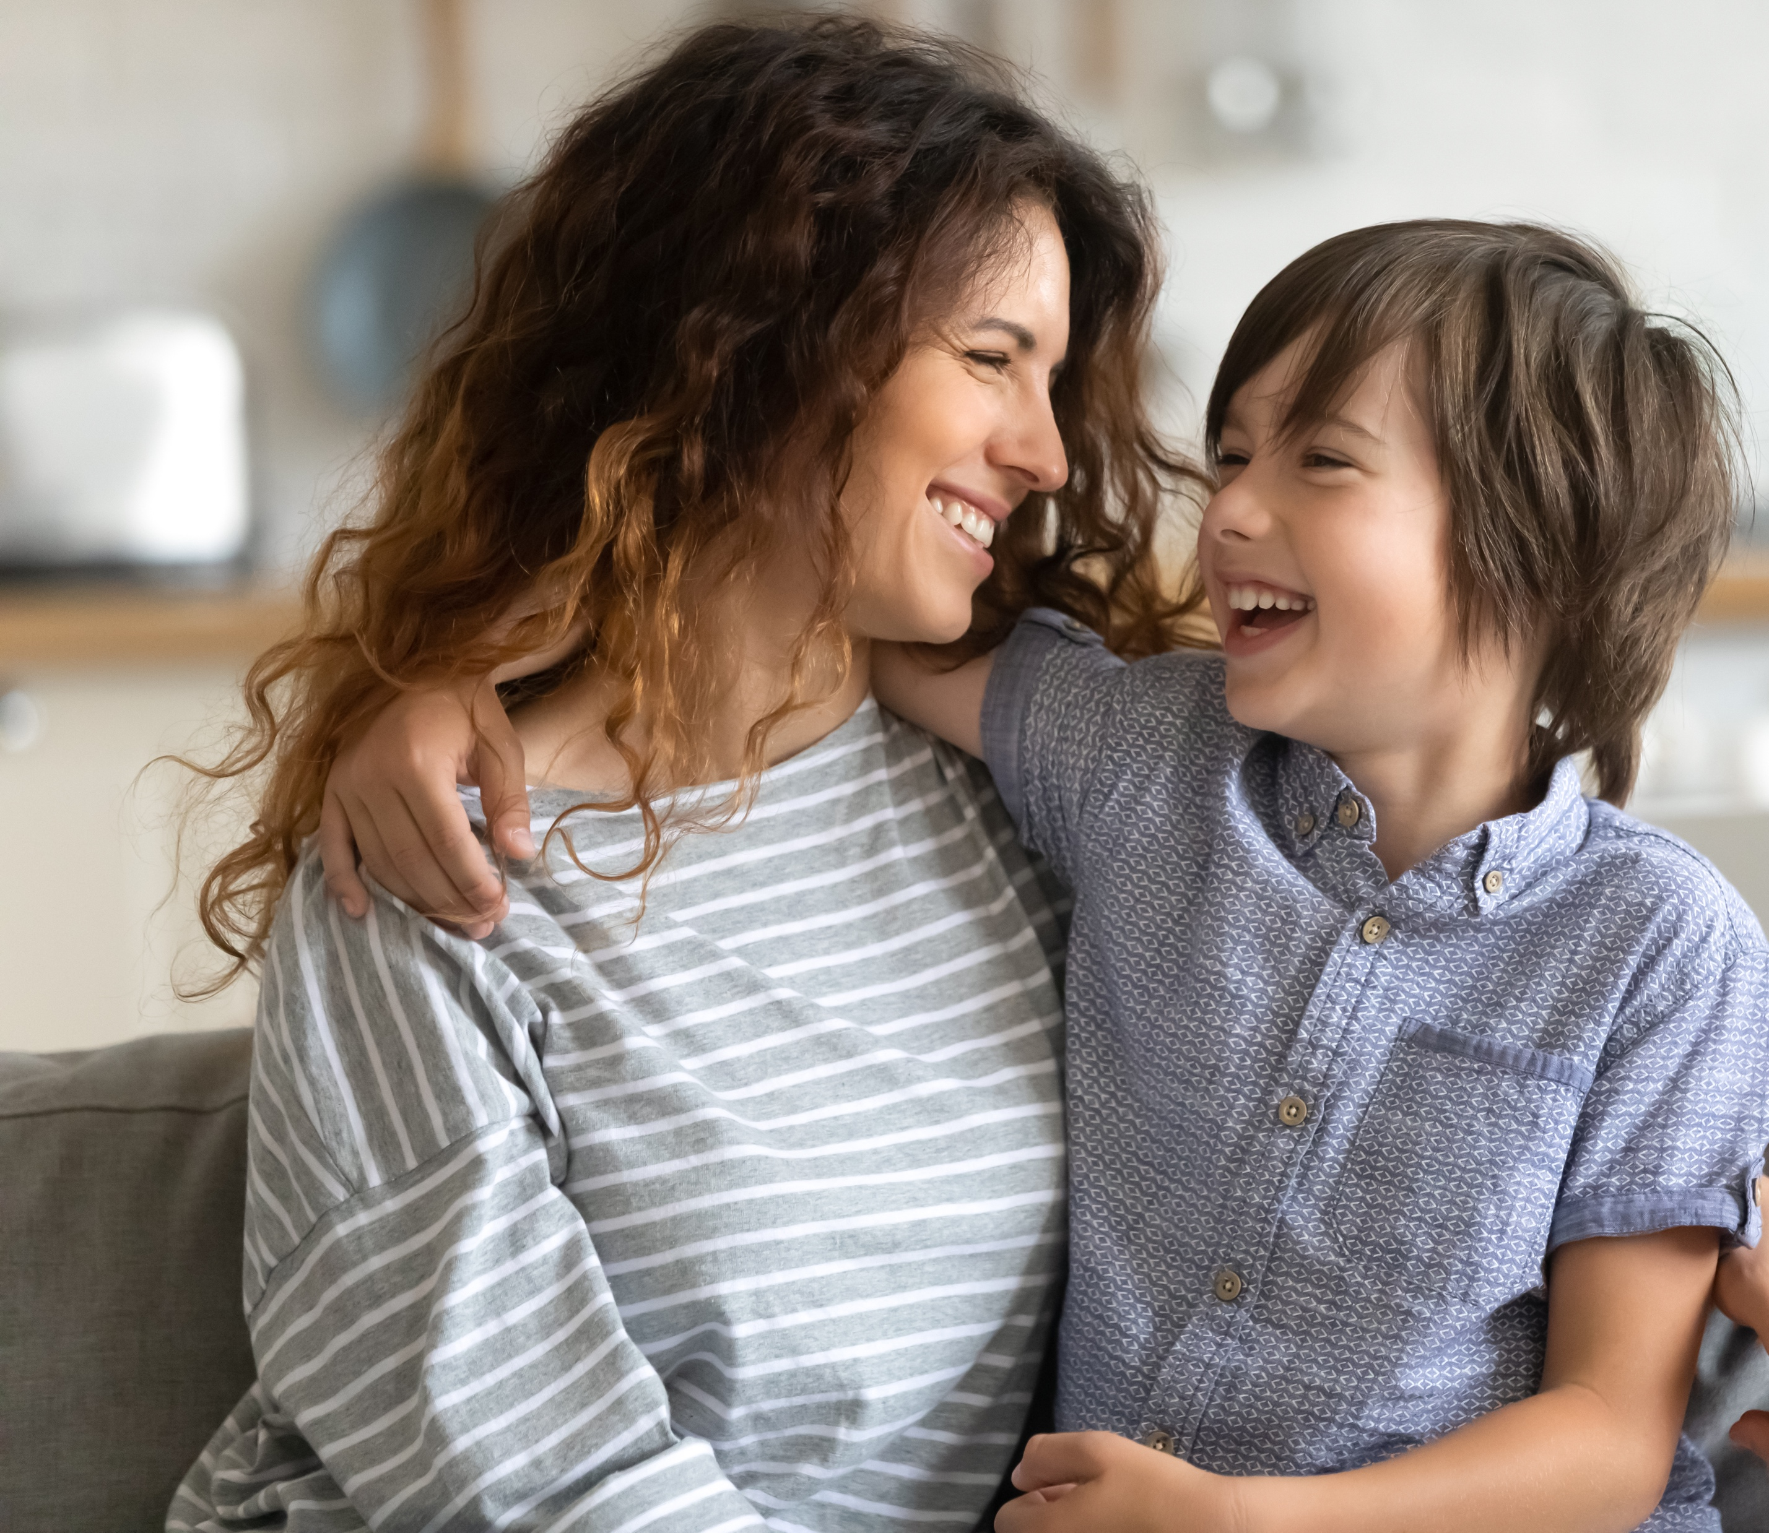

Page header
Your information goes in here.
Your information goes in here.
Your information goes in here.
Your information goes in here.

